Slide 1



Plasticity in micrometer scale:
weakest link statistics, stress fluctuations and the role of the specimen size
Ádám István Hegyi, Péter Dusán Ispánovity, István Groma, Géza Györgyi
12. August 2015, Brno
Eötvös Loránd University of Budapest

Slide 2
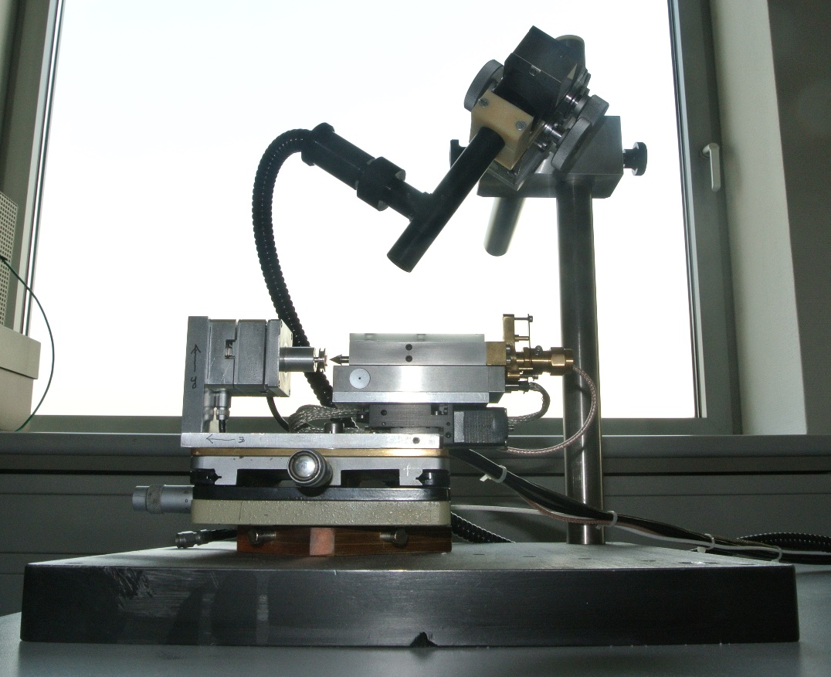
OUTLINE
Motivation
Single crystal sample
Micropillar fabrication
In-situ experiment: NANOTEST
Special effects in high-vacuum indentation
Single compression properties
Dislocation avalanche statistics
Size effect in many dislocation limit
Further question

Slide 3
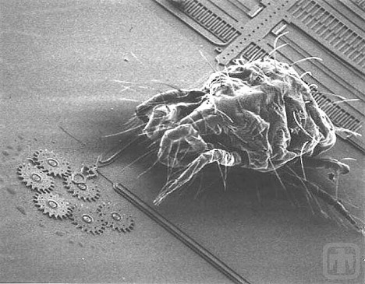
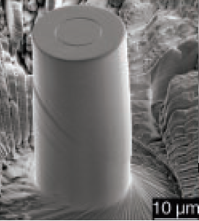
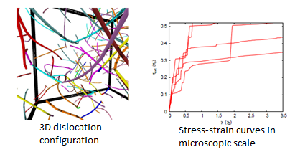
MOTIVATION of micropillar experiments
Increased interest in MEMS, how to construct micrometer sized tools?
From acoustic emission of ice single crystals the first signals from dislocation avalanche and intermittent plasticity were measured.
The intermittency was demonstrated experimental way and simulation methods.
Dimiduk et. al. Science 2004
Groma et. al. Phys. Rev. Lett. 2010

Slide 4
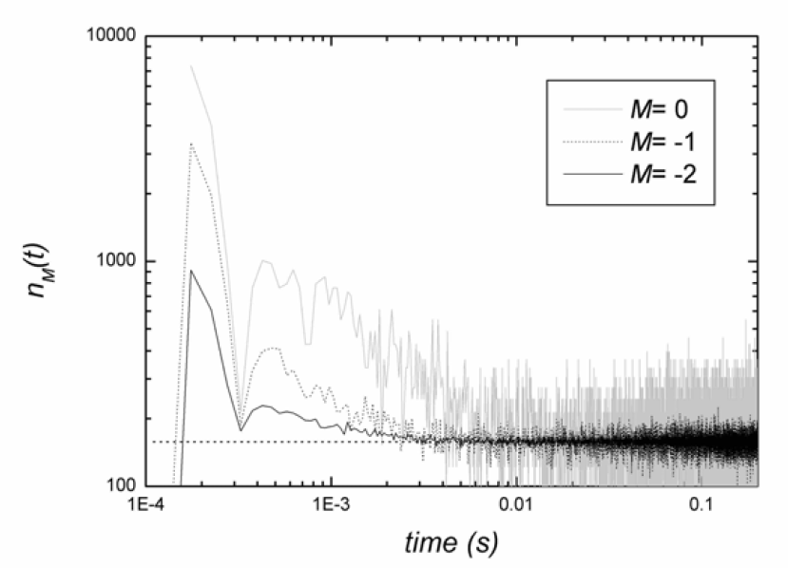
MOTIVATION of acoustic emission in-situ measurements
Space and time correlation of dislocation motion
Time correlation: acoustic emission
Space correlation: synchronized SEM movie of in-situ compression
J. Weiss et. al. Mater. Sci. Eng. A 2004
BSE image of compressed micropillar

Slide 5
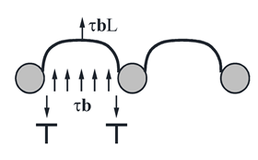
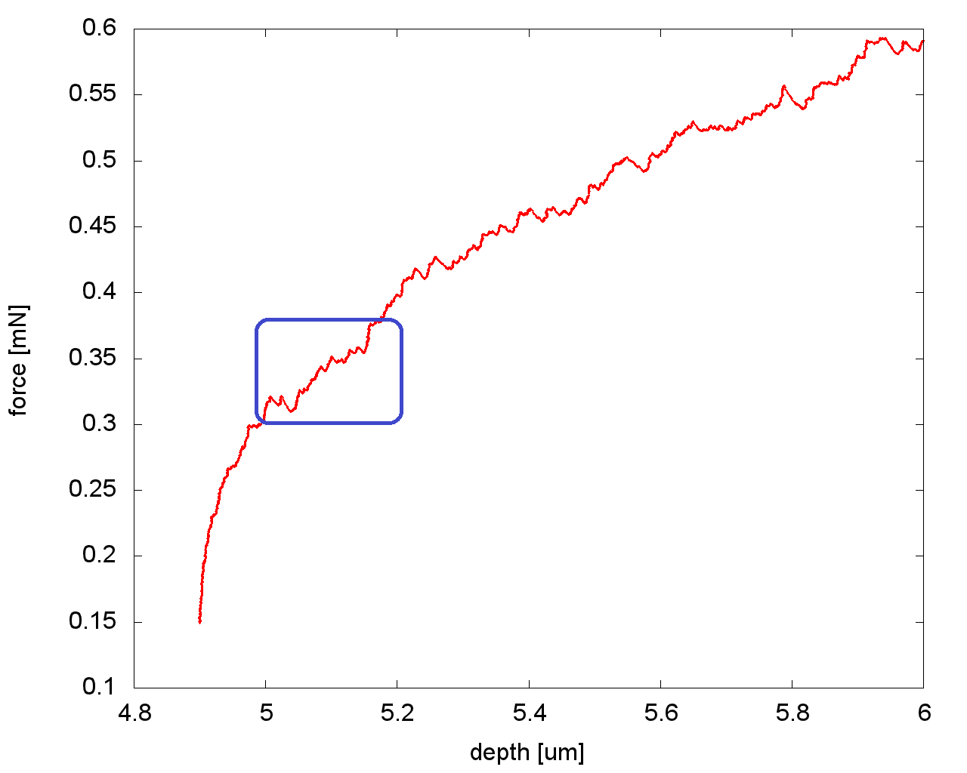
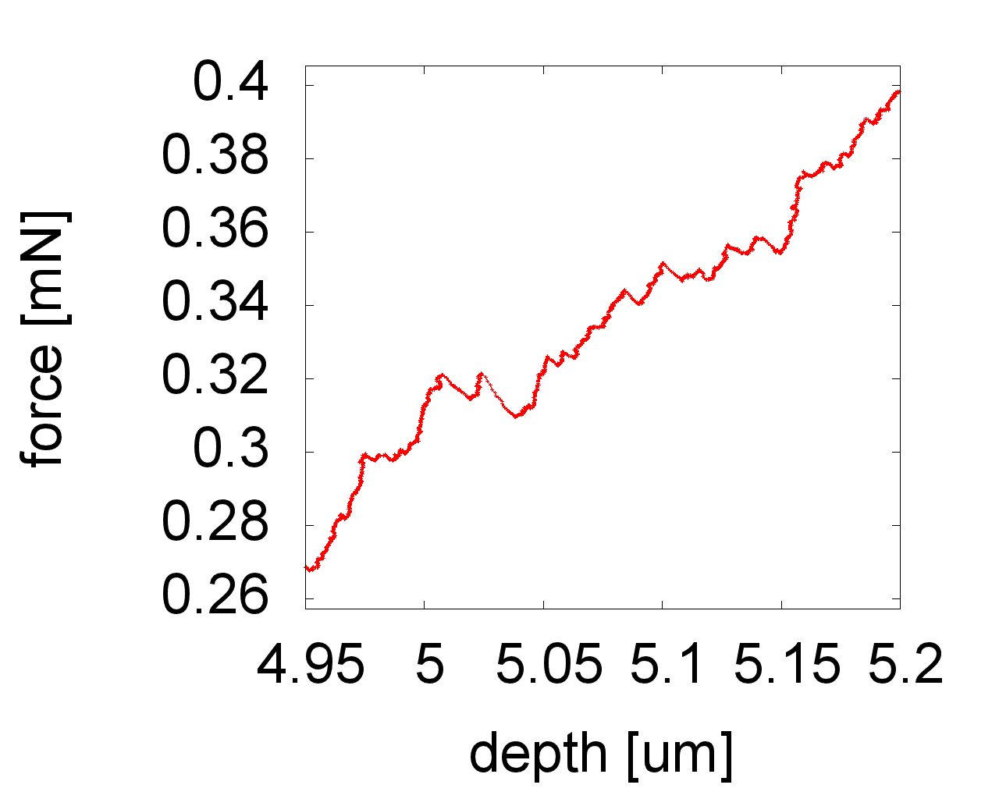
MOTIVATION of high resolution in-situ measurements
Two possible mechanism of microplasticity:
Dislocation bending between junctions: reversible
Single dislocation movement: irreversible
In 2) case a phase-transition like change can be noticed in dislocation mobility
What are the influential parameters:
Dislocation density: ρ
Sample size: l
Average junction or solute atom spacing: d
Strain rate: dε/dt

Slide 6
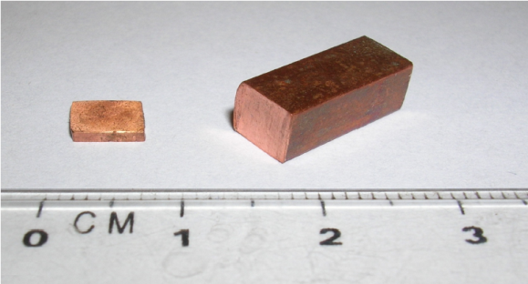
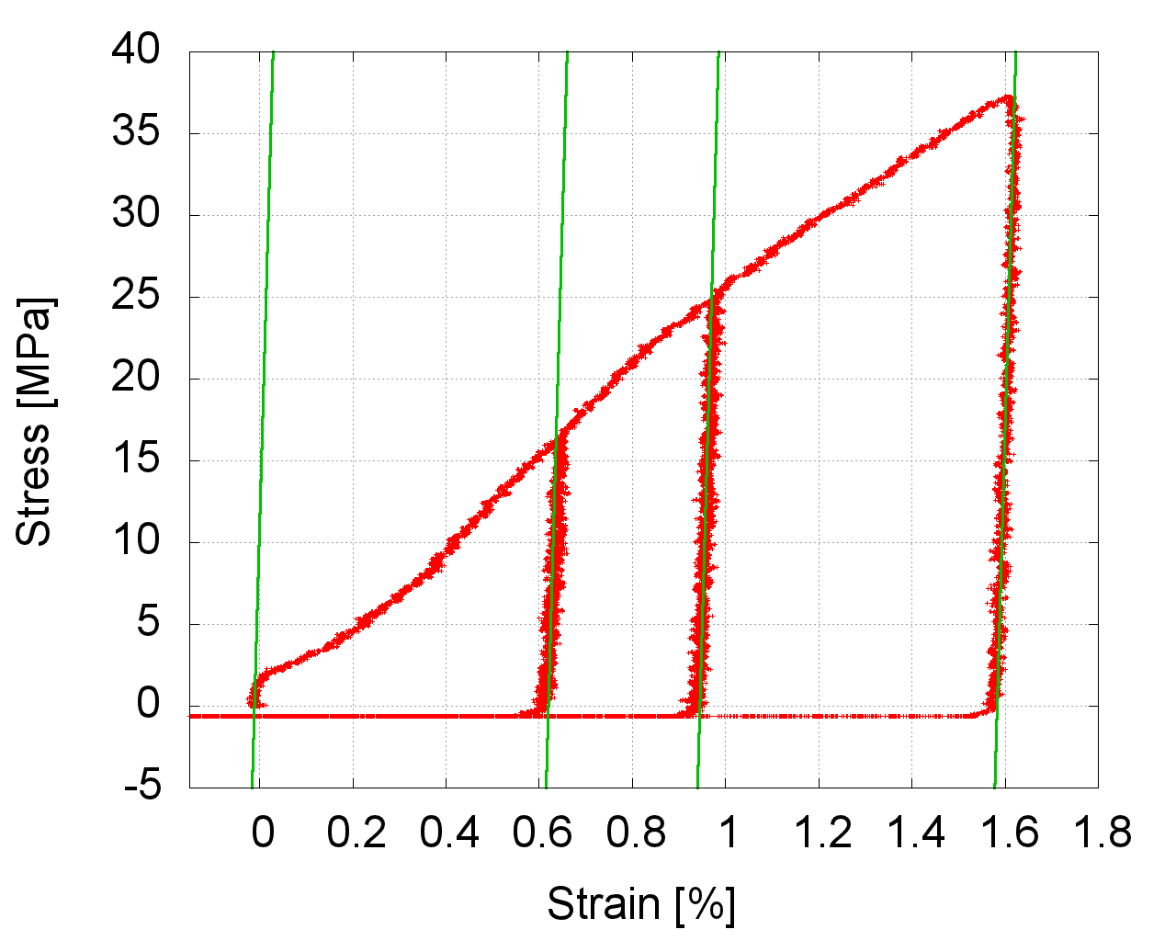
SINGLE CRYSTAL SAMPLE
Cu Single crystal sample
Single-slip orientation
Sample preparation:
Electrical discharge machining
Electropolishing
Heat threatment in vacuum furnace at 400 °C, for 72 h
Resulting really low dislocation density (yield stress: σ_{yield} = 2 Mpa)
Pre-deformation of the sample:
One axis compression in single slip direction
Compression until the required yield stress
σ_{yield} ~ ρ^{0.5}
Copper single crystal
Young modulus of Cu
Deformationless
σ_{yield} = 2 MPa
Pre-deformation until 36 Mpa

Slide 7
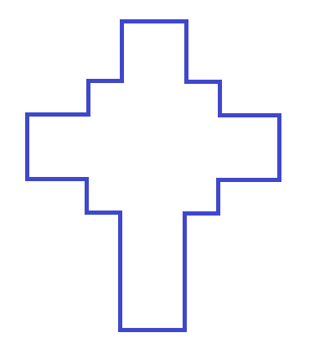
MICROPILLAR FABRICATION
Pt hat to get harder top and smoother sides
+ for aiming, takeing care of erosion
Huge ditch around to see inside
Determined height
30 nA, 5 nA, 1 nA and 100 pA ion current series using RCS pattern
Total fabrication time: 1, 5 h / micropillar
1)
2)
4)
Fine view with electrons
3)

Slide 8
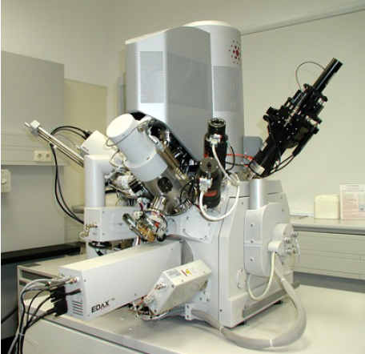
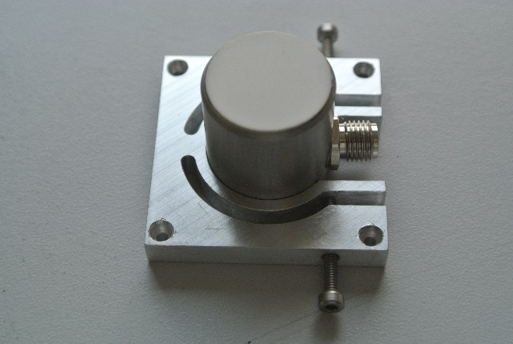
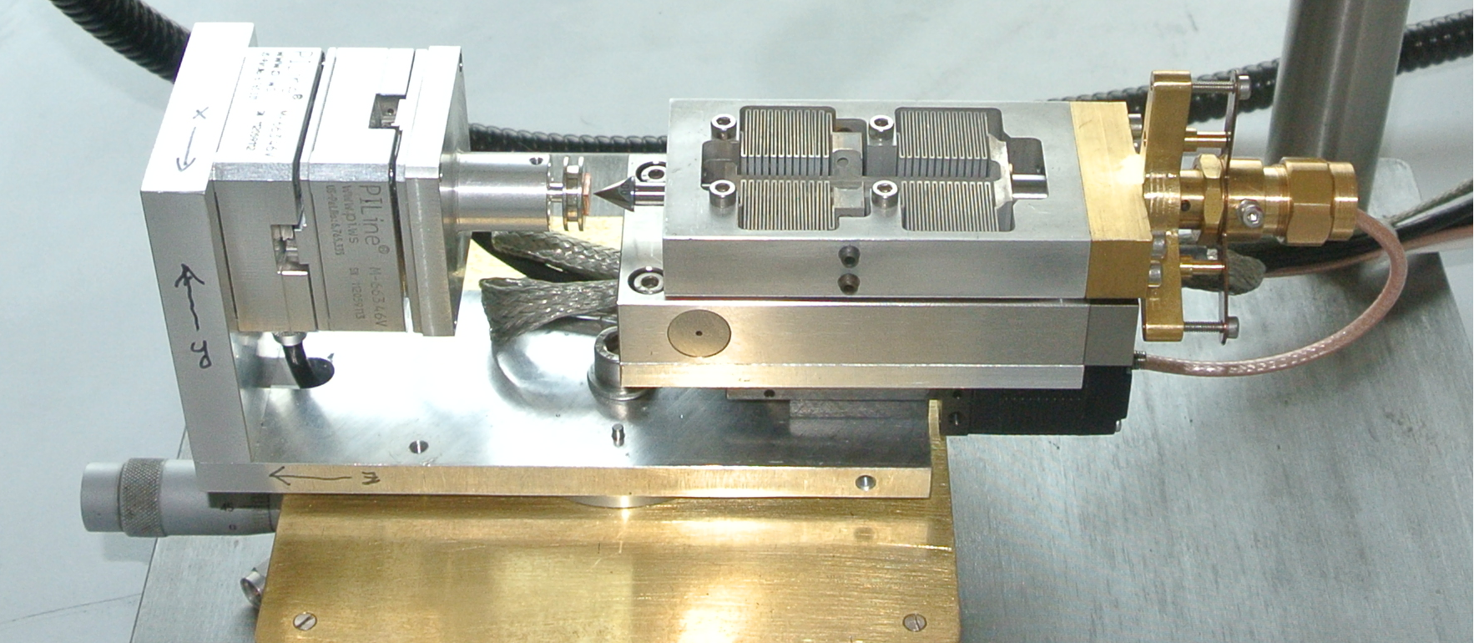
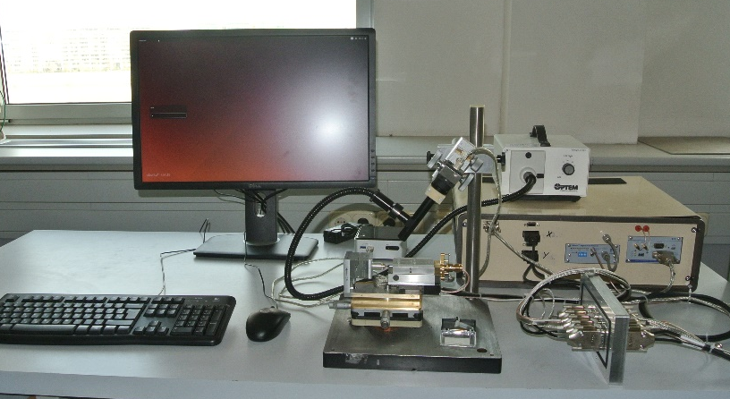
NANOTEST specifications
Linear X and Y stage
Linear coarse Z stepmotor
Piezoelectric fine Z stage
Capacitive force sensor
Acoustic Emission tranducer can be mounted
Built for FEI Quanta 3D FEG
6)
5)
1)
4)
3)
2)

Slide 9
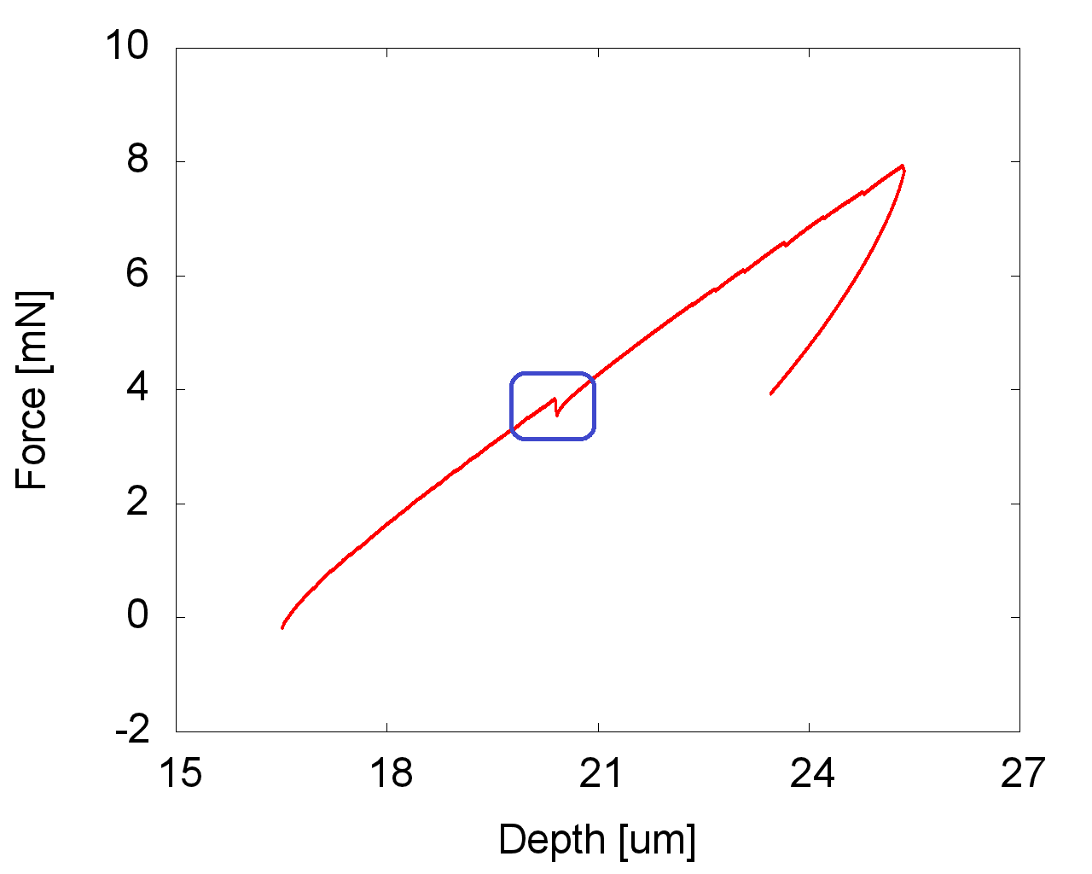
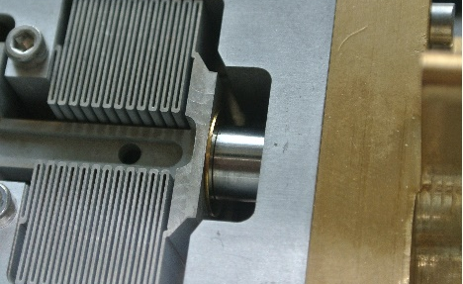

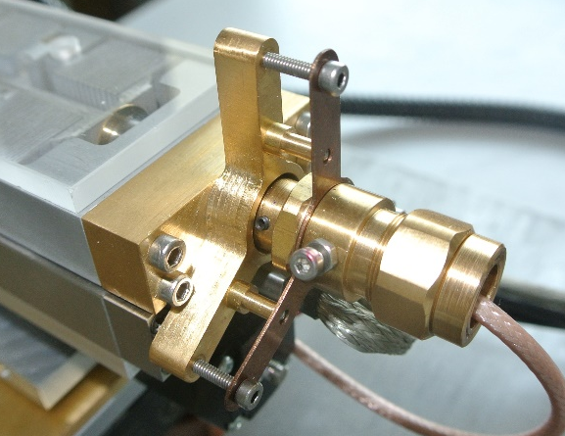
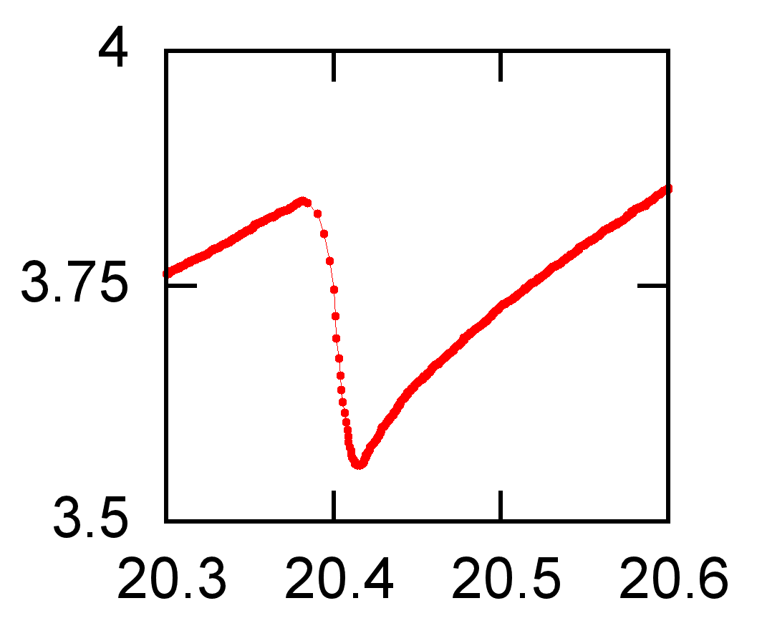
NANOTEST specifications
X and Y stage:
9 mm total moving range
From 1 um/s up to 1 mm/s speed
0.5 um precision
Coarse Z stage:
10 mm total moving range
From 1 um/s up to 100 um/s speed
1 um precision
Fine Z stage:
Deformation control unit
50 um total moving range
From 0.01 um/s to 10 um/s speed
1 nm precision
Capacitive force sensor:
Self designed spring to convert force to micron scale displacement (e. g.: D = 1 mN/um)
20 um or 50 um total measuring range
Under 1 nm precision
Berkovich nanoindentation in Al 3% Mg PLC sample

Slide 10
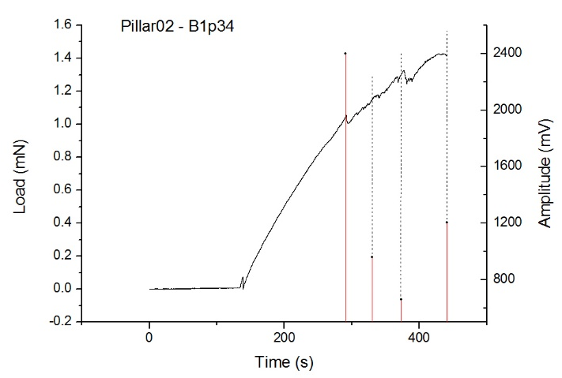
NANOTEST advanced properties
NANOTEST advanced properties
Working in high-vacuum enviroment is not so easy!
Electric charging of simple diamond tip due to electron scanning: conductive layer needed BUT,
Au can be welded (soluted) with Cu: Boron doped tip needed
Dielectric constant changing (no air inside the capacive sensor): Zero adjusment needed
No air = no cooling: Peltier-stage cold point needed to mount
No air = no damping of the spring: Permanent magnetic damping needed
Drift of capacitive sensor: drift compensation using software
Slow answer and triggering time using digital feedback: analogous feedback needed
Constant speed, Force control, Deformation control modes available
In-situ AE pillar compression

Slide 11
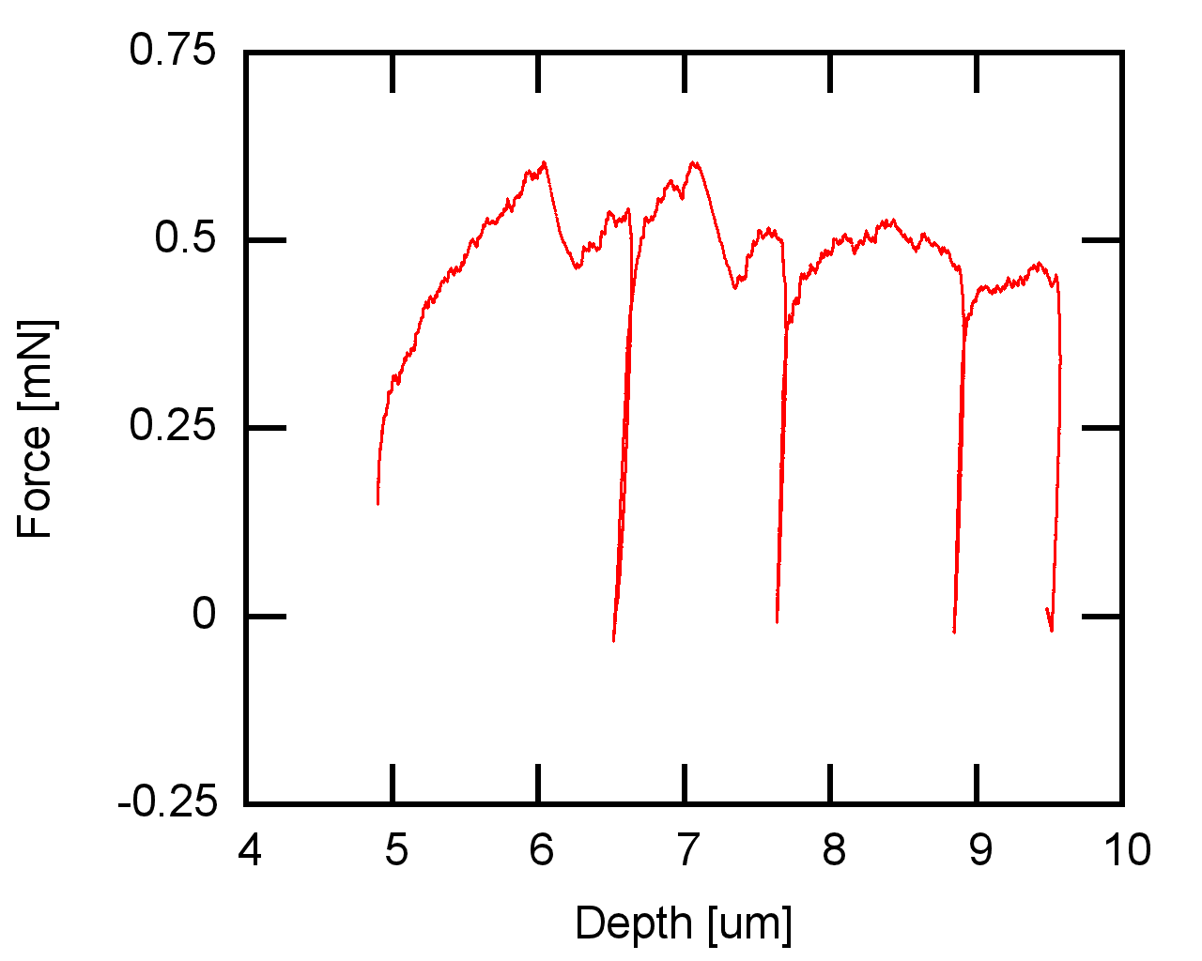
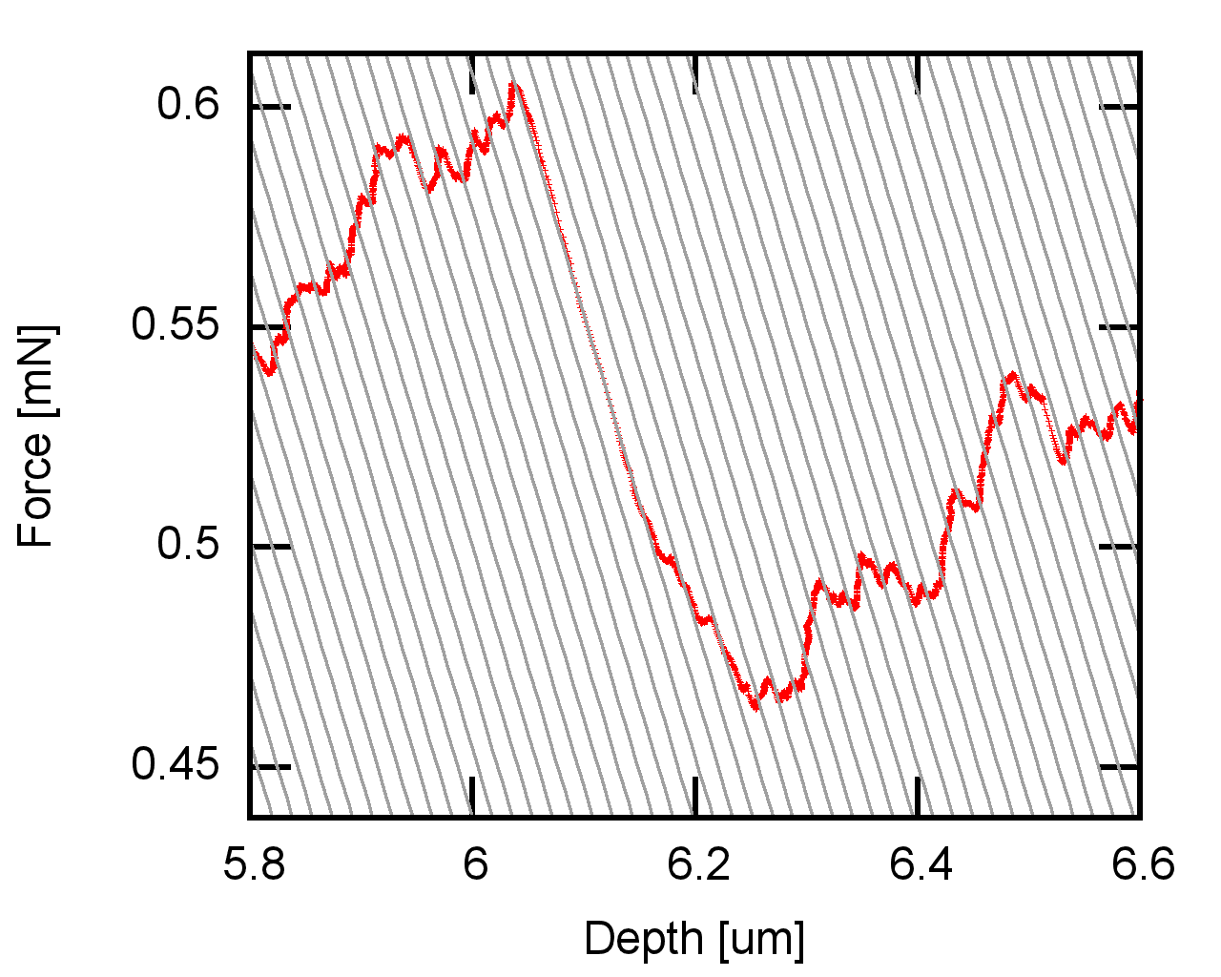
IN-SITU MOVIE
Deformation curve of micropillar compression
Rectangular micropillar
2.4 um side length
10 um height
3*10⁻² um/s crosshead speed
Constant crosshead speed control
Numerous of small avalanches were measured
On the right black stripes show the instrumental spring constant

Slide 12

IN-SITU MOVIE

Slide 13
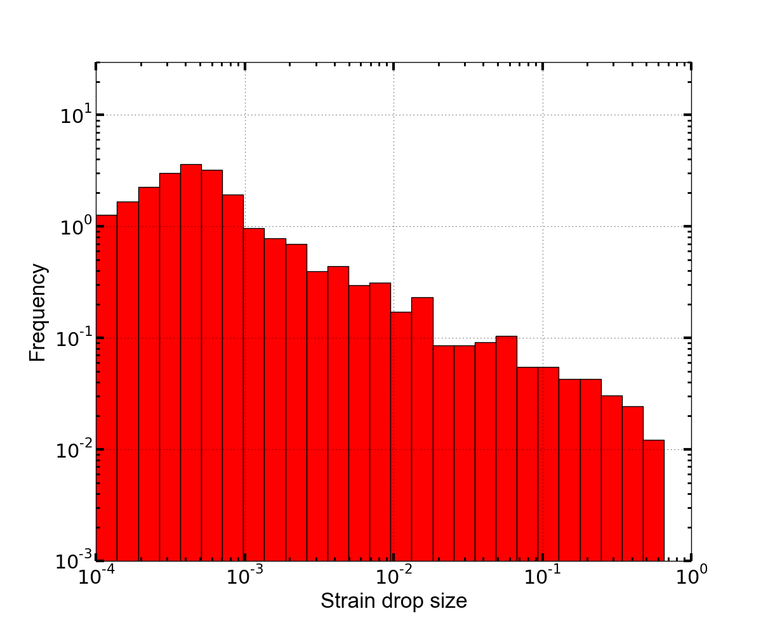
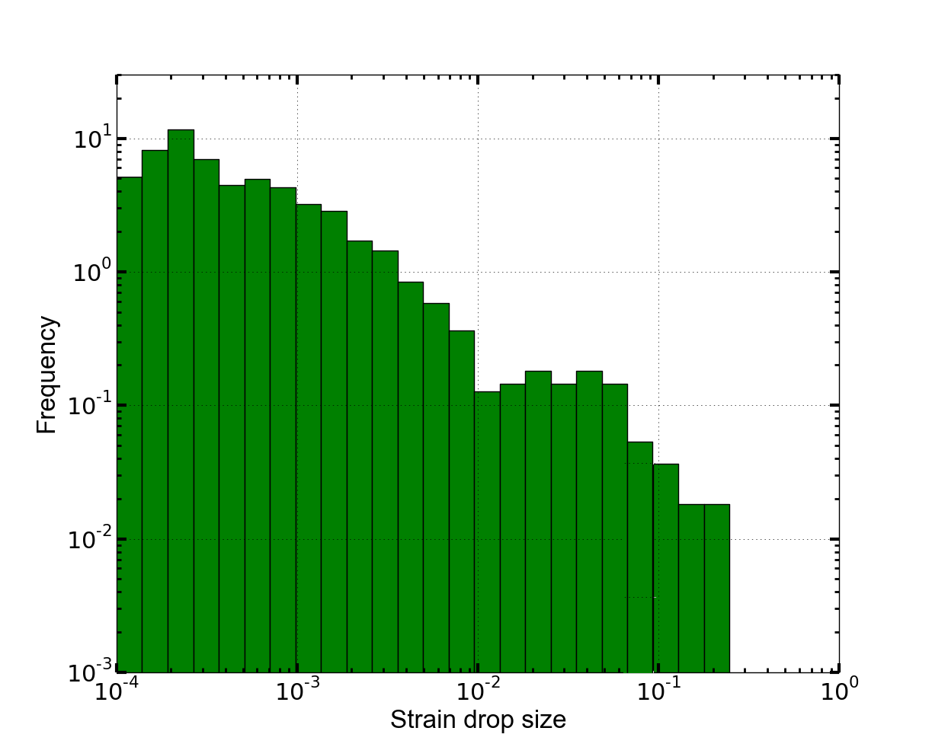
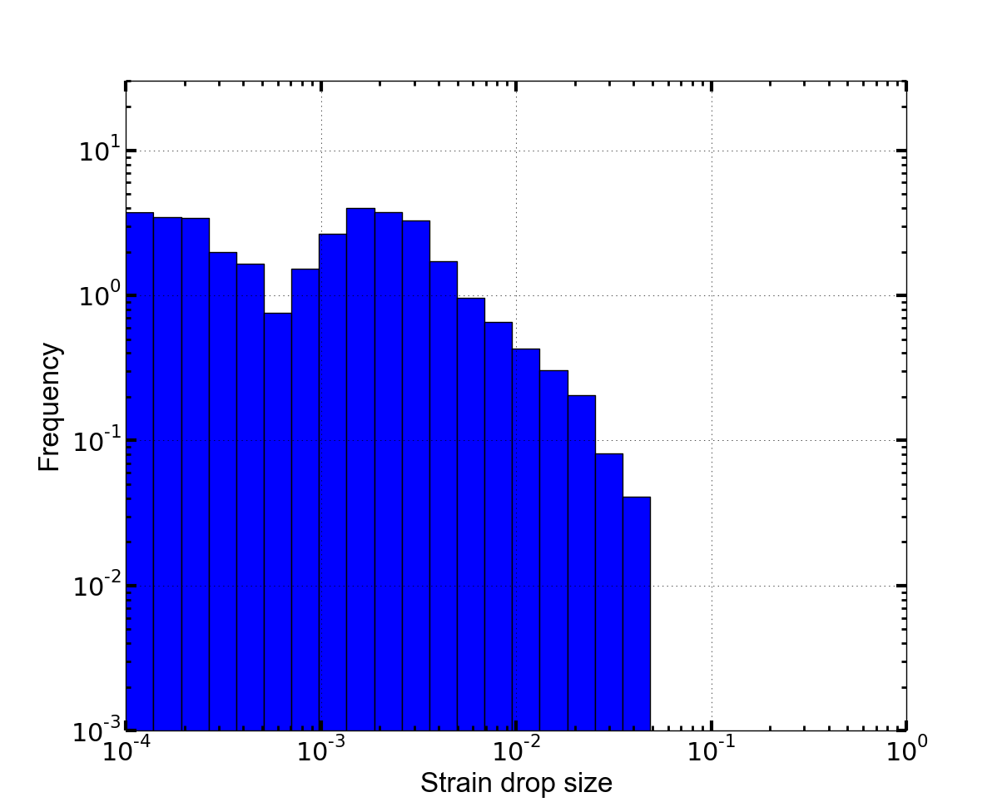
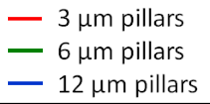
AVALANCHE power-law distribution
Increasing power-law exponent with increasing size
Constant avalanche size in microns

Slide 14
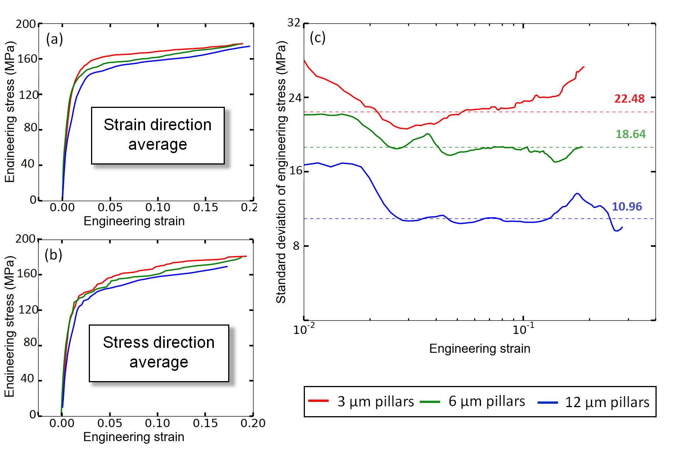
AVALANCHE properties
High dislocation density: ρ_{dl}=10¹⁴
Two marginal averaging direction:
Strain direction average: for each stress values the average strain were calculated from different pillar compressions
Stress direction average: for each strain values the average stress were calculated from different pillar compression
In many dislocation limit:
Standard deviation curves show size effect
BUT average curves not

Slide 15
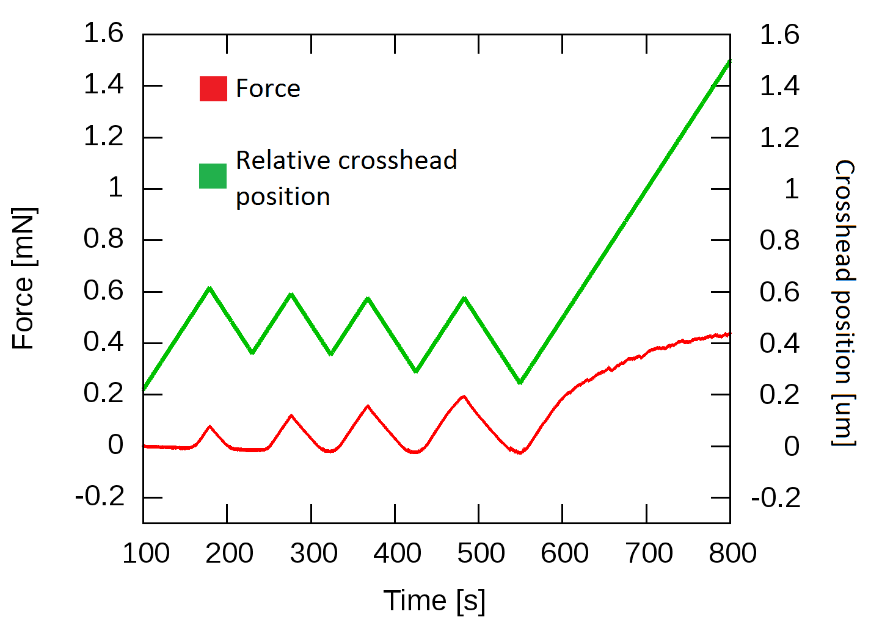
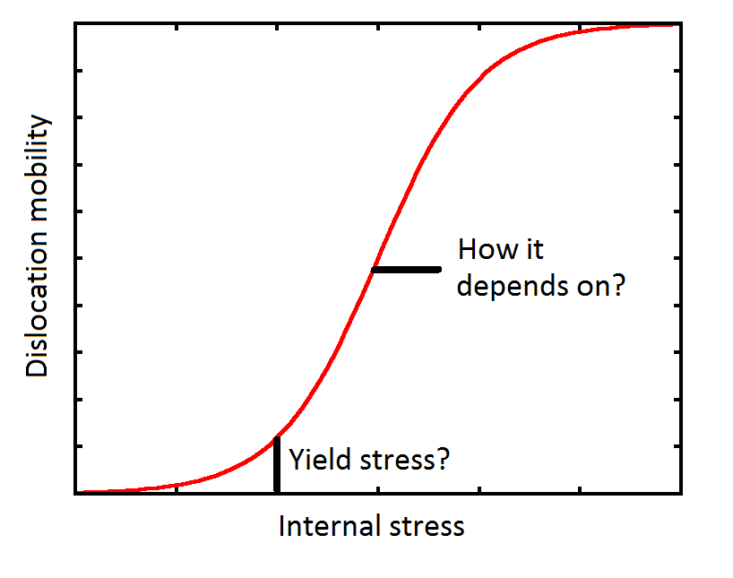
DEFORMATION properties
Microplasticity under elastic deformation:
Irreversible: single dislocation motion
Reversible: total dislocation lenght increase due to dislocation bending between junctions
How microscopic deformation works?
Is there exact limit between elastic and plastic regime?
Is it some kind of phase transition between them?
What are the rules of dislocation mobility?

Slide 16
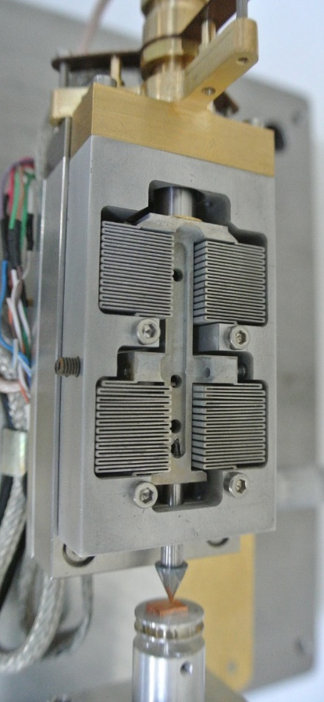
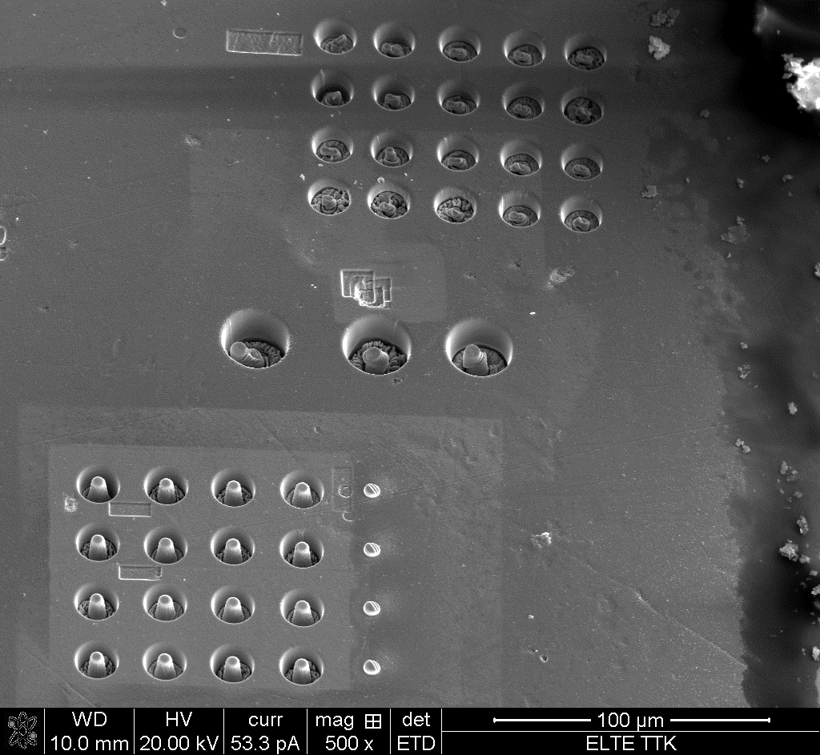
FURTHER INFORMATIVE QUESTIONS
How does dislocation density and sample size derive the micron scale deformation?
How it works in low concentration solid solutions?
How the power-law avalanche size disributions exponent changes?
What is the mechanism of microplasticity?
How theese theories works in HCP metals?
What is the effect of changing deformation rate?
What fatigue causes in strength of material?

Slide 17
Thank you for your attention!
Have you any questions?
Ádám István Hegyi, Péter Dusán Ispánovity, István Groma, Géza Györgyi
12. August 2015, Brno
Eötvös Loránd University of Budapest

