Slide 1
A6180/8180:
Modern Scattering Methods in Materials Science
Lecture given by Prof. Tamas UNGAR
Office: G6601
E-mail: tungar@cityu.edu.hk
Course leader: Dr Suresh M. Chathoth
Scattering by non-crystalline materials
Debye-formula
Zernicke-Prins equation

Slide 2
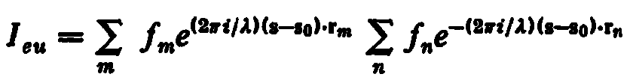
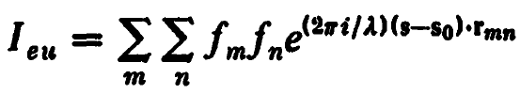
the scattered intensity in the most general form:
where summation has to be done over all the atoms within the illuminated region,
with the difference vector r_{mn} = r_{m} – r_{n} :
Warren, X-ray Diffraction

Slide 3
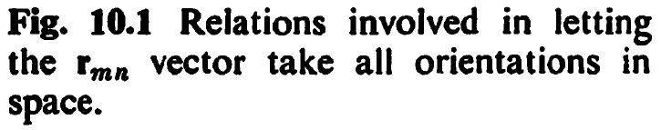
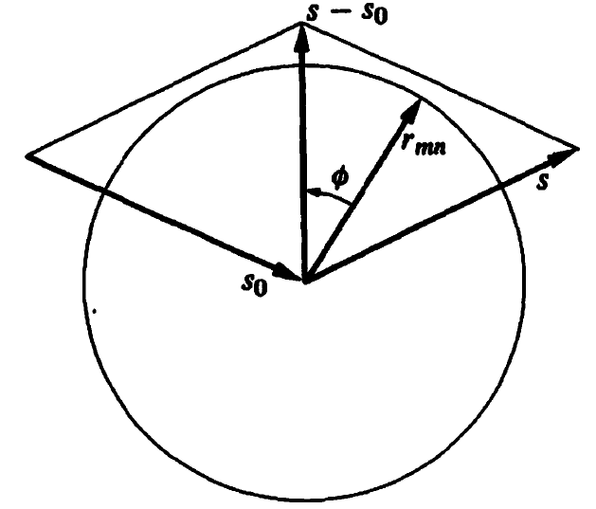
Warren, X-ray Diffraction

Slide 4


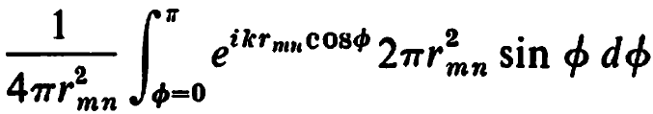
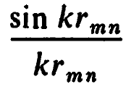
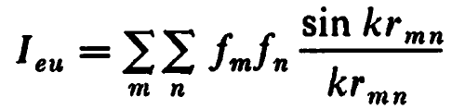
with , the average for each exponential term:
=
=
=
after summation
Debye-formula
Warren, X-ray Diffraction

Slide 5
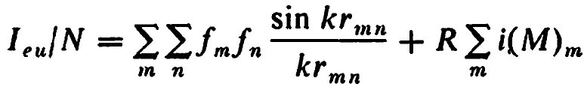
gas of polyatomic molecule:
where the last term on the right-hand side if the modified Compton scattering
and N is the number of molecules in the illuminated volume.
Warren, X-ray Diffraction

Slide 6
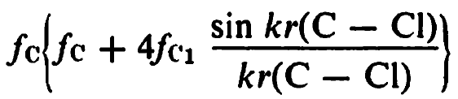
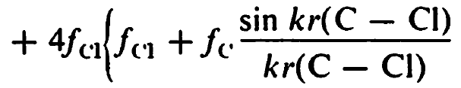
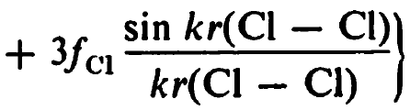
carbon-tetrachloride CCl₄:
+
+
Warren, X-ray Diffraction

Slide 7
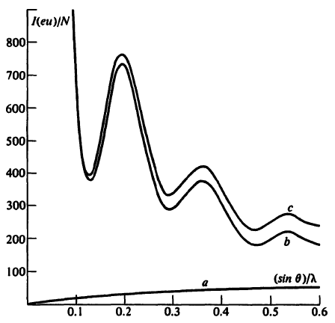
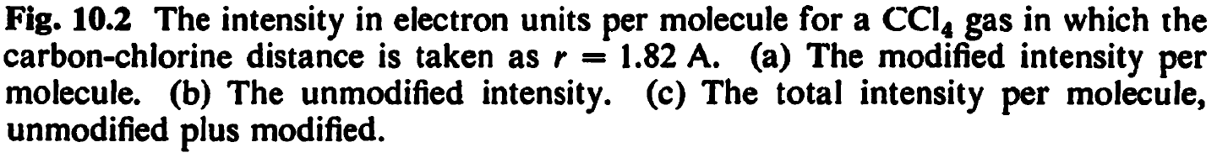
Warren, X-ray Diffraction

Slide 8
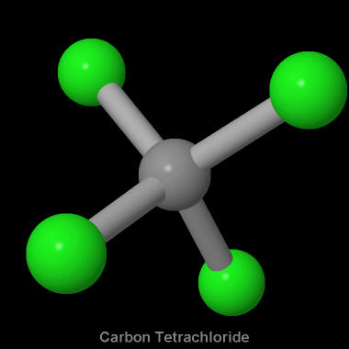
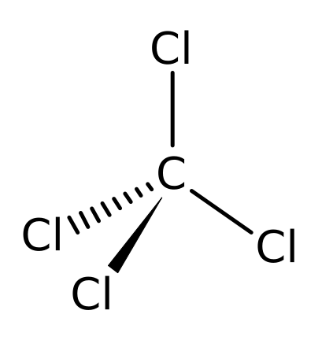
r_{C-Cl} = 0.182 nm

Slide 9
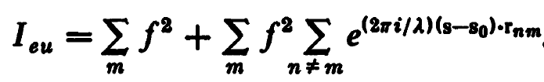


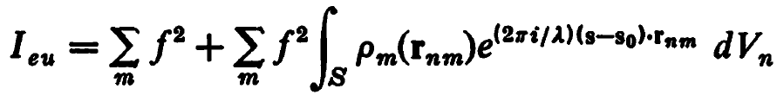
Scattering by liquid or non-crystalline materials
if there is only one kind of atom, the scattered intensity will be:
we introduce a density function:
where is the number of atoms in dV_{n} at r_{nm}.
With this the summation can be replaced by the integral:
Warren, X-ray Diffraction

Slide 10
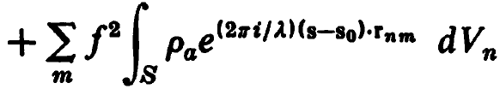

Scattering by liquid or non-crystalline materials
with introducing the average density, ρ_{a}:
+
for a fixed distance r_{mn}=r let , where the average
is over all ρ_{m}(r) within the sample at the distance r from any atom
in the sample.
Warren, X-ray Diffraction

Slide 11

Scattering by liquid or non-crystalline materials
for a fixed distance in the sample,
where the average is taken over all ρ_{m}(r) within the sample
at the distance r from any atom.
With this, in the integral can be replaced by:
Warren, X-ray Diffraction

Slide 12
Scattering by liquid or non-crystalline materials
For a mon-atomic amorphous sample the term
goes to zero at distances of r larger than a few atomic distances.
Since the volume S is considerably larger than a few atomic distances
the summation over m can be replaced
by the number of atoms in S, i.e., N.
Warren, X-ray Diffraction

Slide 13

Scattering by liquid or non-crystalline materials
if there is no preferred orientation in the sample,
will have spherical symmetry and can be written as:
Warren, X-ray Diffraction

Slide 14

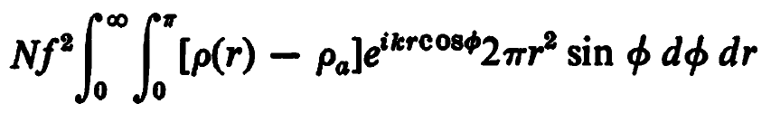
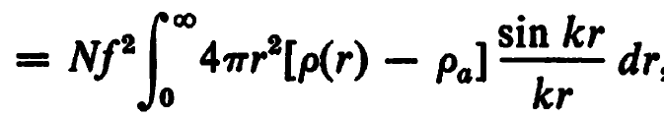
Scattering by liquid or non-crystalline materials
if there is no preferred orientation in the sample,
will have spherical symmetry and can be written as:
Using the notations in Fig. 10.1 and the variable
we obtain:
=
Warren, X-ray Diffraction

Slide 15
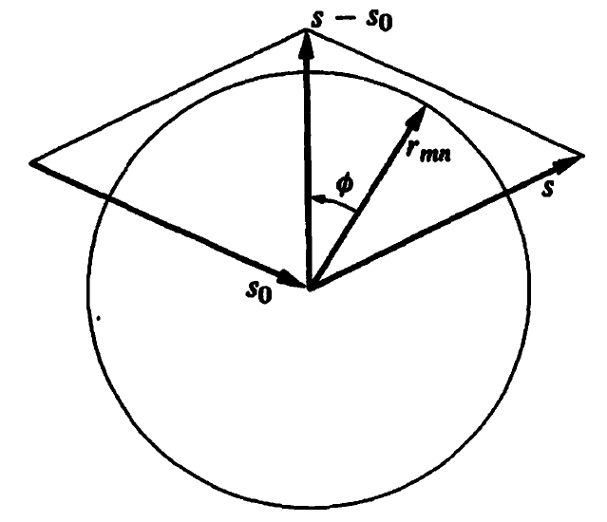
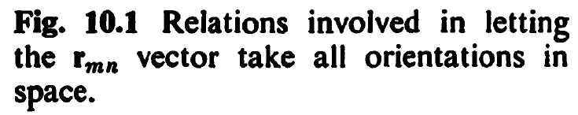
Scattering by liquid or non-crystalline materials
Warren, X-ray Diffraction

Slide 16
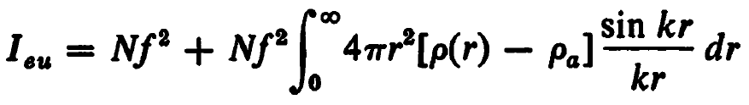
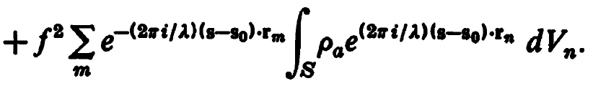
Scattering by liquid or non-crystalline materials
after some rearrangements:
+
next we analyze the integral in the third term:
Warren, X-ray Diffraction

Slide 17
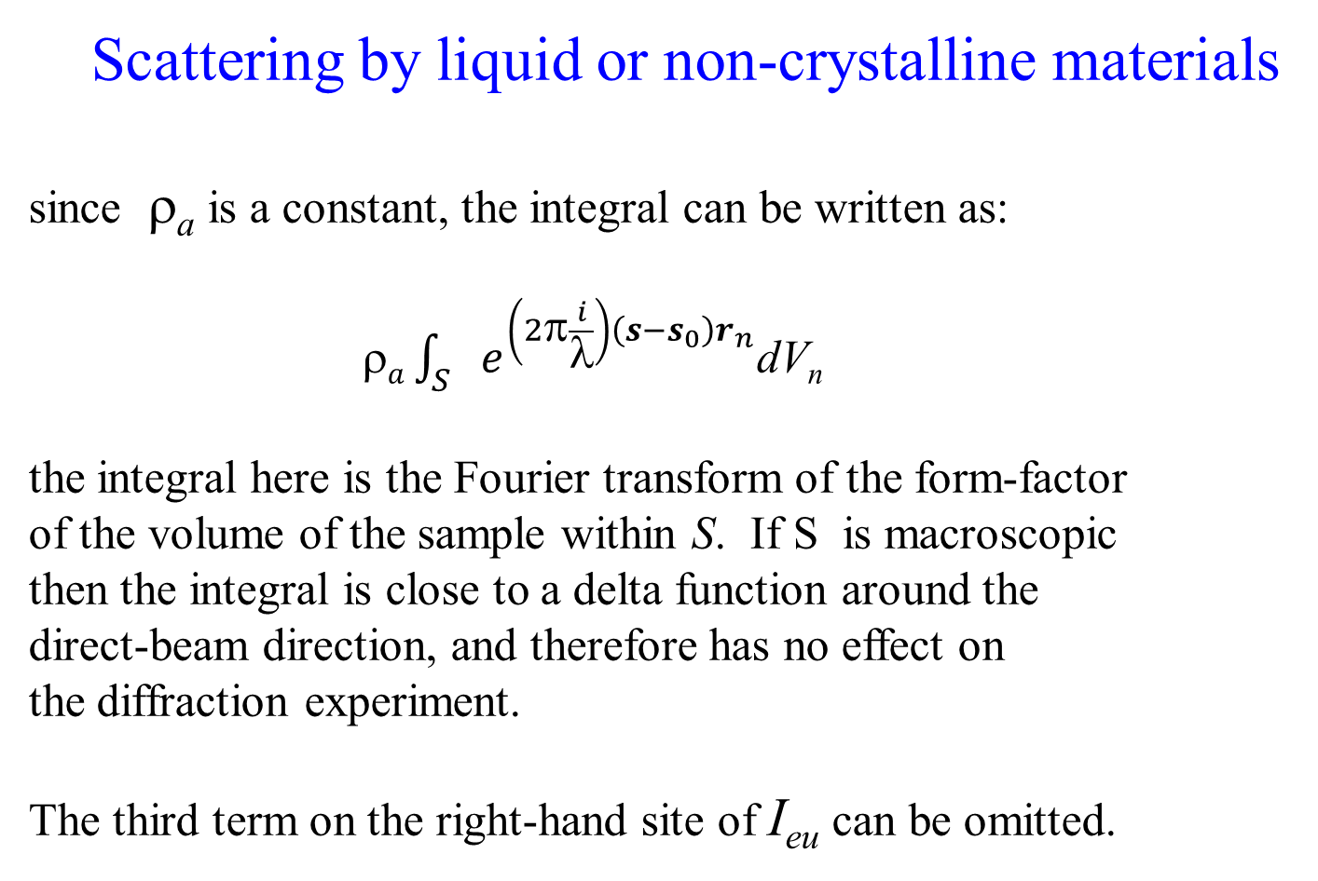
Scattering by liquid or non-crystalline materials
since ρ_{a} is a constant, the integral can be written as:
$a\int_{S}{e^{\left(2π\frac{i}{λ}\right)\left(s−s_{0}\right)r_{n}}}$dV_{n}
the integral here is the Fourier transform of the form-factor
of the volume of the sample within S. If S is macroscopic
then the integral is close to a delta function around the
direct-beam direction, and therefore has no effect on
the diffraction experiment.
The third term on the right-hand site of I_{eu} can be omitted.
Warren, X-ray Diffraction

Slide 18
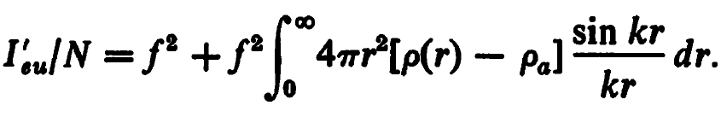
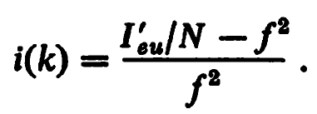
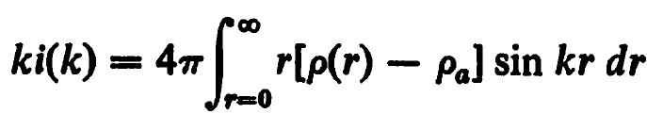
Scattering by liquid or non-crystalline materials
the scattered intensity per atom will become:
We introduce the abbreviation:
,
and do some rearrangements:
Warren, X-ray Diffraction

Slide 19
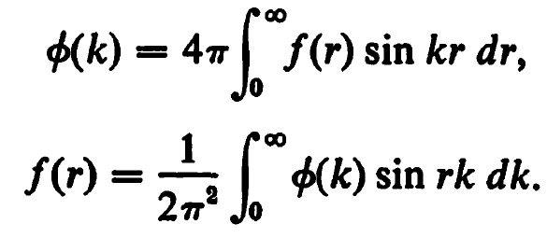
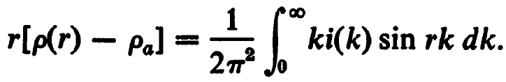
Scattering by liquid or non-crystalline materials
with taking into account the rules of Fourier transformation:
the inverse Fourier transformation provides:
and with some rearrangements:
Warren, X-ray Diffraction

Slide 20
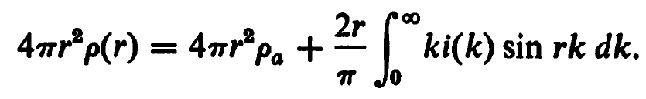
Scattering by liquid or non-crystalline materials
we arrive at the Zernicke-Prins equation:
4πr²ρ(r) is the radial-distribution-function (RDF)
Warren, X-ray Diffraction

Slide 21
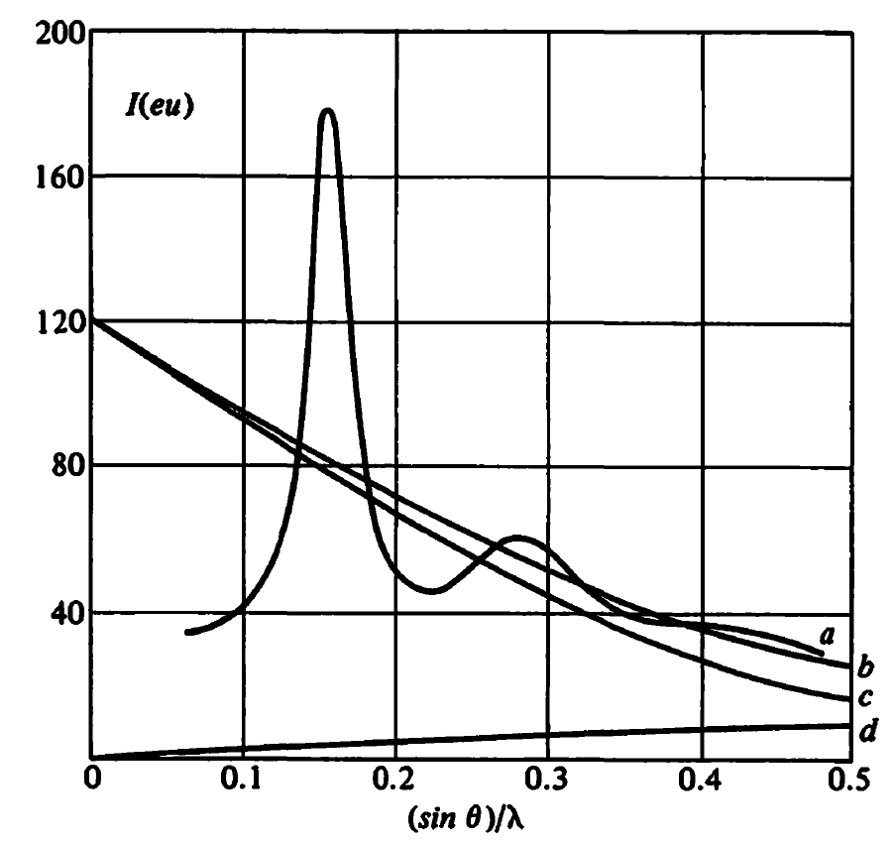
Scattering by liquid or non-crystalline materials
Warren, X-ray Diffraction

Slide 22
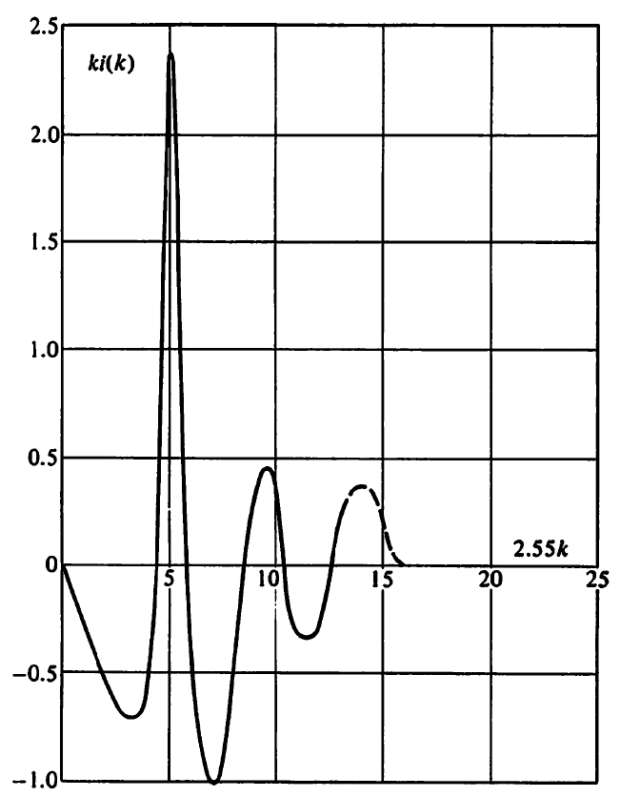
Scattering by liquid or non-crystalline materials
Warren, X-ray Diffraction

Slide 23
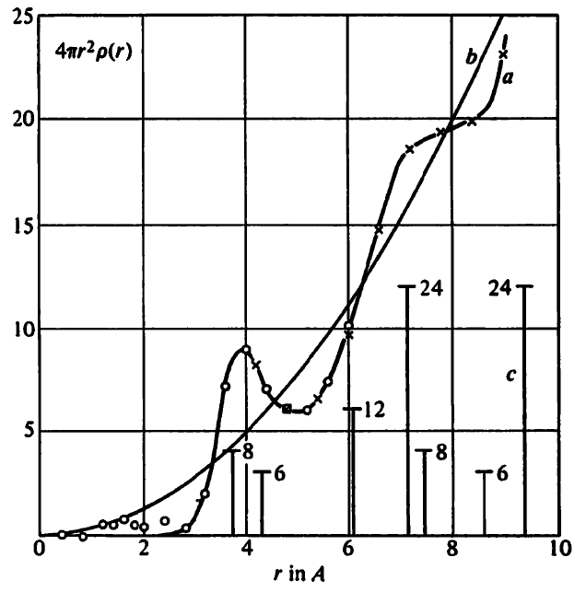
Scattering by liquid or non-crystalline materials
Warren, X-ray Diffraction

Slide 24
Thank you

