Slide 1
AP6180/AP8180
Modern Scattering Methods in Materials Science
Lecture given by Prof. Tamas UNGAR
Office: G6601
e-mail: tungar@cityu.edu.hk
Course leader: Dr Suresh M. Chathoth
Fundamentals of X-ray scattering

Slide 2
Fundamentals of X-ray scattering
Brief history
Laboratory X-ray sources,
Basic properties of X-rays,
X-ray spectra,
X-ray absorption edges,
Synchrotron X-ray sources,
Scattering mechanisms of X-rays by matter,
Atomic scattering factors for X-rays
Total X-ray reflection,
Darwin-breadth (qualitatively)
Monochromators (briefly)

Slide 3
Fundamentals of X-ray scattering
Brief history
Laboratory X-ray sources,
Basic properties of X-rays,
X-ray spectra,
X-ray absorption edges,
Synchrotron X-ray sources,
Scattering mechanisms of X-rays by matter,
Atomic scattering factors for X-rays
Total X-ray reflection,
Darwin-breadth (qualitatively)
Monochromators (briefly)

Slide 4
Brief history
Reading:
B.E.Warren, X-ray Diffraction,
Dover Publ., 1969, 1990
B.D.Cullity & S.R.Stock, Elements of X-ray Diffraction
Prentice Hall Inc. 2001
P.Klug & L.E.Alexander, X-ray diffraction procedures
for polycrystalline and amorphous materials,
Wiley, NY, 1954
L.H.Schwartz & J.B.Cohen, Diffraction from Materials,
AP. Academic Press, 1977

Slide 5
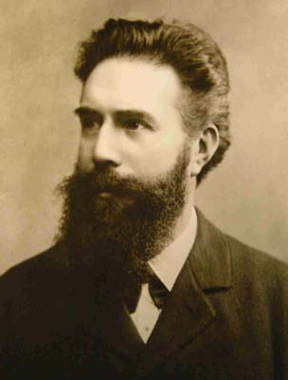
The tale:
Röntgen, a German physicist,
was experimenting with a Crookes tube
when it produced streams of electrons
called cathode rays.
Just before leaving for lunch one day,
Röntgen put an activated tube on a book and
the book just happened to be lying on
a piece of photographic film.
Inside the book was a key and
when he later discovered that image,
he knew he was looking at
something entriely new.
The world's first ever x-ray
Discovery: 1895, Nobel Prize: 1901
Wilhelm Konrad Röntgen
1845 - 1923

Slide 6
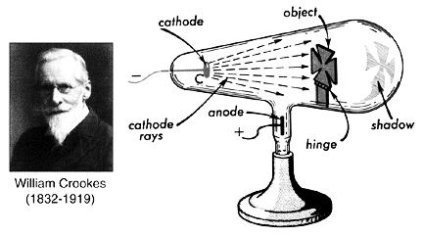
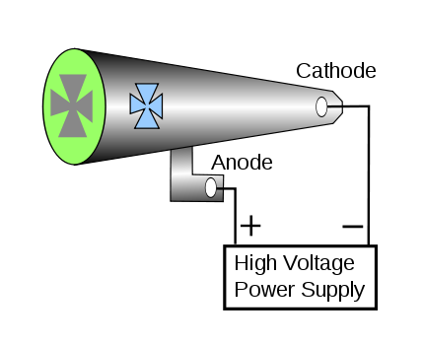
Crookes tube

Slide 7
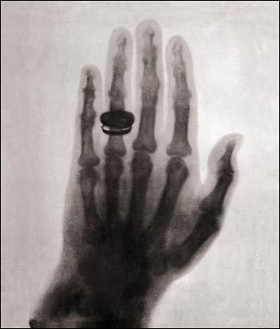
X-ray or röntgen image of
one of the hands of
Röntgen’s wife

Slide 8
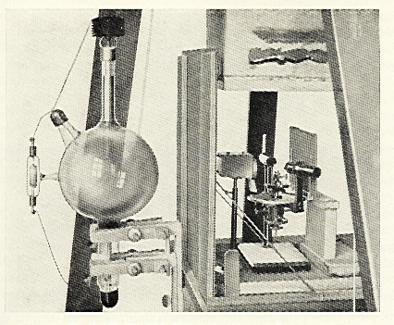
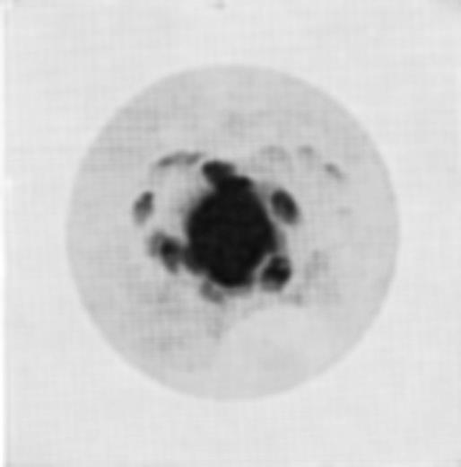
the first diffraction experiments: Max von Laue, 1912
Laue photograph of zinc blend, ZnS
along the three-fold axis
M.vonLaue, Friedrich & Knipping, 1912

Slide 9
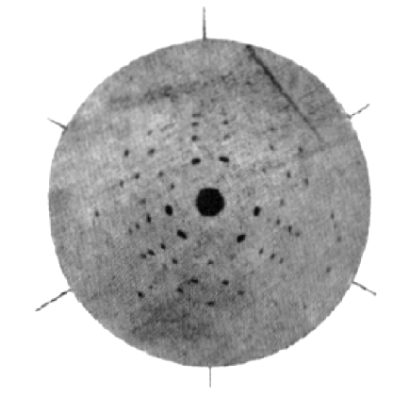
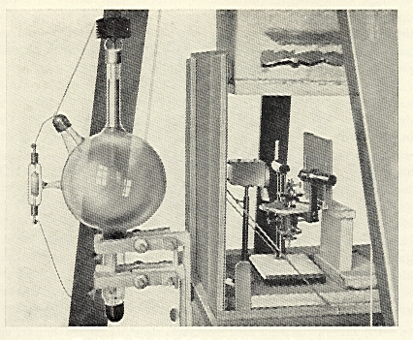
the first diffraction experiments: Max von Laue, 1912
third improved image,
after applying a pinhole
Laue photograph of zinc-blend, ZnS
along the three-fold axis
M.vonLaue, Friedrich & Knipping, 1912

Slide 10
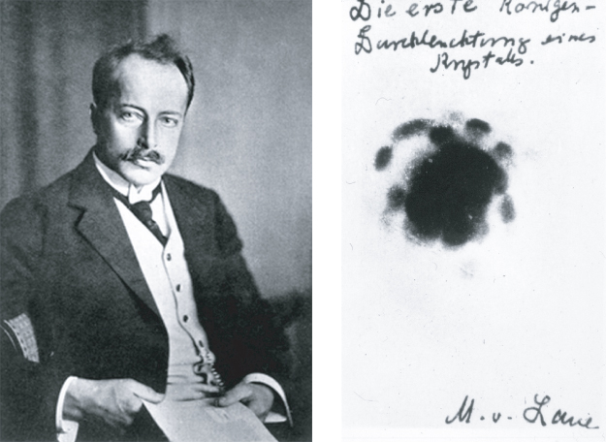
the first diffraction experiments: Max von Laue, 1912

Slide 11
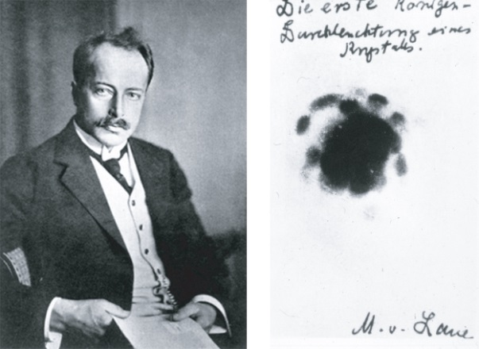
the first diffraction experiments: Max von Laue, 1912
two consequences
1) materials are crystalline consisting of atoms
2) X-rays are waves
electromagnetic waves
Nobel Prize in Physics 1914

Slide 12
Fundamentals of X-ray scattering
Brief history
Laboratory X-ray sources,
Basic properties of X-rays,
X-ray spectra,
X-ray absorption edges,
Synchrotron X-ray sources,
Scattering mechanisms of X-rays by matter,
Atomic scattering factors for X-rays
Total X-ray reflection,
Darwin-breadth (qualitatively)
Monochromators (briefly)

Slide 13
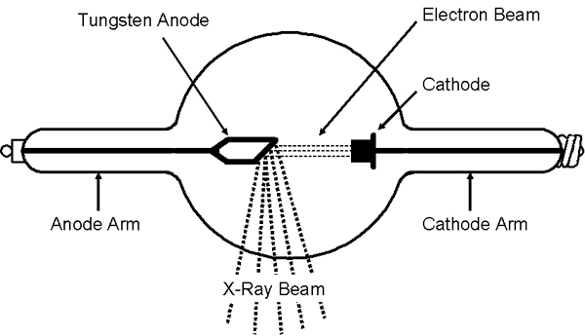
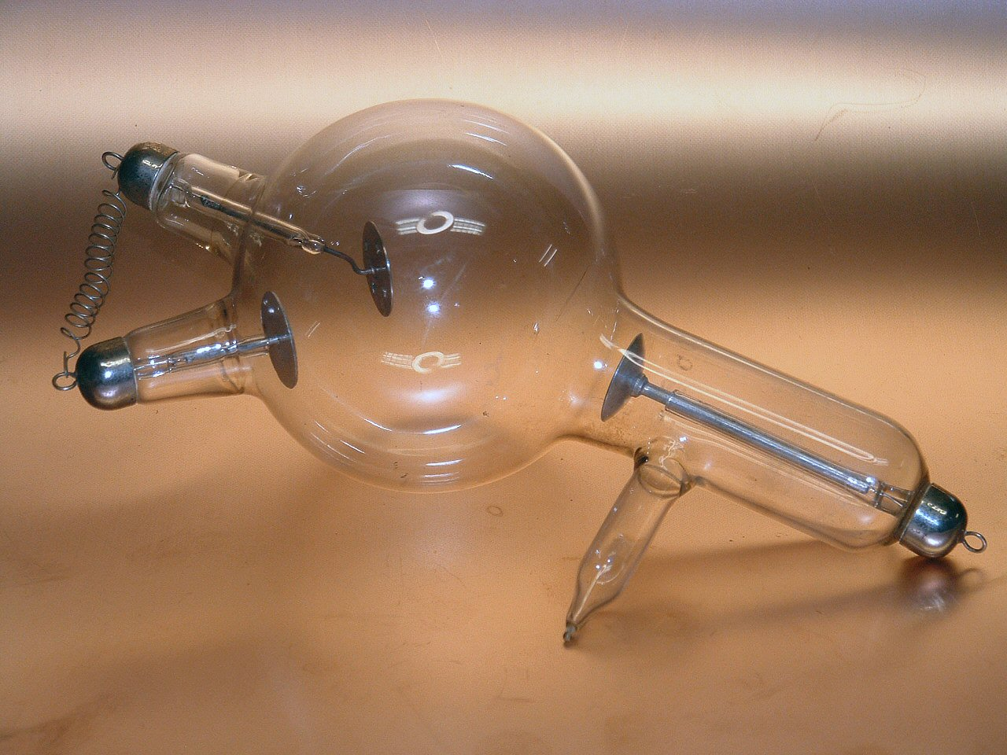
the first X-ray tubes:

Slide 14
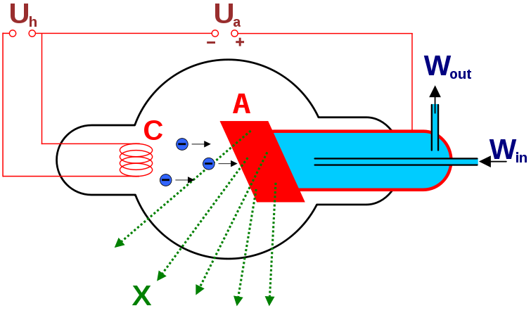
the first X-ray tubes:

Slide 15
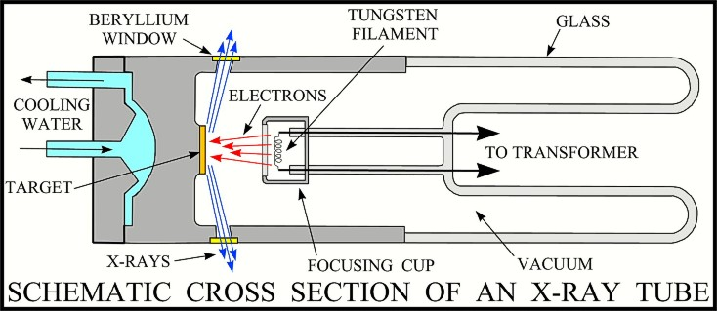
X-ray tubes today

Slide 16
Fundamentals of X-ray scattering
Brief history
Laboratory X-ray sources,
Basic properties of X-rays,
X-ray spectra,
X-ray absorption edges,
Synchrotron X-ray sources,
Scattering mechanisms of X-rays by matter,
Atomic scattering factors for X-rays
Total X-ray reflection,
Darwin-breadth (qualitatively)
Monochromators (briefly)

Slide 17
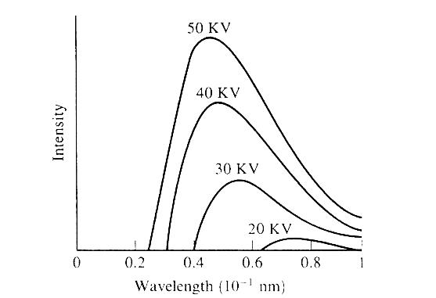
X-ray spectra
bremsstrahlung radiation produced by
random inelastic scattering by
the electrons in the material

Slide 18
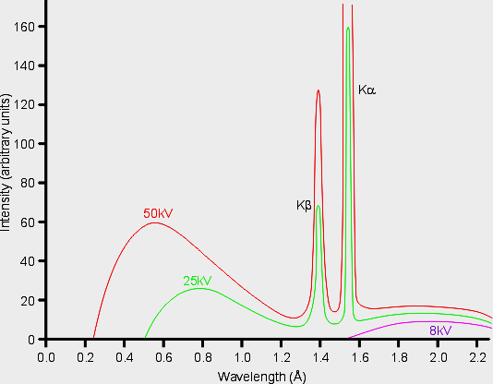
X-ray spectra
characteristic X-ray spectrum radiation produced by
when the exited atom relaxes
by emitting a photon

Slide 19
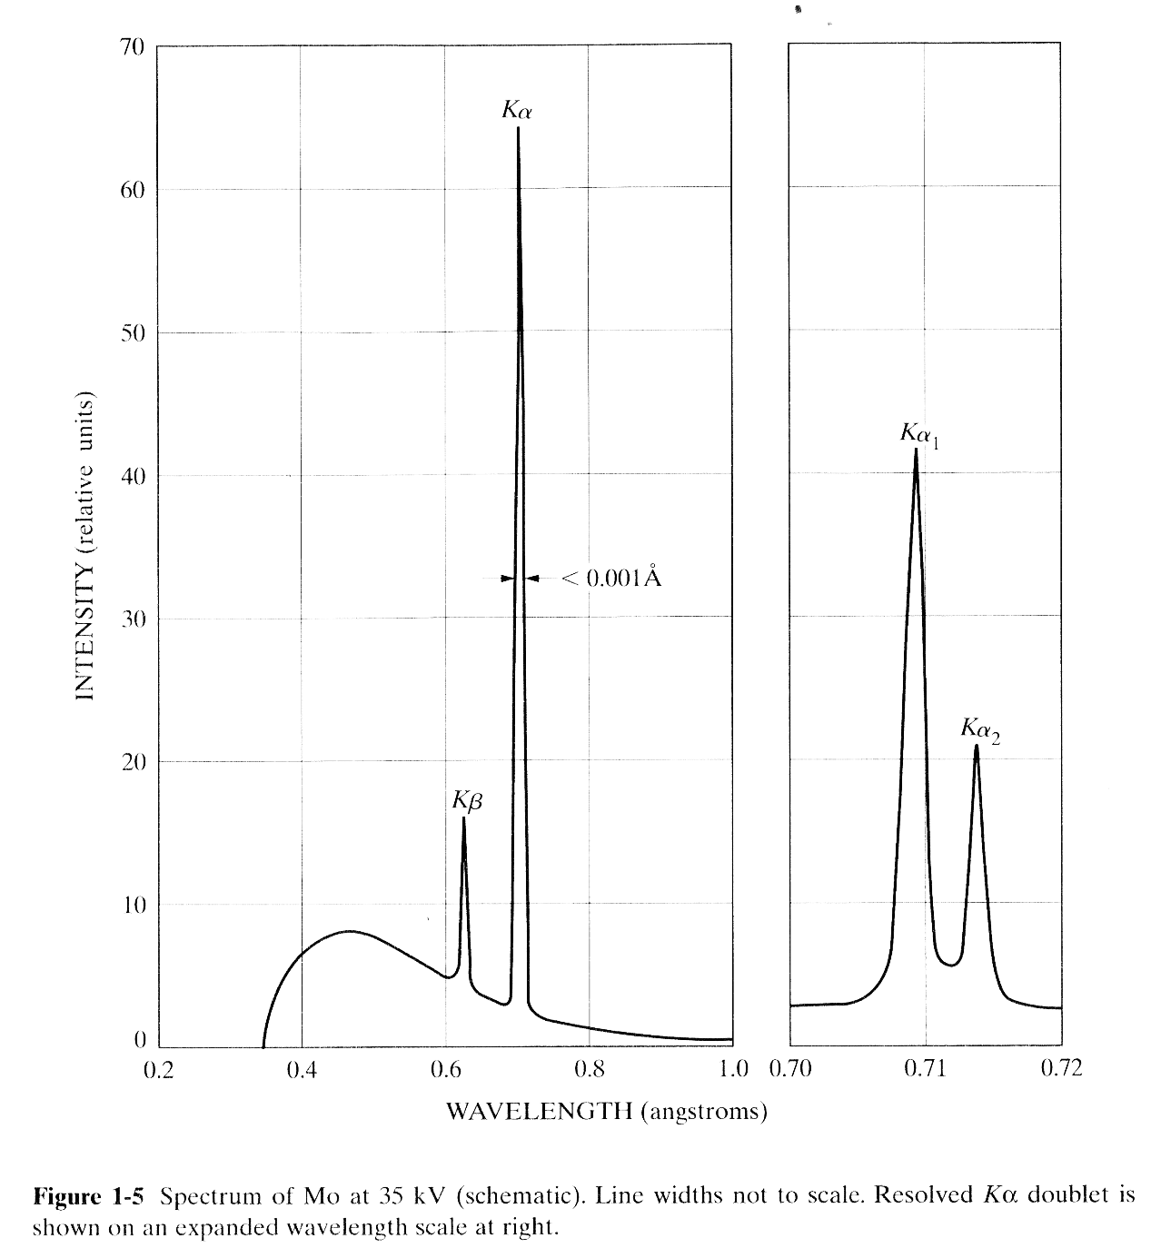
X-ray spectra
characteristic
X-ray spectrum
radiation produced by
when the exited atom relaxes
by emitting a photon

Slide 20
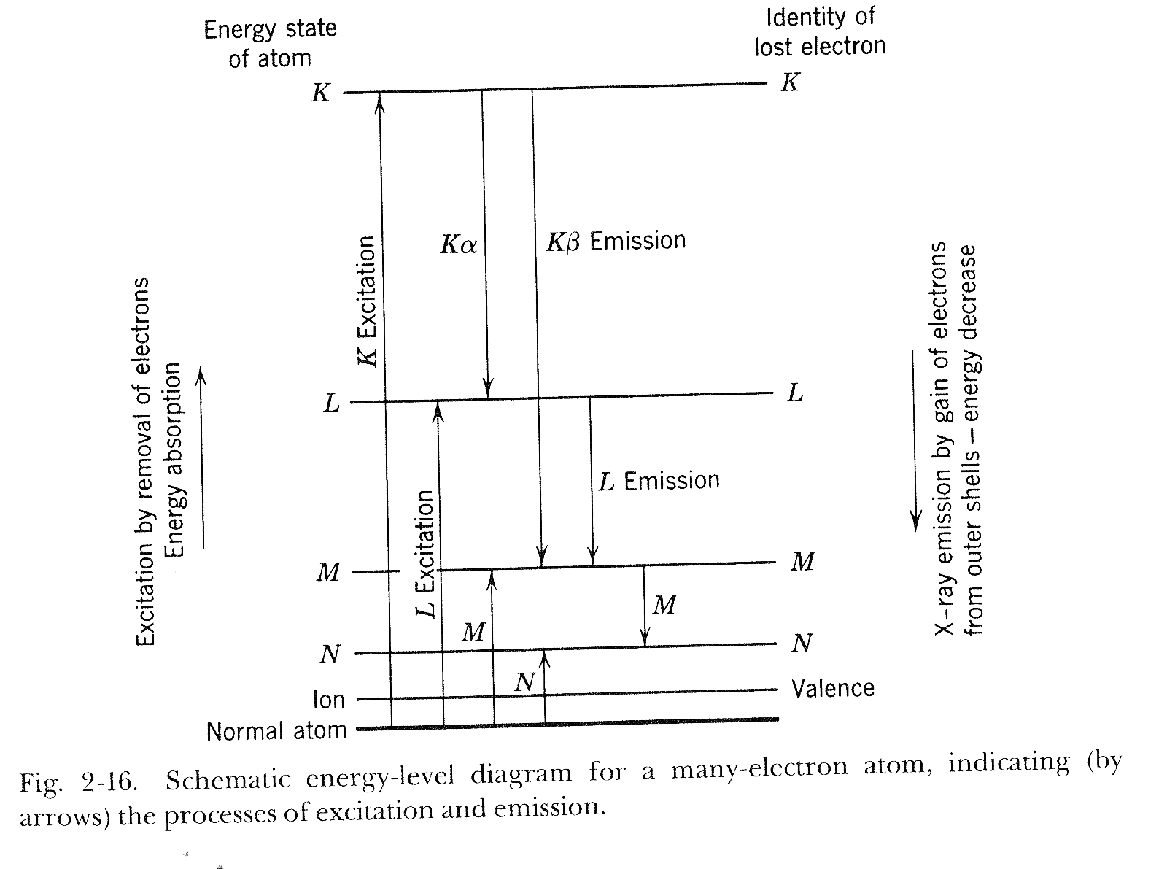
X-ray spectra

Slide 21
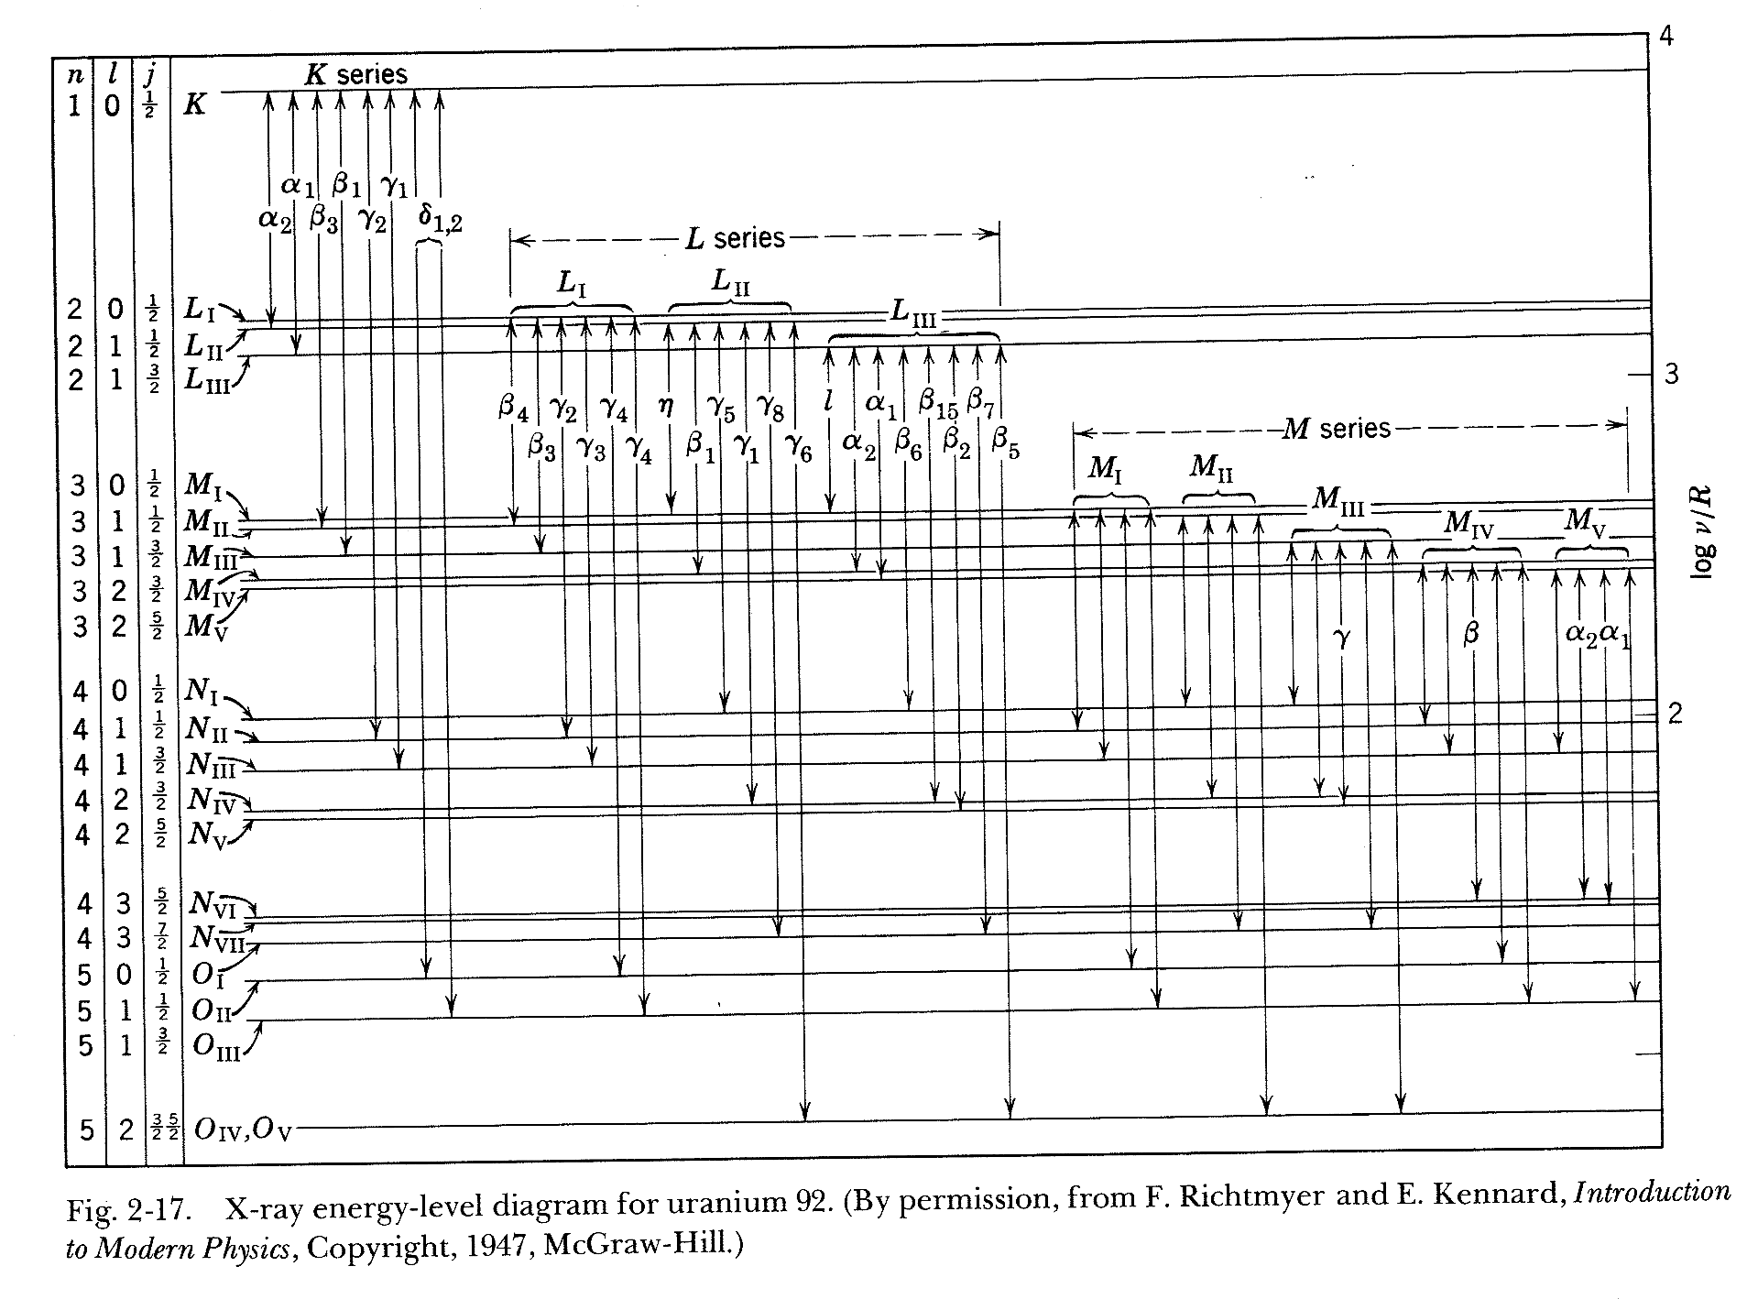
X-ray spectra

Slide 22
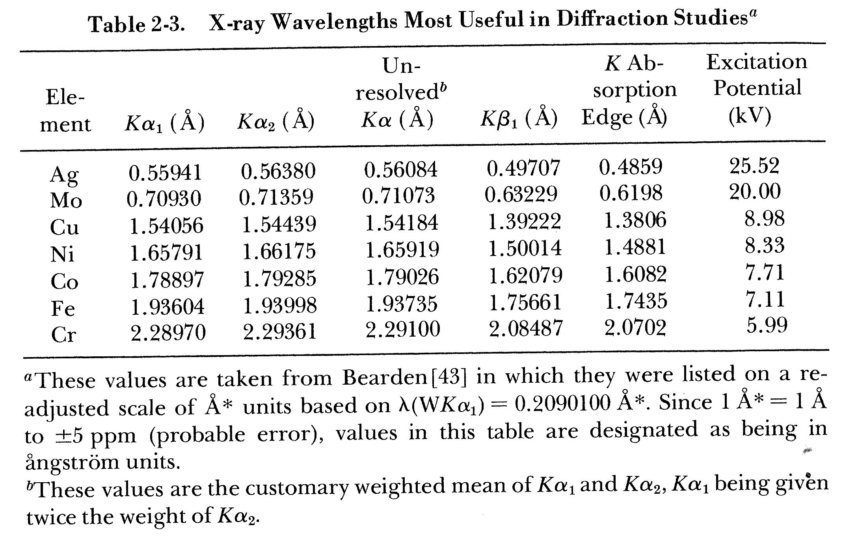
X-ray wavelengths used in the laboratory

Slide 23
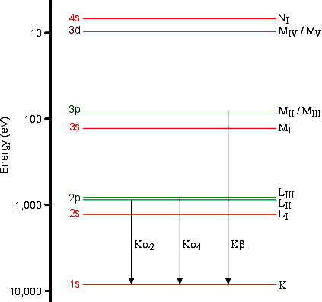
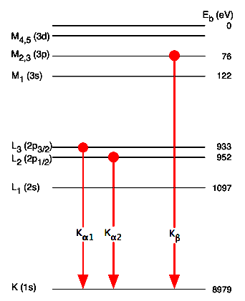
X-ray spectra

Slide 24
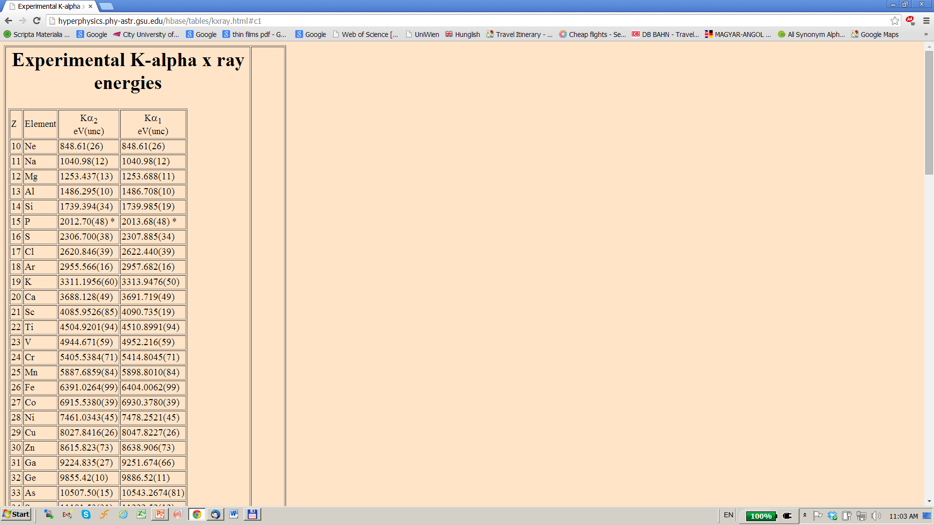
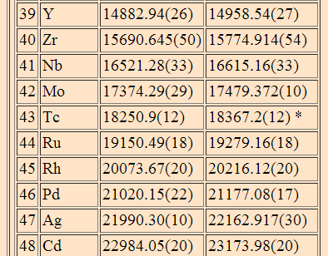
X-ray spectra

Slide 25
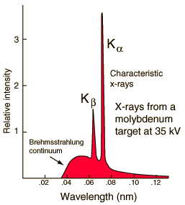
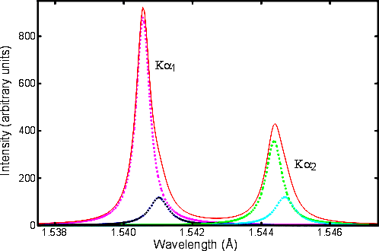
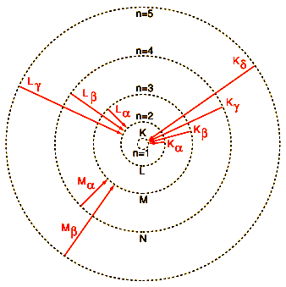
X-ray spectra

Slide 26
Fundamentals of X-ray scattering
Brief history
Laboratory X-ray sources,
Basic properties of X-rays,
X-ray spectra,
X-ray absorption edges,
Synchrotron X-ray sources,
Scattering mechanisms of X-rays by matter,
Atomic scattering factors for X-rays
Total X-ray reflection,
Darwin-breadth (qualitatively)
Monochromators (briefly)

Slide 27
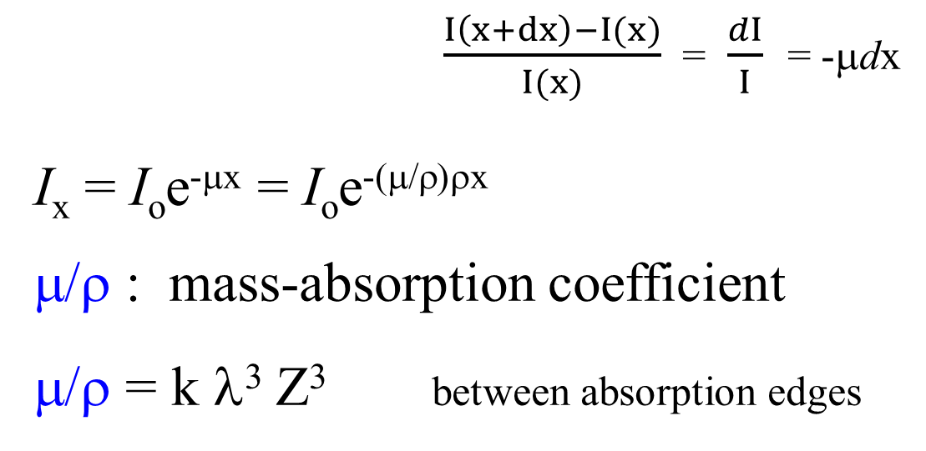
X-ray absorption
I(x) I(x+dx)
$\frac{I\left(x+dx\right)−I(x)}{I(x)}$ = $\frac{dI}{I}$ = -μdx
I_{x} = I_{o}e^{-μx} = I_{o}e^{-(μ/ρ)ρx}
μ/ρ : mass-absorption coefficient
μ/ρ = k λ³ Z³ between absorption edges
dx

Slide 28
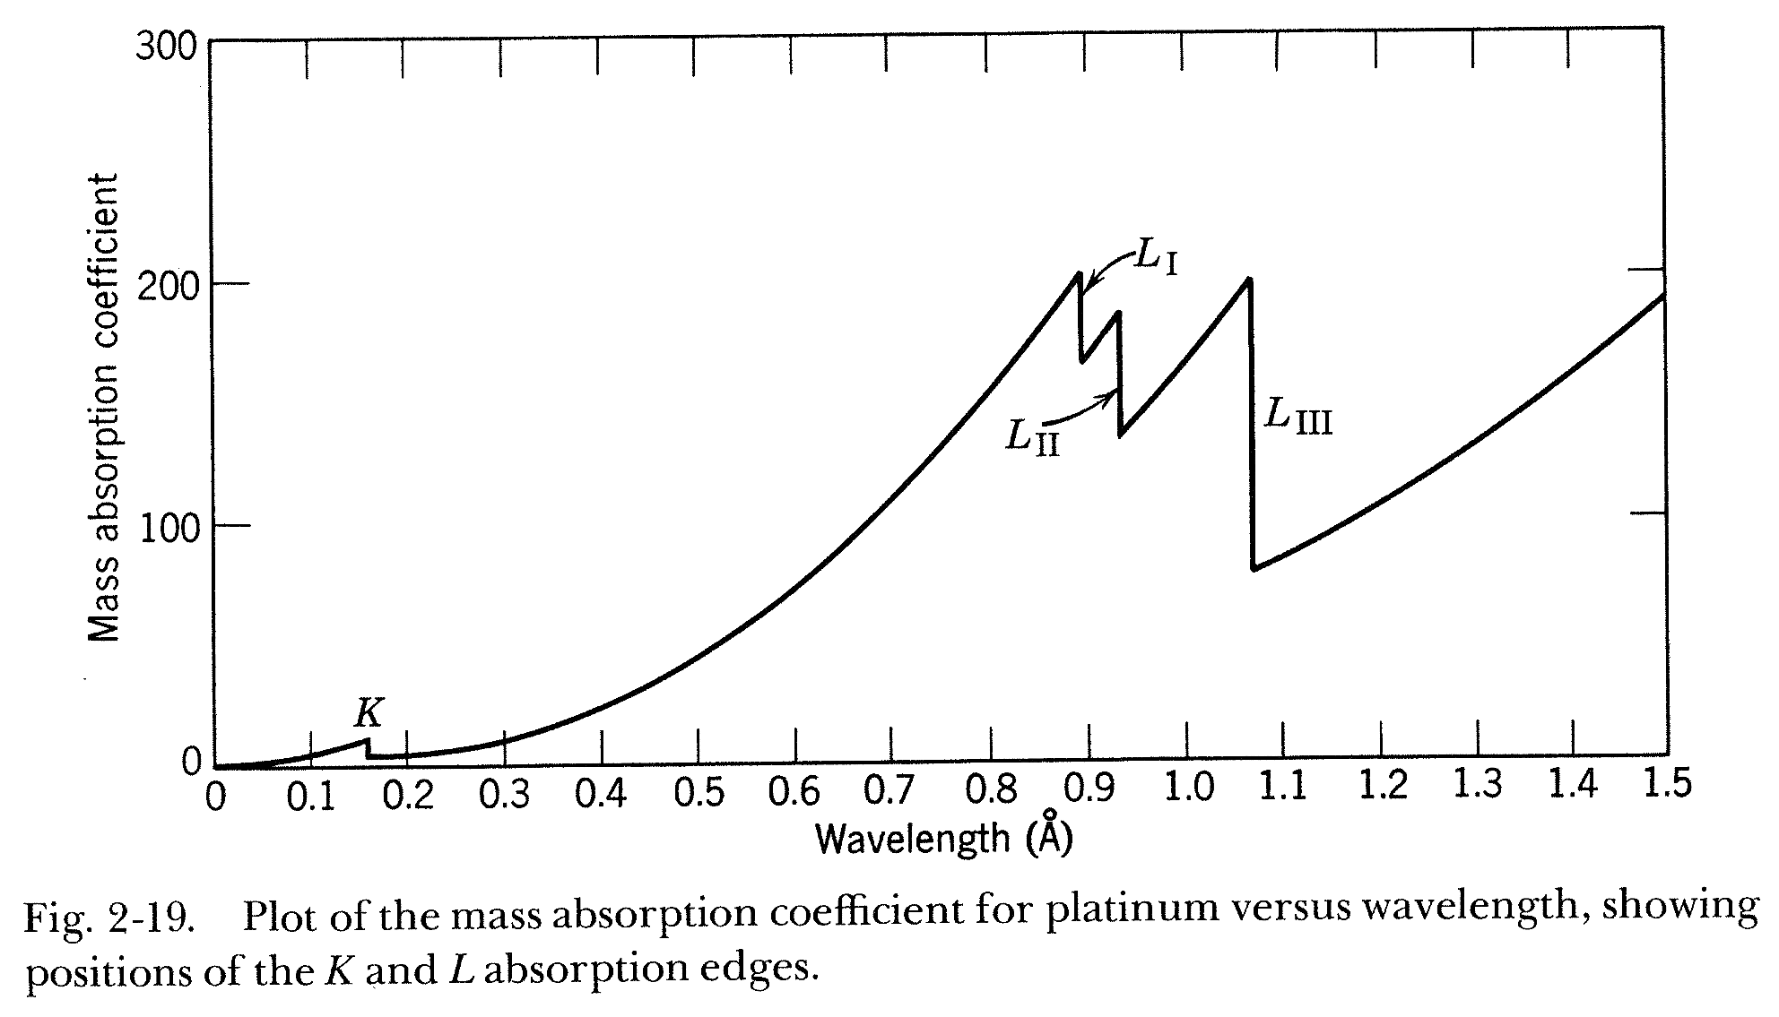
X-ray absorption spectrum for platinum
I = I_{o}e^{-μx} = I_{o}e^{-(μ/ρ)ρx} μ/ρ : mass-absorption coefficient

Slide 29
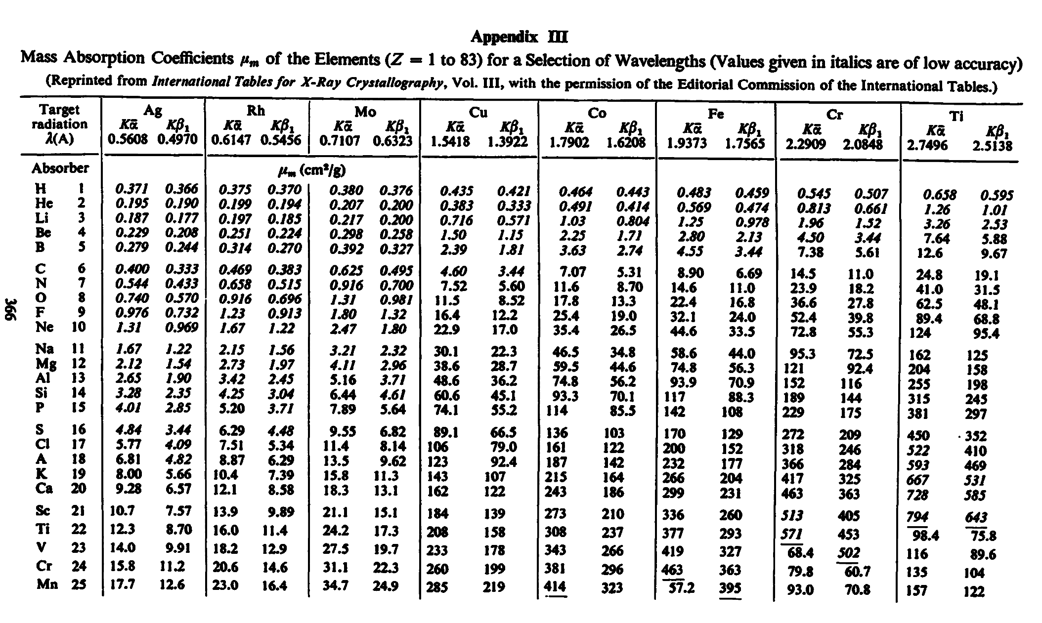
X-ray absorption
                cm²/g
Warren, X-ray diffraction

Slide 30

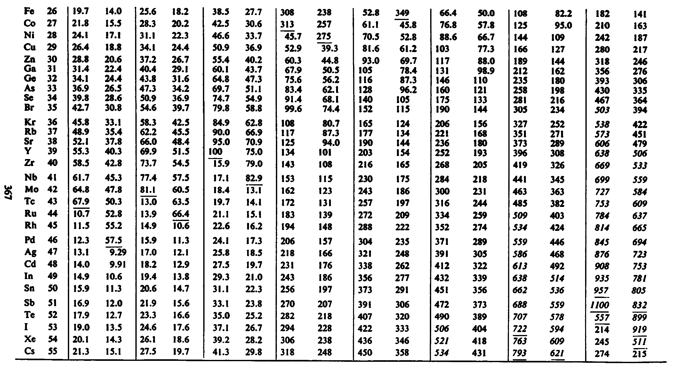
X-ray absorption
                cm²/g
Warren, X-ray diffraction

Slide 31
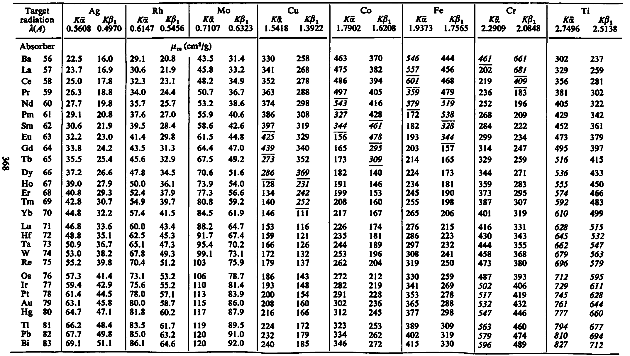
X-ray absorption
                cm²/g
Warren, X-ray diffraction

Slide 32
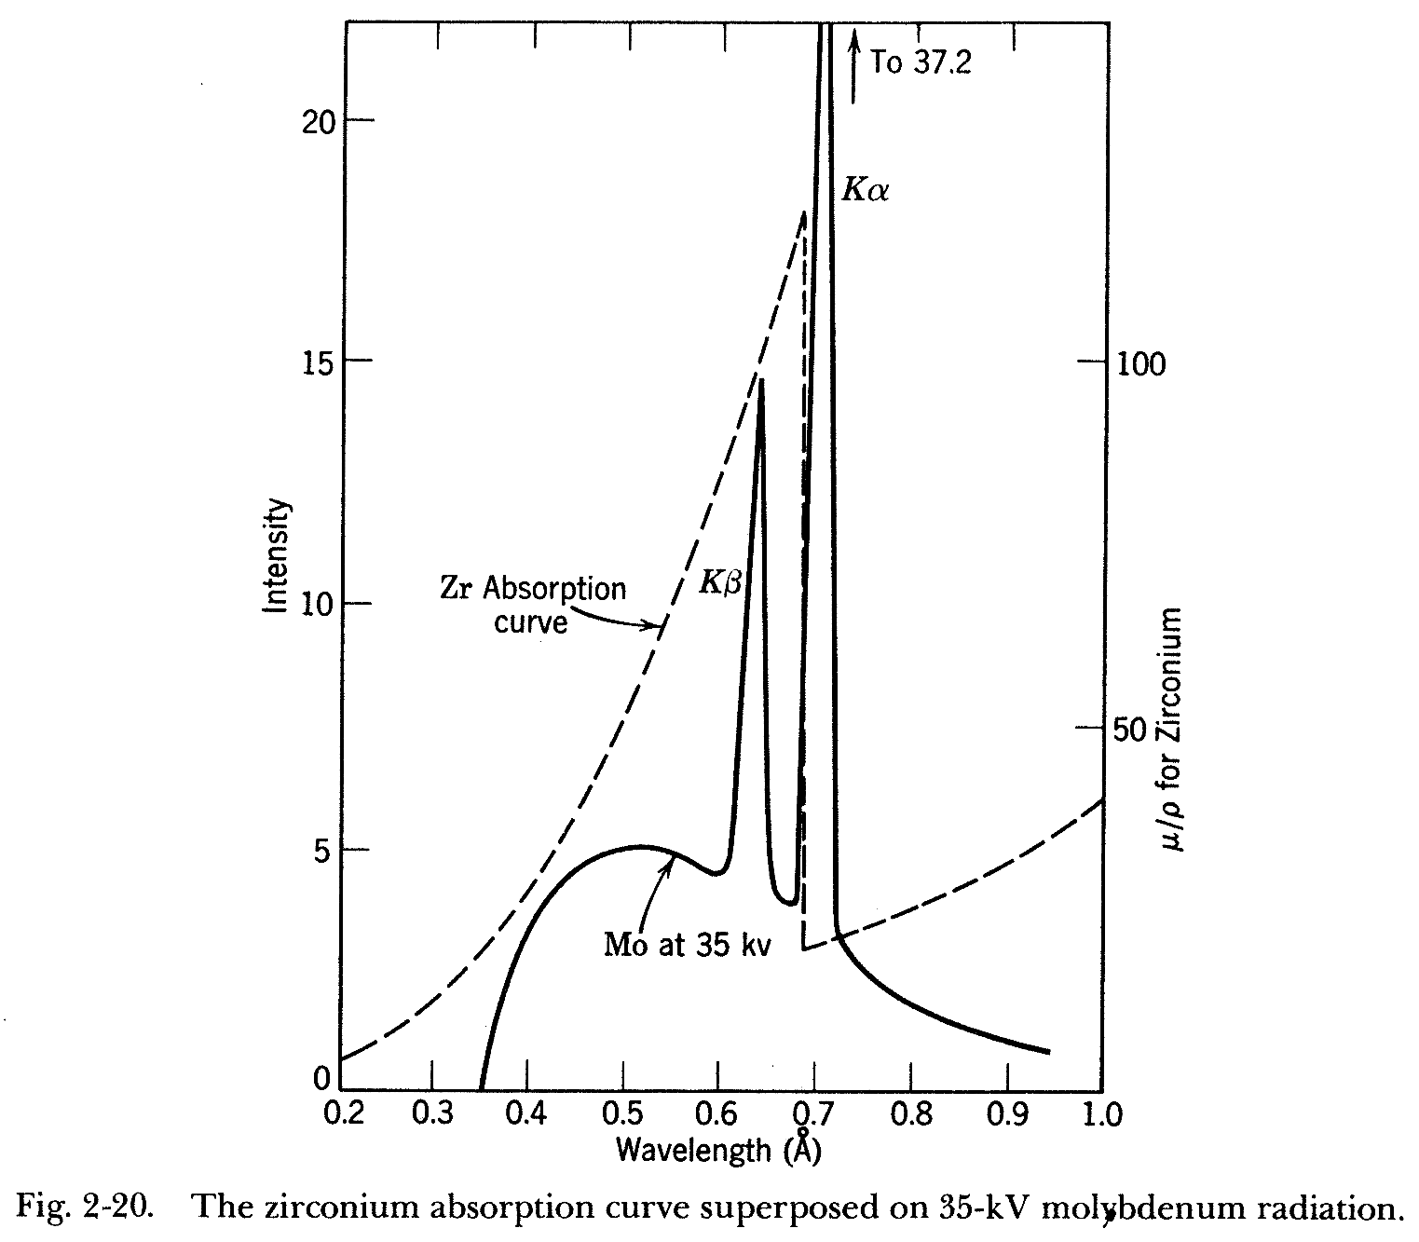
X-ray filters

Slide 33
Fundamentals of X-ray scattering
Brief history
Laboratory X-ray sources,
Basic properties of X-rays,
X-ray spectra,
X-ray absorption edges,
Synchrotron X-ray sources,
Scattering mechanisms of X-rays by matter,
Atomic scattering factors for X-rays
Total X-ray reflection,
Darwin-breadth (qualitatively)
Monochromators (briefly)

Slide 34
correspondence between different radiations

Slide 35
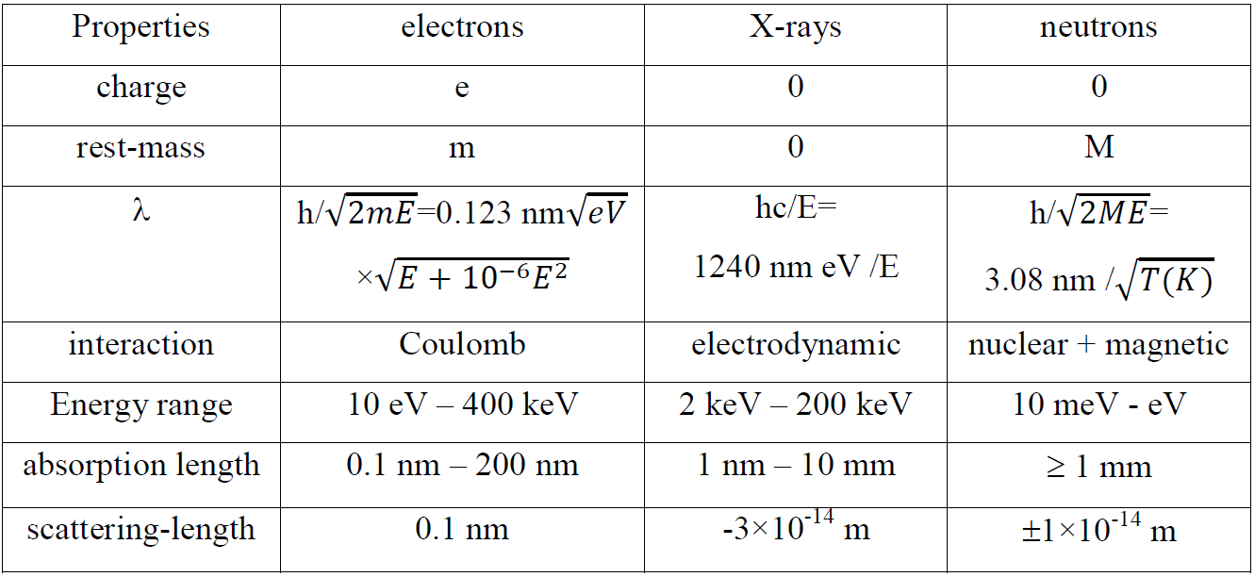
correspondence between different radiations

Slide 36
solving the acronyms
LEED: low energy electron diffraction
AES: Auger electron scattering
EELS: electron energy loss spectroscopy
SEM: scanning electron microscopy
HEED: high energy electron diffraction
TEM: transmission electron microscopy
XRD: X-ray diffraction
Cold/thermal: thermalized neutrons
XPS: X-ray-photon-spectroscopy
Synchrotron: synchrotron source of photons

Slide 37
Fundamentals of X-ray scattering
Brief history
Laboratory X-ray sources,
Basic properties of X-rays,
X-ray spectra,
X-ray absorption edges,
Synchrotron X-ray sources,
Scattering mechanisms of X-rays by matter,
Atomic scattering factors for X-rays
Total X-ray reflection,
Darwin-breadth (qualitatively)
Monochromators (briefly)

Slide 38
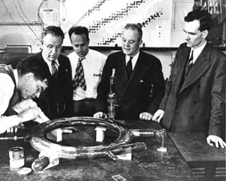
The first ”synchrotron source”
“Synchrotron radiation was seen for the first time at the
General Electric in the USA in 1947”

Slide 39
Brilliance of X-ray sources:
number of fotons
sec × mm²

Slide 40
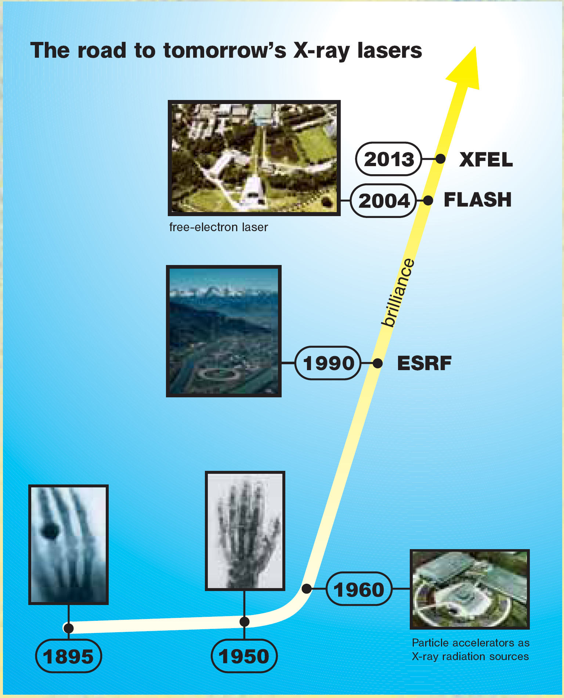
foton/s/mm²
10³⁴
10²⁴
10¹²
10⁸
120 years of
brilliance

Slide 41
Synchrotron X-ray sources
X-ray beam
packages of electrons

Slide 42
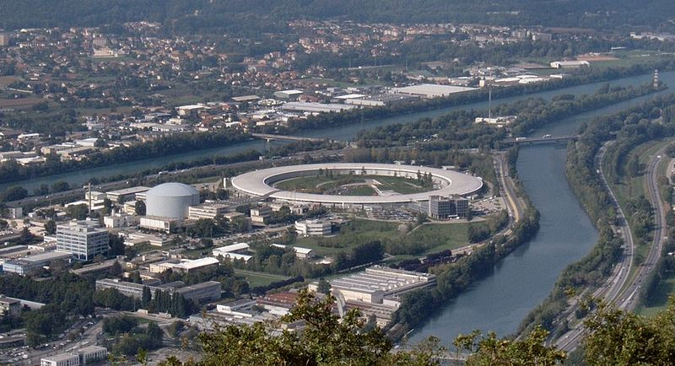
ESRF, Grenoble
European Synchrotron Radiation Facility
ILL

Slide 43
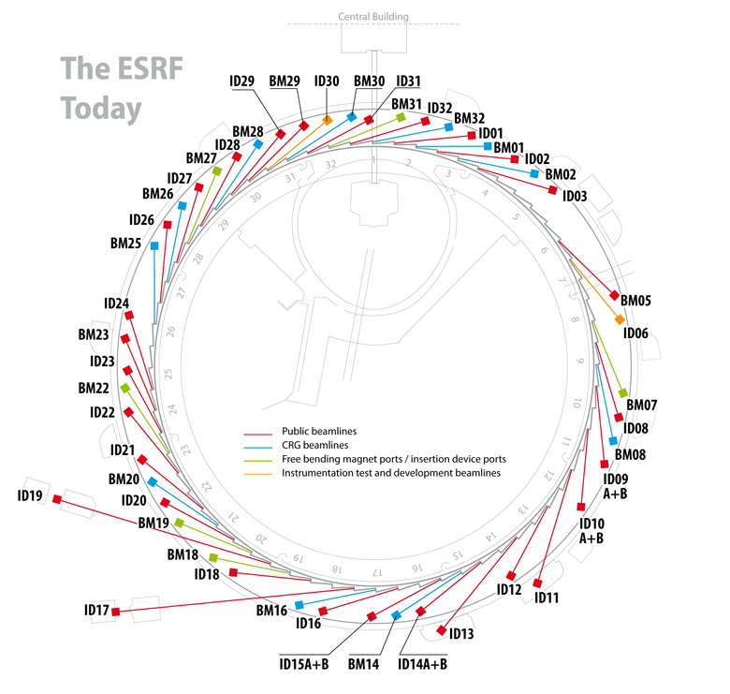
ESRF, Grenoble
European Synchrotron Radiation Facility

Slide 44
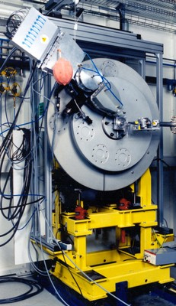
ID31
high resolution
powder diffractometer
∼ 3 m

Slide 45
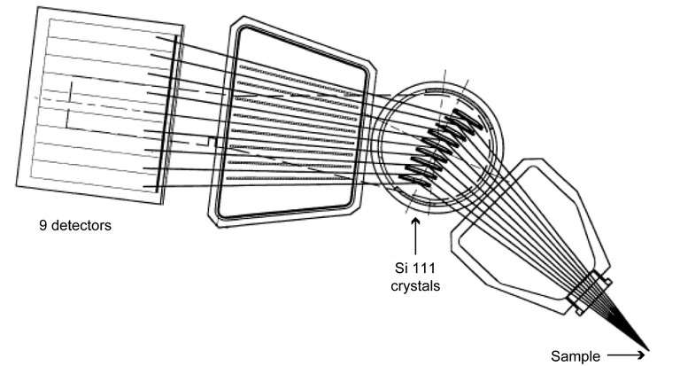
ID31 high resolution powder diffractometer:
detector system

Slide 46
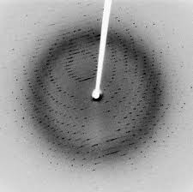
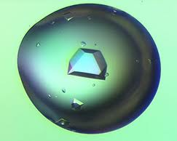
protein crystallography
X-ray beam

Slide 47
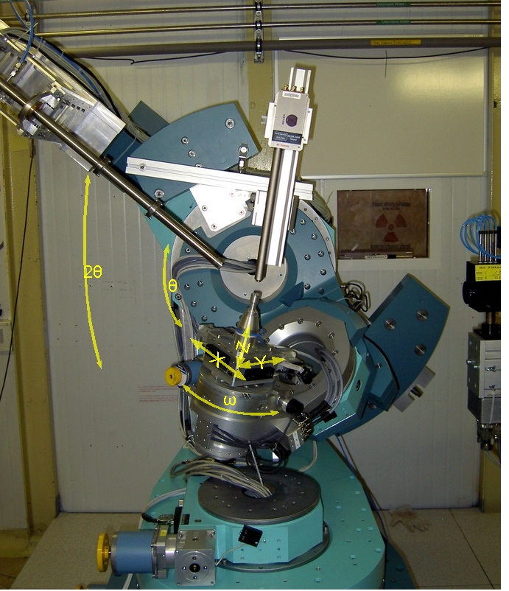
protein crystallography
ESRF, Grenoble
European Synchrotron Radiation Facility

Slide 48
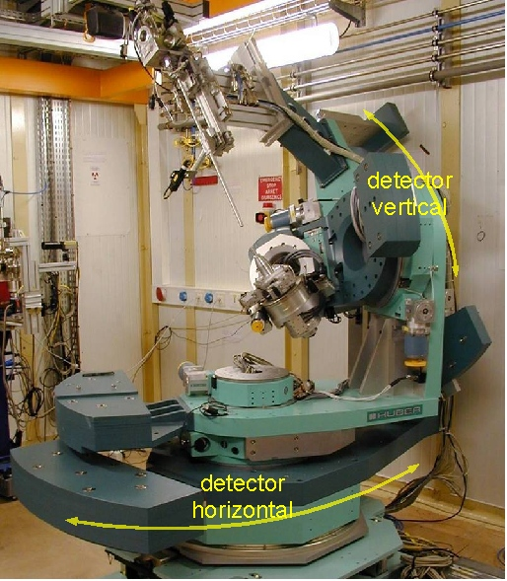
protein crystallography
ESRF, Grenoble
European Synchrotron Radiation Facility

Slide 49
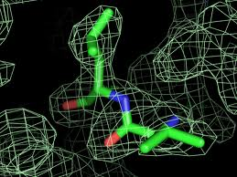
protein crystallography

Slide 50
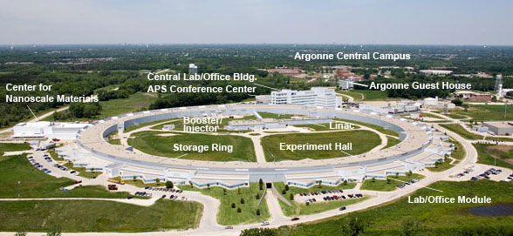
APS, Argonne, IL, USA
Advanced Photon Source

Slide 51
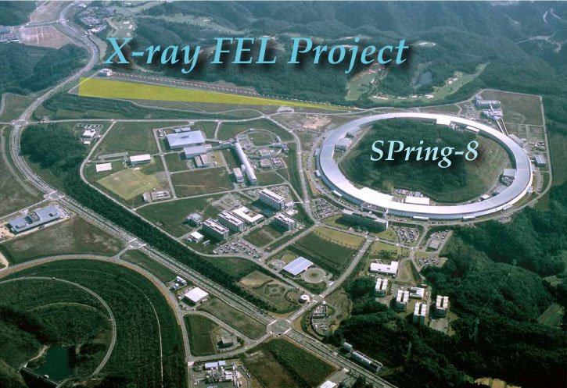
SPring-8
Japan’s synchrotron

Slide 52

SPring-8
Japan’s synchrotron

Slide 53
controlling the path of electrons
incertion devices
  Bending magnet
  Wiggler
  Undulator

Slide 54
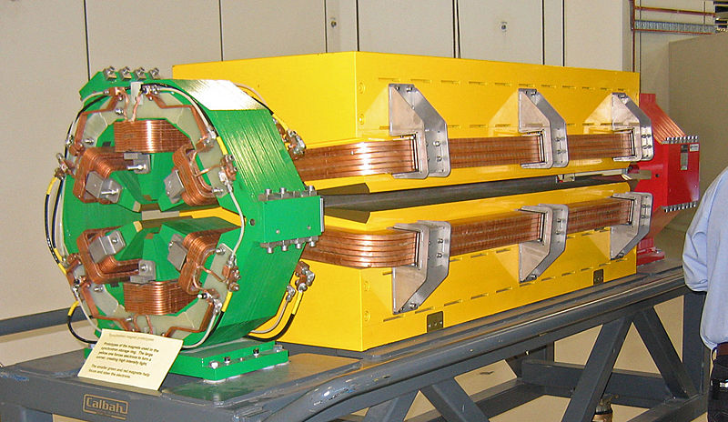
Bending magnet

Slide 55
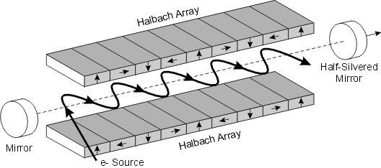
Wiggler
Intensities are adding up

Slide 56
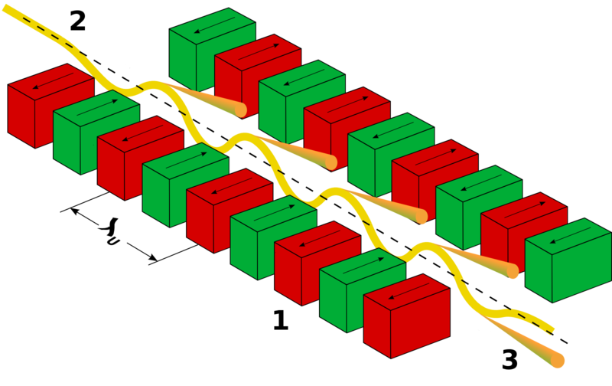
Undulator
the amplitudes are in phase

Slide 57

typical undulator spectrum at APS - Argonne

Slide 58

X-ray spectra at
SPring-8

Slide 59
free electron laser: FEL
a very long undulator

Slide 60
the synchrotron in Hamburg (Germany) today:

Slide 61

schematics of the European Free Electron Laser (XFEL)
3,2 km

Slide 62
Vizsgáló sugárzások
Vizsgálat tárgyai
courtecy: Hastings, Stanford

Slide 63
prospective diffraction on
single molecules
at the European FEL

Slide 64
courtecy: Hajdu, Uppsala

Slide 65
courtecy: Hajdu, Uppsala

Slide 66
Fundamentals of X-ray scattering
Brief history
Laboratory X-ray sources,
Basic properties of X-rays,
X-ray spectra,
X-ray absorption edges,
Synchrotron X-ray sources,
Scattering mechanisms of X-rays by matter,
Atomic scattering factors for X-rays
Total X-ray reflection,
Darwin-breadth (qualitatively)
Monochromators (briefly)

Slide 67

Mechanism of X-ray scattering
E
-
+
•
•
the atom is polarized
-
+
the polarized dipole radiates

Slide 68
Fundamentals of X-ray scattering
Brief history
Laboratory X-ray sources,
Basic properties of X-rays,
X-ray spectra,
X-ray absorption edges,
Synchrotron X-ray sources,
Scattering mechanisms of X-rays by matter,
Atomic scattering factors for X-rays
Total X-ray reflection,
Darwin-breadth (qualitatively)
Monochromators (briefly)

Slide 69




scattering of X-rays by an electron
the electric field, ε, in cgs units:
s
s₀
Warren, X-ray diffraction

Slide 70


scattering of X-rays by an electron
the Y’ component of the electric field at P:
the amplitude is:
the E_{0Z} amplitude (for the E_{Z} φ=90º) :
Y
E_{0Y’}
Warren, X-ray diffraction

Slide 71




scattering of X-rays by an electron
the observed intensity at P:
assuming that the incoming beam is randomly polarized:
and
finally:
polarization factor
for an unpolarized
incoming beam
Warren, X-ray diffraction

Slide 72

scattering of X-rays by an electron
the numerical factor in the scattered intensity:
the number of electrons in the volume illuminated by the incoming beam
in a usual specimen:
∼ 10²²
therefore, the scattered intensity is approximately of-the-order of:
I_{scattered} ∼ I₀ × 10⁻⁴
Warren, X-ray diffraction

Slide 73


scattering of X-rays by an atom
r_{n} is the position of the n-th electron
in the atom
the amplitude scattered by the n-th electron at P:
X₁ << X₂
it can be shown that:
Warren, X-ray diffraction

Slide 74


scattering of X-rays by an atom
turning to complex exponentials and summing over all electrons:
e
electron scattering factor, f_{e}
ρ is the average charge-density distribution
of the electron
f_{e} is the amplitude scattered by an electron in 1-electron-scattering-units
scattering of X-rays by a smeared-out electron
Warren, X-ray diffraction

Slide 75


scattering of X-rays by a smeared-out electron
taking into account the real charge-density distribution: ρ (r)
the atomic scattering-factor:
f is measured in units of
scattering by a single electron
scattering of X-rays by an atom
Warren, X-ray diffraction

Slide 76

atomic scattering factors of X-rays
Klug & Alexander, X-ray diffraction

Slide 77

atomic scattering factors of X-rays
Klug & Alexander, X-ray diffraction

Slide 78


atomic scattering factors of X-rays
at k=0, where k=4πsinθ/λ, sinkr/kr = 1,
i.e. in the forward scattering case, or at small values of 2θ:
Warren, X-ray diffraction

Slide 79

comparison of scattering factors of X-rays and neutrons
scattering factors/lengths

Slide 80

comparison of scattering factors of X-rays and neutrons
q or angle dependence of scattering factor

Slide 81


comparison of scattering factors of X-rays and neutrons

Slide 82
Fundamentals of X-ray scattering
Brief history
Laboratory X-ray sources,
Basic properties of X-rays,
X-ray spectra,
X-ray absorption edges,
Synchrotron X-ray sources,
Scattering mechanisms of X-rays by matter,
Atomic scattering factors for X-rays
Total X-ray reflection,
Darwin-breadth (qualitatively)
Monochromators (briefly)

Slide 83
kinematical vs. dynamical scattering
incident beam
crystal surface
scattering is
back & forth
energy travels
parallel to
the planes
energy
lattice planes in a large crystal
and perfect

Slide 84
kinematical vs. dynamical scattering
incident beam
crystal surface
lattice planes in a small crystal
scattering occurs
one single times

Slide 85
kinematical vs. dynamical scattering
we want to deal with small crystals
where scattering occurs one single times:
this is: kinematical scattering

Slide 86

kinematical vs. dynamical scattering
monochromators are large perfect crystal
scattering occurs in the
dynamical regime
Darwin breadth
Cu (200): 19’’
Si (220): 5.02’’
http://www.chess.cornell.edu/oldchess/operatns/xrclcdwn.htm

Slide 87
Thank you

