Slide 1
Basic Structure of Condensed Materials
Lecture 1

Slide 2
Outline
Motivation
Atomic structure and interatomic bonding
Crystalline materials
Composite materials
Soft materials (Polymers and Biomolecules)
Magnetic materials
Liquids and non-crystalline materials
Phase transition and glass formation

Slide 3
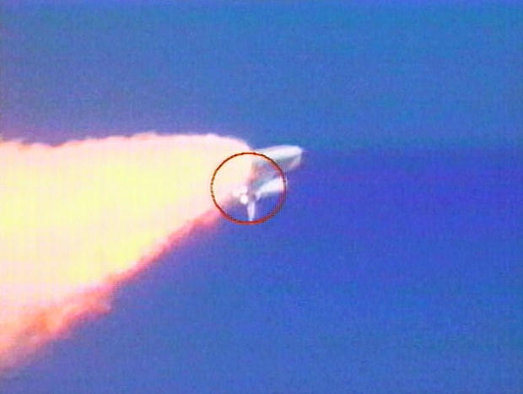
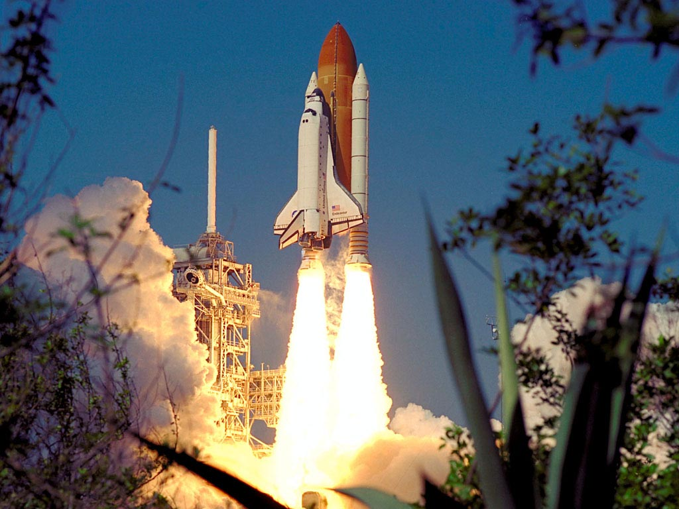
Motivation
Why is understanding the material’s properties important?
That’s easy! Look around.
Materials make modern life possible
the polymers in the chair you’re sitting
the metal ball-point pen you’re using
the concrete that made the building you live or work
Advance made in science and technology
Example: Space Shuttle thermal protection
Up on reentry temperature of outer surface can go up to 2300 degree celsius.
The material should withstand the high temperature and low thermal conductivity

Slide 4
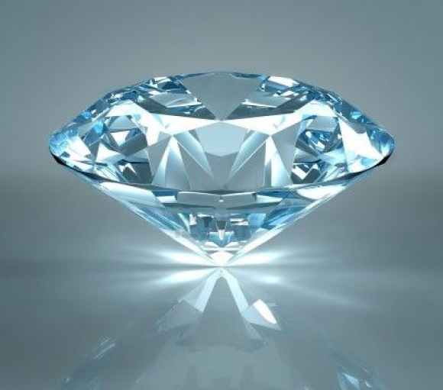
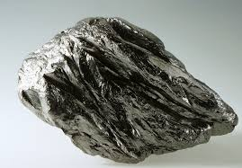
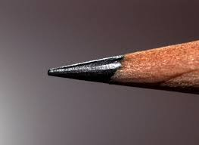
Atomic structure and interatomic bonding
Some of the important properties of solid materials depend on geometrical atomic arrangements, and also the interactions that exist among constituent atoms or molecules.
For example: carbon, which may exist as both graphite and diamond. Whereas graphite is relatively soft and diamond is the hardest known material.
What is the most stable state of carbon?

Slide 5
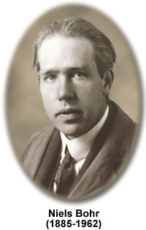
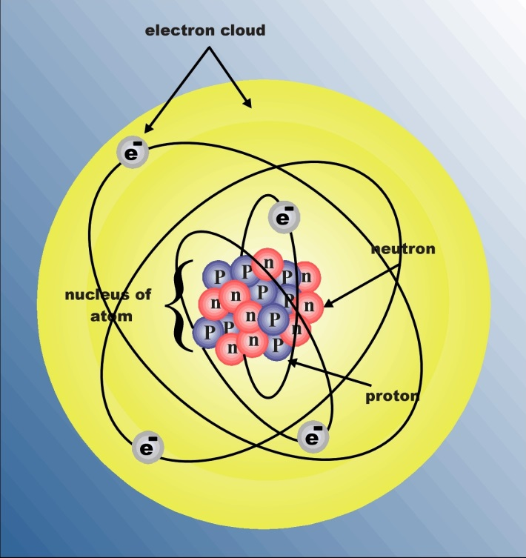
Atomic structure
Atom consists of a very small nucleus composed of protons and neutrons, which is encircled by moving electrons.
Both electrons and protons are electrically charged, the charge magnitude being 1.60×10⁻¹⁹ C, which is negative in sign for electrons and positive for protons; neutrons are electrically neutral.
Each chemical element is characterized by the number of protons in the nucleus, or the atomic number
The atomic mass (A) of a specific atom may be expressed as the sum of the masses of protons and neutrons within the nucleus
The number of protons is the same for all atoms of a given element, the number of neutrons (N) may be variable. Thus atoms of some elements have two or more different atomic masses, which are called isotopes.
How many isotopes does hydrogen atom have?

Slide 6
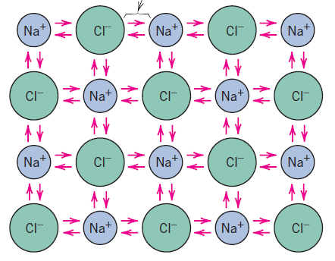
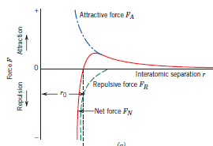
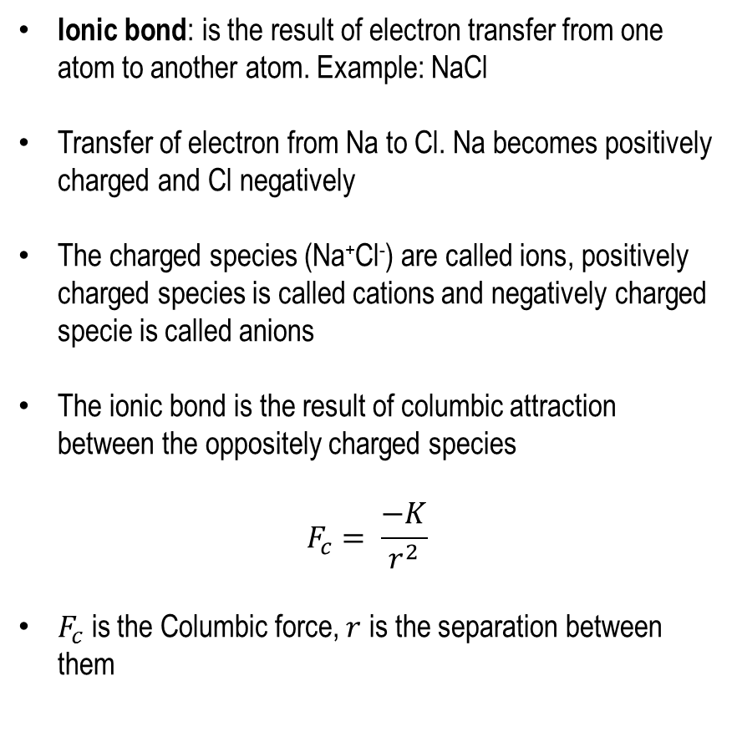
Atomic bonding: Ionic bonding
Ionic bond: is the result of electron transfer from one atom to another atom. Example: NaCl
Transfer of electron from Na to Cl. Na becomes positively charged and Cl negatively
The charged species (Na⁺Cl⁻) are called ions, positively charged species is called cations and negatively charged specie is called anions
The ionic bond is the result of columbic attraction between the oppositely charged species
$$F_{c}= \frac{−K}{r^{2}}$$
$F_{c}$ is the Columbic force, $r$ is the separation between them

Slide 7
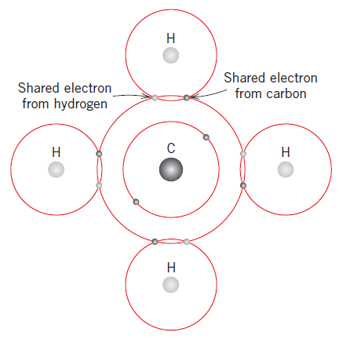
Atomic bonding: Covalent bonding
Covalent bonding: The cooperative sharing of valance electron, example: CH₄
Two atoms that are covalently bonded will each contribute at least one electron to the bond, and the shared electrons may be considered to belong to both atoms.
Covalent bonding is schematically illustrated in figure for a molecule of methane . The carbon atom has four valence electrons, whereas each of the four hydrogen atoms has a single valence electron. Each hydrogen atom can acquire a helium electron configuration (two 1s valence electrons) when the carbon atom shares with it one electron. The carbon now has four additional shared electrons, one from each hydrogen, for a total of eight valence electrons, and the electron structure of neon.
The covalent bond is directional; that is, it is between specific atoms and may exist only in the direction between one atom and another that participates in the electron sharing.
Many nonmetallic elemental molecules as well as molecules containing dissimilar atoms, such as and HF, are covalently bonded.
Elemental solids such as diamond (carbon), silicon, and germanium
Solid compounds composed of elements that are located on the right-hand side of the periodic table, such as gallium arsenide (GaAs), indium antimonide (InSb), and silicon carbide (SiC).

Slide 8
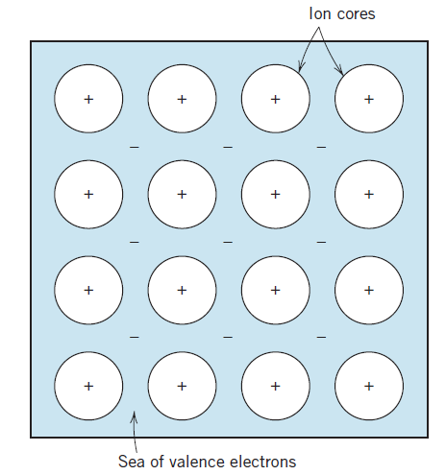
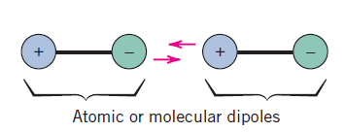
Atomic bonding: Metallic bonding
Metallic materials have one, two, or at most, three valence electrons. These valence electrons are not bound to any particular atom in the solid and are more or less free to drift throughout the entire metal. They may be thought of as belonging to the metal as a whole, or forming a “sea of electrons” or an “electron cloud.” The remaining non-valence electrons and atomic nuclei form ion cores, which possess a net positive charge equal in magnitude to the total valence electron charge per atom.
The free electrons shield the positively charged ion cores from mutually repulsive electrostatic forces, which they would otherwise exert upon one another; consequently the metallic bond is non-directional in character.
Example: metals and their alloys.
Secondary or van der Waals bonding
In this types of bonding the outer valance electrons are shared. This is similar to ionic bonding but the difference is no electrons are transferred.
Which is the strongest chemical bond?

Slide 9
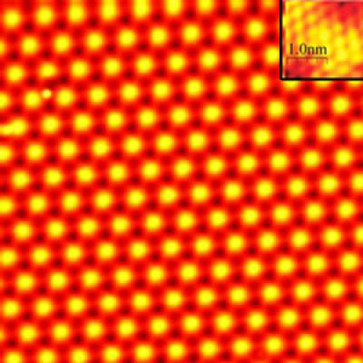
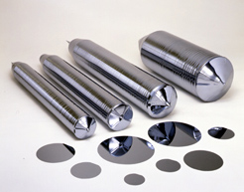
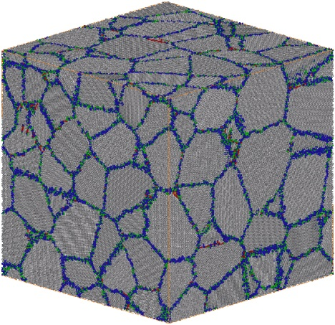
Crystal structure
A crystalline material is one in which the atoms are situated in a repeating or periodic array over large atomic distances; that is, long-range order exists, such that upon solidification, the atoms will position themselves in a repetitive three-dimensional pattern, in which each atom is bonded to its nearest-neighbor atoms.
All metals, many ceramic materials, and certain polymers form crystalline structures under normal solidification conditions.
The properties of crystalline solids depend on the crystal structure
Crystal structure of the material is the manner in which atoms, ions, or molecules are spatially arranged
Single-crystalline materials: Has no boundaries, so there is complete uniformity of crystal structure over the entire crystal.
Polycrystalline materials: The overall crystalline structure is composed of highly-ordered units, with grain boundaries between individual crystals.
Single crystals
A polycrystalline materials

Slide 10
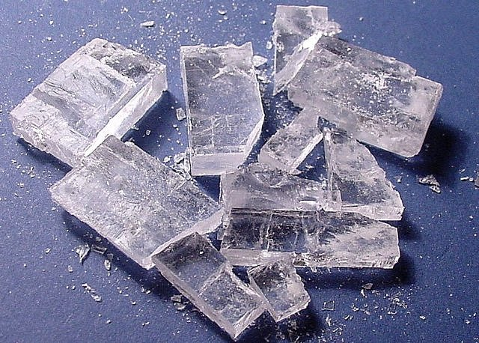
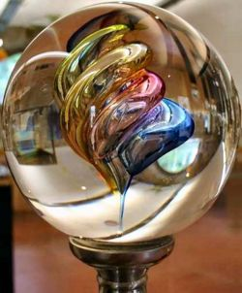

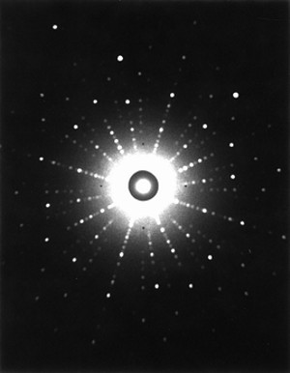
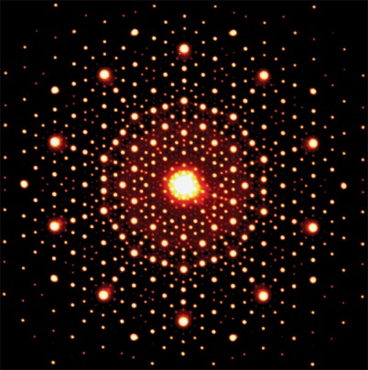
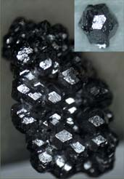
Crystal, amorphous and quasicrystal
Salt Crystal
Crystals: usually form with certain geometrical shape and some geometrical features, such as flat surface, sharp corners, sharp edges. For example, salt crystal.
Amorphous solids: do not have preferential geometrical shape for features. Example: glass
Quasicrystals: A quasicrystal is a structure that is ordered but not periodic. A quasicrystalline pattern can be continuously filled in all available space, but it lacks translational symmetry.
Amorphous solid
Quasicrystals
Laue diffraction: Crystal
Laue diffraction: quasicrystal
Dan Shechtman

Slide 11
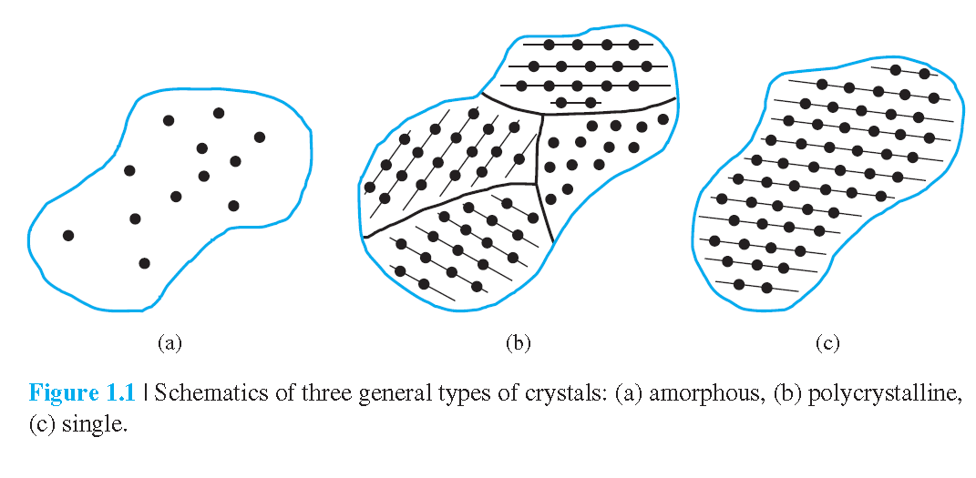
Amorphous, polycrystalline and single crystals

Slide 12
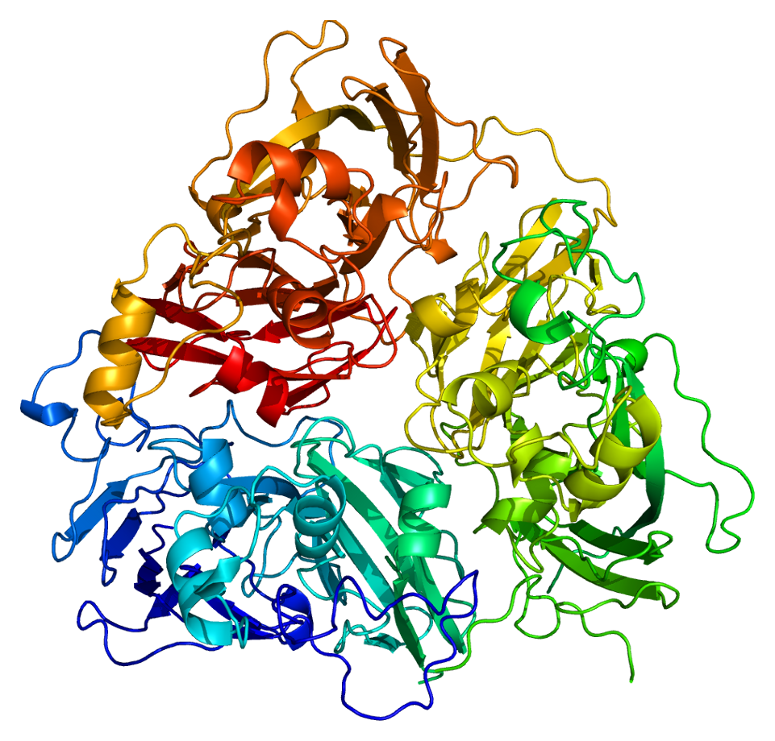
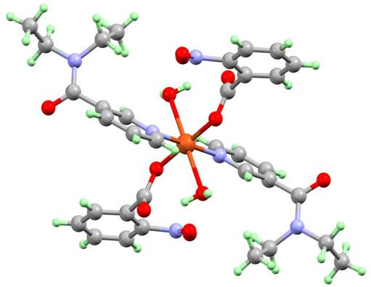
Protein and biomolecule:
Protein and (2) A biomolecule: Can these molecules form crystals or a periodic
pattern?

Slide 13
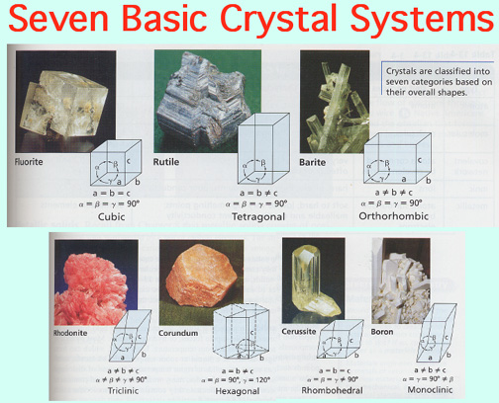

Slide 14
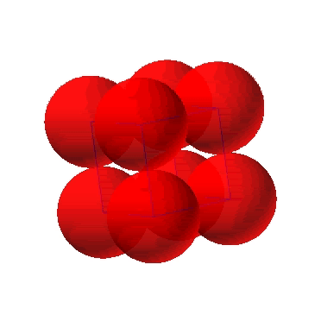
Simple Cubic Structure (SC)
Rare due to low packing density (only Po has this structure)
Close-packed directions are cube edges.
Coordination number (number of nearest neighbors) = 6

Slide 15
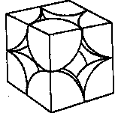
Atomic Packing Factor (APF):SC
Volume of atoms in unit cell*
APF =
Volume of unit cell
*assume hard spheres
• APF for a simple cubic structure = 0.52
volume
atoms
atom
a
4
3
unit cell
1
π
(0.5a)
3
R=0.5a
APF =
a
3
volume
close-packed directions
unit cell
contains 8 x 1/8 =
1
atom/unit cell

Slide 16
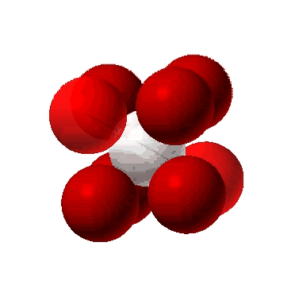
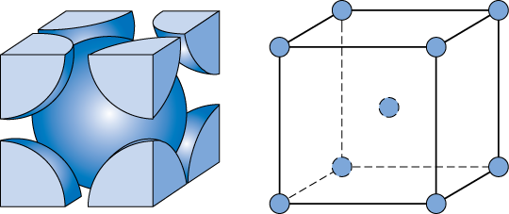
Body Centered Cubic Structure (BCC)
• Atoms touch each other along cube diagonals.
--Note: All atoms are identical; the center atom is shaded
differently only for ease of viewing.
ex: Cr, W, Fe (α), Tantalum, Molybdenum
• Coordination number = 8
Adapted from Fig. 3.2,
Callister & Rethwisch 8e.
2 atoms/unit cell: 1 center + 8 corners x 1/8

Slide 17
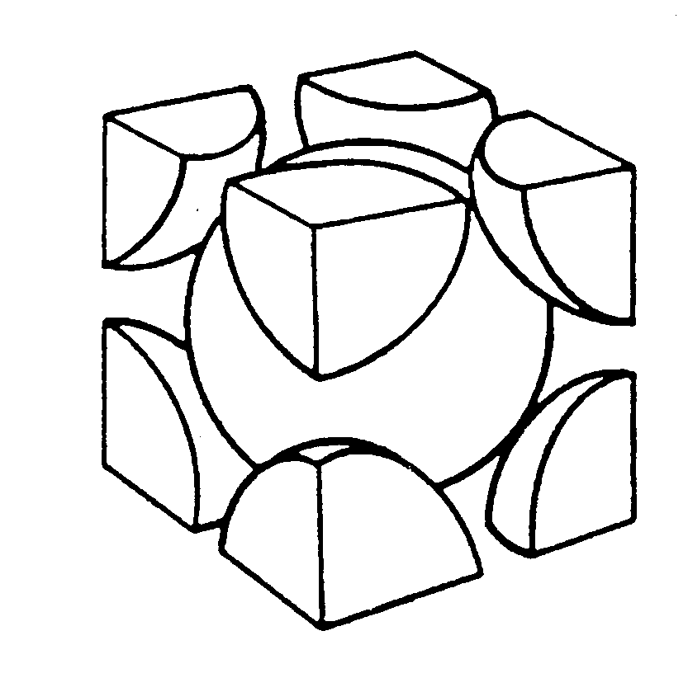
Atomic Packing Factor: BCC
• APF for a body-centered cubic structure = 0.68
3
a
a
2
a
Close-packed directions:
Adapted from
Fig. 3.2(a), Callister & Rethwisch 8e.
R
length = 4R =
3 a
a
atoms
volume
4
3
unit cell
2
π
(
3
a/4
)
3
atom
APF =
3
volume
a
unit cell

Slide 18
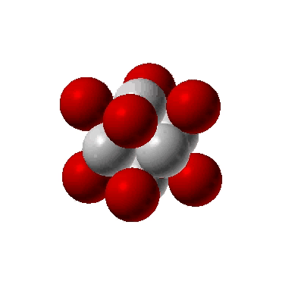
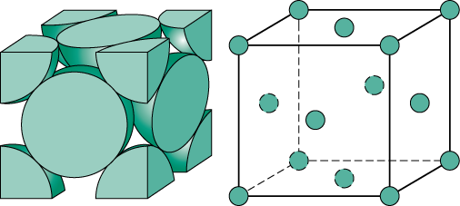
Face Centered Cubic Structure (FCC)
• Atoms touch each other along face diagonals.
--Note: All atoms are identical; the face-centered atoms are shaded
differently only for ease of viewing.
ex: Al, Cu, Au, Pb, Ni, Pt, Ag
• Coordination number = 12
Adapted from Fig. 3.1, Callister & Rethwisch 8e.
Click once on image to start animation
4 atoms/unit cell: 6 face x 1/2 + 8 corners x 1/8
(Courtesy P.M. Anderson)

Slide 19
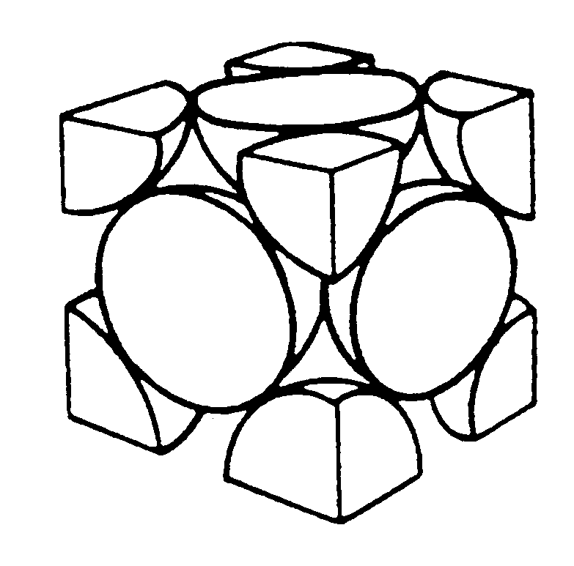
Atomic Packing Factor: FCC
• APF for a face-centered cubic structure = 0.74
maximum achievable APF
Close-packed directions:
length = 4R =
2 a
2 a
Unit cell contains:
6 x 1/2 + 8 x 1/8
=
4 atoms/unit cell
a
Adapted from
Fig. 3.1(a),
Callister & Rethwisch 8e.
atoms
volume
4
3
unit cell
4
π
(
2
a/4
)
3
atom
APF =
3
volume
a
unit cell

Slide 20
FCC Stacking Sequence
• ABCABC... Stacking Sequence
• 2D Projection
B
B
B
B
C
C
C
A
A
A
B
B
B
B
B
B
A sites
B
C
C
C
C
C
C
B
B
sites
sites
B
B
B
B
C
sites
A
• FCC Unit Cell
B
C

Slide 21
Hexagonal Close-Packed Structure (HCP)
• ABAB... Stacking Sequence
• 3D Projection
• 2D Projection
A sites
Top
layer
c
B
sites
Middle layer
A sites
Bottom layer
a
Adapted from Fig. 3.3(a),
Callister & Rethwisch 8e.
• Coordination number = 12
6 atoms/unit cell
• APF = 0.74
ex: Cd, Mg, Ti, Zn
• c/a = 1.633

Slide 22
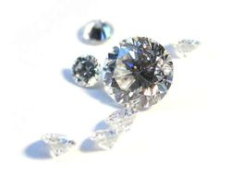
Diamond and Zinc blende Crystal Structure
The diamond structure or the zinc blende structure is basically a face-centered cubic structure, with a basis of two atoms. For the diamond structure, the two atoms are identical, while they are different for the zinc blende structure.
Crystal structure of semiconductors
Diamond structure: Si, Ge
Zinc blende: GaAs, InP
Number of atoms in a unit cell of diamond structure: = 8
Co-ordination number : Number of nearest neighbor: = 4
Assuming atoms are hard spheres and radius of the hard sphere is r, and a is the lattice spacing, calculate the relation between r and a ?
r =

Slide 23
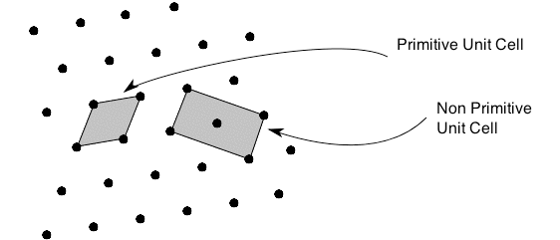
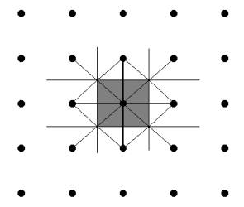
Unit cell and primitive cell
A unit cell is the smallest volume of the crystal that can be used to produce the entire crystal or smallest building block.
A primitive cell is the smallest unit cell that can be repeated to from the lattice.
Draw lines to connect lattice points to all nearby lattice points
At the midpoint and normal to the line draw new lines
The smallest volume enclosed in this way is the primitive cell
What is the unit and primitive cell of a FCC lattice?

Slide 24
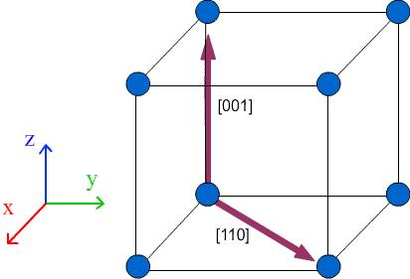
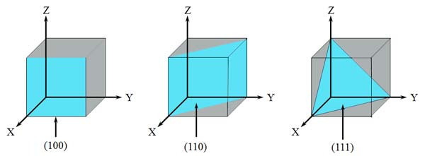
Lattice plane and directions
The crystallographic directions are lines linking lattice points of a crystal.
The crystallographic planes are planes linking lattice points.
Lattice directions are written the same way as lattice vectors, in the form [UVW]. The direction in which the lattice vector is pointing is the lattice direction.
The difference between lattice directions and lattice vectors is that a lattice vector has a magnitude which can be shown by prefixing the lattice vector with a constant. By convention U, V and W are integers.
Crystal planes: Parentheses ()
Crystal directions: Brackets []
http://www.doitpoms.ac.uk/tlplib/miller_indices/lattice_draw.php

Slide 25
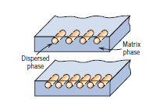
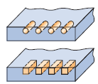
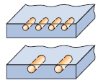
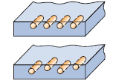
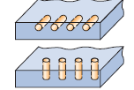
Composite materials
Generally composite materials are composed of just two phases; one is termed the matrix, which is continuous and surrounds the other phase, often called the dispersed phase.
The properties of composites are a function of the properties of the constituent phases, their relative amounts, and the geometry of the dispersed phase.
Dispersed phase geometry: means the shape of the particles and the particle size, distribution, and orientation
shape
size
distribution
orientation

Slide 26
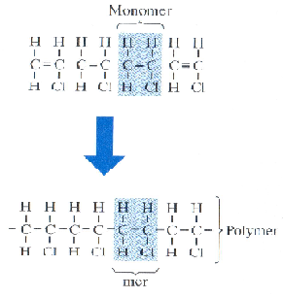
Polymers
The term polymer means “many mers” where mer is the building block of the long-chain network
Polymerization: The process by which long-chain molecules are made from relatively small organic molecules
Two ways of polymerization:
(1) Chain growth: Rapid chain reaction of chemically activated monomers
(2) Step growth: individual chemical reaction between pairs of reactive monomers
Vinyl chloride (C₂H₃Cl)_{n}

Slide 27
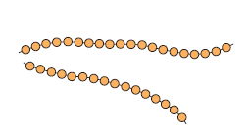
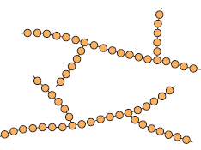
Molecular structure of polymers
Linear polymers: The repeated units are joined together end to end in single chain
Example: Polyethylene, Poly(vinyl chloride) and Polystyrene
Branched polymers: The side branch chain are connected to the main chain
Example: high density polyethylene (HDPE)

Slide 28
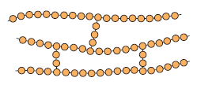
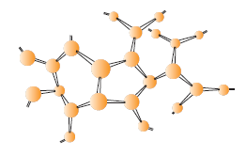
Molecular structure of polymers
Cross linked polymers: The adjacent linear chains are joined one to another at various
position by covalent bonds. Examples: Rubber
Network polymers: Multifunctional monomers forming three or more active covalent bonds makes three dimensional network are called network polymers.
Examples: Epoxies, polyurethane and phenolformaldehyde

Slide 29
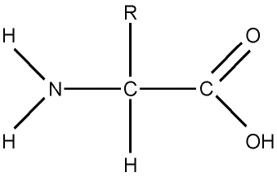
Biomolecules
Proteins and DNA: The proteins and DNA are biopolymers containing large number of amino acids joined to each other by peptide bonds. In proteins the monomers are a group of about 20 amino acids
Composed of chains of amino acids
20 amino acids exist
Amino acids contain
Central Carbon
Amine group
Carboxyl group
R group

Slide 30
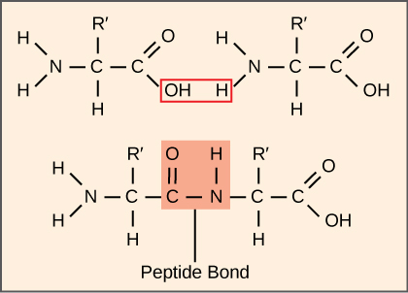

Biomolecules
Peptide bonds occur between amino acids
The COOH group of 1 amino acid binds to the NH2 group of another amino acid forms a peptide bond
The chain (polymer) of amino acids forms a variety of loops, coils, and folded sheets from an assortment of bonds and attractions between amino acids within the chain(s)

Slide 31

Structure of proteins
Structure of proteins: The structure of both protein and biopolymers are divided into four levels of organization
Primary structure: is the order of the monomer, i.e., the sequence of the amino acids for a protein, or nucleotides in the case of DNA and RNA
Secondary structure: is the folding or coiling of the original polymer chains by means of hydrogen bonding. In the case of protein, the hydrogen bonds are between the atoms of the polypeptide backbone

Slide 32
Biomolecules
Tertiary structure: is the further folding that gives the final 3-D structure of a single polymer chain
Quaternary structure: is the assembly of several separate polymer chain

Slide 33

Nucleic acids: DNA
DNA = deoxyribonucleic acid
DNA is a double polymer (chain)
Each chain is made of nucleotides
The 2 chains bond together to form a helix

Slide 34

DNA nucleotides
Each nucleotide in DNA contains:
5-C sugar
(deoxyribose)
Phosphate
Nitrogen base
-adenine (A)
-guanine (G)
-cytosine (C)
-thymine (T)

Slide 35

Fig. 3.15
The DNA “double helix”

Slide 36



Magnetic materials
Magnetic dipoles: Magnetic dipoles can be thought of as small bar magnets composed of north and south poles. Magnetic dipoles are influenced by magnetic fields
Origins of magnetic moments: Each electron in an atom has magnetic moments that originate from two sources.
(1) Orbital motion around the nucleus: being a moving charge, an electron may be considered to be a small current loop, generating a very small magnetic field, and having a magnetic moment along its axis of rotation
(2) Each electron may also spinning around an axis: the other magnetic moment originates from this electron spin. Spin magnetic moments may be only in an “up” direction or in an antiparallel “down” direction. Thus each electron in an atom may be thought of as being a small magnet having permanent orbital and spin magnetic moments.

Slide 37

Magnetic materials
The most fundamental magnetic moment is the Bohr magneton which is of magnitude. For each electron in an atom the spin magnetic moment is (plus for spin up, minus for spin down).
The orbital magnetic moment contribution is equal to being the magnetic quantum number of the electron.
DIAMAGNETISM: is a very weak form of magnetism that is nonpermanent and persists only while an external field is being applied. It is induced by a change in the orbital motion of electrons due to an applied magnetic field. The magnitude of the induced magnetic moment is extremely small, and in a direction opposite to that of the applied field. Examples: Lead, Copper, Silver etc.

Slide 38

Magnetic materials
Paramagnetism: For some solid materials, each atom possesses a permanent dipole moment by virtue of incomplete cancellation of electron spin and/or orbital magnetic moments. In the absence of an external magnetic field, the orientations of these atomic magnetic moments are random, such that a piece of material possesses no net macroscopic magnetization. These atomic dipoles are free to rotate, and paramagnetism results when they preferentially align, by rotation, with an external field. Examples: Lithium, Sodium, Tungsten etc.

Slide 39

Magnetic materials
Certain metallic materials possess a permanent magnetic moment in the absence of an external field, and manifest very large and permanent magnetizations. These are the characteristics of ferromagnetism. Examples: Co, Fe, Ni etc.
Permanent magnetic moments in ferromagnetic materials result from atomic magnetic moments due to electron spin—uncancelled electron spins as a consequence of the electron structure. There is also an orbital magnetic moment contribution that is small in comparison to the spin moment. Furthermore, in a ferromagnetic material, coupling interactions cause net spin magnetic moments of adjacent atoms to align with one another, even in the absence of an external field.
This mutual spin alignment exists over relatively large volume regions of the crystal called domains

Slide 40


Magnetic materials
Antiferromagnetism: This phenomenon of magnetic moment coupling between adjacent atoms or ions occurs in materials other than those that are ferromagnetic. In one such group, this coupling results in an antiparallel alignment; the alignment of the spin moments of neighboring atoms or ions in exactly opposite directions is termed antiferromagnetism. Manganese oxide (MnO)
Ferrimagnetism: Some ceramics also exhibit a permanent magnetization, termed ferrimagnetism. The macroscopic magnetic characteristics of ferromagnets and ferrimagnets are similar. In ferrimagnetic materials, the opposing moments are unequal and a spontaneous magnetization remains. Example: Fe₃O₄

Slide 41



Liquids and non-crystalline materials
Liquid is one of the four fundamental states of matter (the others being solid, gas, and plasma), and is the only state with a definite volume but no fixed shape.
Amorphous solids (non-crystalline solids) are solid materials that do not possess the long-range order (periodicity) characteristic of crystals
Glass are amorphous solids obtained by cooling a melt. Or, more generally, amorphous solids that exhibit a glass transition when heated.

Slide 42


Preparation methods of amorphous materials
• Melt quenching
• Splat cooling
• Melt spinning
• Thermal evaporation
• Sputtering
• Chemical vapor deposition
• Sol-gel processes
• Electrolytic deposition
• Reaction amorphization
• Irradiation
• Pressure-induced amorphization
• Solid-state diffusional amorphization
melt spinning
~ 10⁷ K/s
melt quenching
splat cooling
thermal evaporation
~ 10⁻³ K/s
~ 10² K/s
~ 10⁵ K/s
~ 10¹⁰ K/s

Slide 43
Crystallization is controlled by thermodynamics
Volume is high as a hot liquid
Volume shrinks as liquid is cooled
At the melting point, T_{m}, the liquid crystallizes to the thermodynamically stable crystalline phase
More compact (generally) crystalline phase has a smaller volume
The crystal then shrinks as it is further cooled to room temperature
Slope of the cooling curve for liquid and solid is the thermal expansion coefficient, α
T_{m}
α_{liquid} >>α_{crystal}
α_{liquid}
Volume
liquid
ΔV_{crystallization}
crystal
α_{crystal}
Temperature

Slide 44
Glass formation is controlled by kinetics
Glass forming liquids are those that are able to “by-pass” the melting point, T_{m}
Liquid may have a high viscosity that makes it difficult for atoms of the liquid to diffuse (rearrange) into the crystalline structure
Liquid maybe cooled so fast that it does not have enough time to crystallize
Two time scales are present
“Internal” time scale controlled by the viscosity (bonding) of the liquid
“External” timescale controlled by the cooling rate of the liquid
supercooled
liquid
Molar Volume
liquid
glass
Temperature

Slide 45

Phase transition
A phase transition is the transformation of a thermodynamic system from one phase or state of matter to another
Rich and complex phase diagram, well established over a wide range of P&T
15 Known ice phases
Several triple points
Possibly two critical points
A critical point, also known as a critical state, occurs under conditions (such as specific values of temperature, pressure or composition) at which no phase boundaries exist.
There are multiple types of critical points, including vapor–liquid critical points and liquid–liquid critical points.
Pressure-Temperature phase diagram of water

Slide 46
Phase transition
Eutectic transformation: a two component single phase liquid is cooled and transforms into two solid phases.
Peritectic transformation: a two component single phase solid is heated and transforms into a solid phase and a liquid phase.
Spinodal decomposition: a single phase is cooled and separates into two different compositions of that same phase.
Transition to a mesophase between solid and liquid, such as one of the "liquid crystal" phases.
The transition between the ferromagnetic and paramagnetic phases of magnetic materials at the Curie point.
Displacive phase transformations: martensitic transformation which occurs as one of the many phase transformations in carbon steel.
Changes in the crystallographic structure such as between ferrite and austenite of iron.
Order-disorder transitions such as in alpha-titanium aluminides.
The transition between different molecular structures (polymorphs, allotropes or polyamorphs), especially of solids, such as between an amorphous structure and a crystal structure, between two different crystal structures, or between two amorphous structures.
Quantum condensation of bosonic fluids (Bose–Einstein condensation). The superfluid transition in liquid helium is an example of this.

Slide 47
Phase transition
First-order phase transitions are those that involve a latent heat. During such a transition, a system either absorbs or releases a fixed (and typically large) amount of energy.
Second-order phase transitions are also called continuous phase transitions. They are characterized by a divergent susceptibility, an infinite correlation length, and a power-law decay of correlations near criticality. Examples of second-order phase transitions are the ferromagnetic transition, superconducting transition (for a Type-I superconductor the phase transition is second-order at zero external field and for a Type-II superconductor the phase transition is second-order for both normal state-mixed state and mixed state-superconducting state transitions) and the superfluid transition.
The liquid-glass transition is observed in many polymers and other liquids that can be supercooled far below the melting point of the crystalline phase. This is atypical in several respects. It is not a transition between thermodynamic ground states: it is widely believed that the true ground state is always crystalline. Glass is a quenched disorder state, and its entropy, density, and so on, depend on the thermal history. Therefore, the glass transition is primarily a dynamic phenomenon: on cooling a liquid, internal degrees of freedom successively fall out of equilibrium

Slide 48
Thank you

