Slide 1
Fundamentals of Neutron Scattering
Lecture 2

Slide 2
Outline
Discovery of neutron
Properties of neutron
Production of neutrons
Neutron moderators
Transport of neutrons
Neutron interactions with matter
Detection of neutrons
Neutron scattering
Coherent and incoherent scattering
Principle of detailed balance

Slide 3
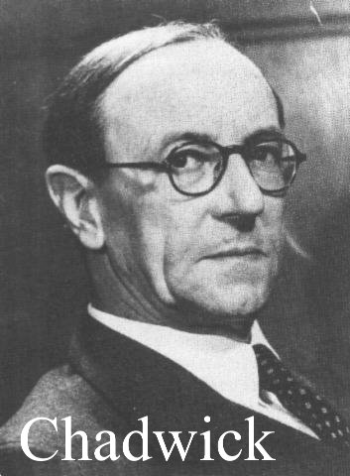
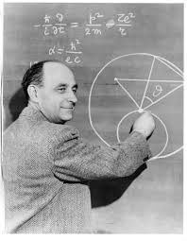
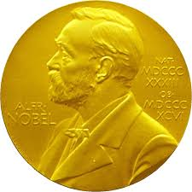
Discovery of neutron
The neutron was discovered in 1932 by James Chadwick
Coherent neutron diffraction (Bragg scattering by crystal lattice planes) was first demonstrated in 1936 by Mitchel & Powers (MgO) and Halban & Preiswerk (Fe).
The possibility of using the scattering of neutrons as a probe of materials developed with the availability of slow neutrons from reactors after 1945. Fermi's group used Bragg scattering to measure nuclear cross-sections
James Chadwick: Nobel Prize in physics 1935
Enrico Fermi: Nobel Prize in physics 1938

Slide 4
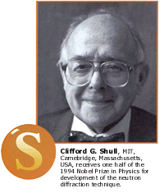
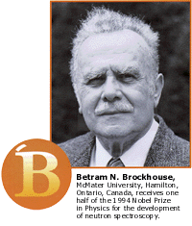
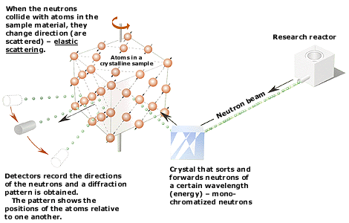
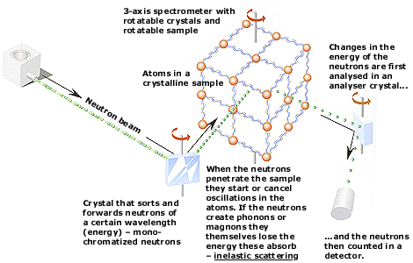
History of neutron scattering
Brockhouse is the first person to develop slow neutron spectroscopy to study the excitations of atoms in condensed matter.
The energy of thermal neutron is comparable to the quantum energy or phonon in a normal mode of vibration of a crystal
Neutrons see..
where atoms are….(Structure)
… and what atoms do. (Dynamics)
Notes:
Starting to measurements of AF in single powders of MnO

Slide 5
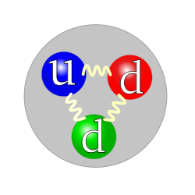
Properties of neutron
Mass of the neutron
M_{n} = 1.675 x 10⁻²⁷ Kg
M_{p} (mass of a Proton) = 1.673 x 10⁻²⁷ Kg
M_{e} (mass of an Electron) = 9.109 × 10⁻³¹ Kg
Electric Charge
Charge of a Neutron = 0
Charge of Proton = 1.602 x 10⁻¹⁹ C
Charge of Electron = -1.602 x 10⁻¹⁹ C
Spin angular momentum (Spin)
Spin of a Neutron = ½
Spin of a Proton = ½
Spin of an Electron = ½
Magnetic dipole moment:
μ_{n} = 9.6623640×10⁻²⁷ J.T⁻¹ (-1.913 μ_{N})
μ_{p =} 14.106067 × 10⁻²⁷ J⋅T⁻¹
μ_{e =} −9284.764 × 10⁻²⁷ J⋅T⁻¹ (Joule/Tesla)
What is the origin of magnetic dipole moment of neutron?
The non-zero magnetic moment of the neutron indicates that it is not an elementary particle.

Slide 6
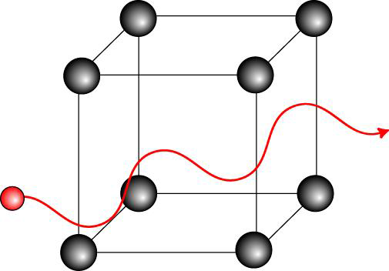
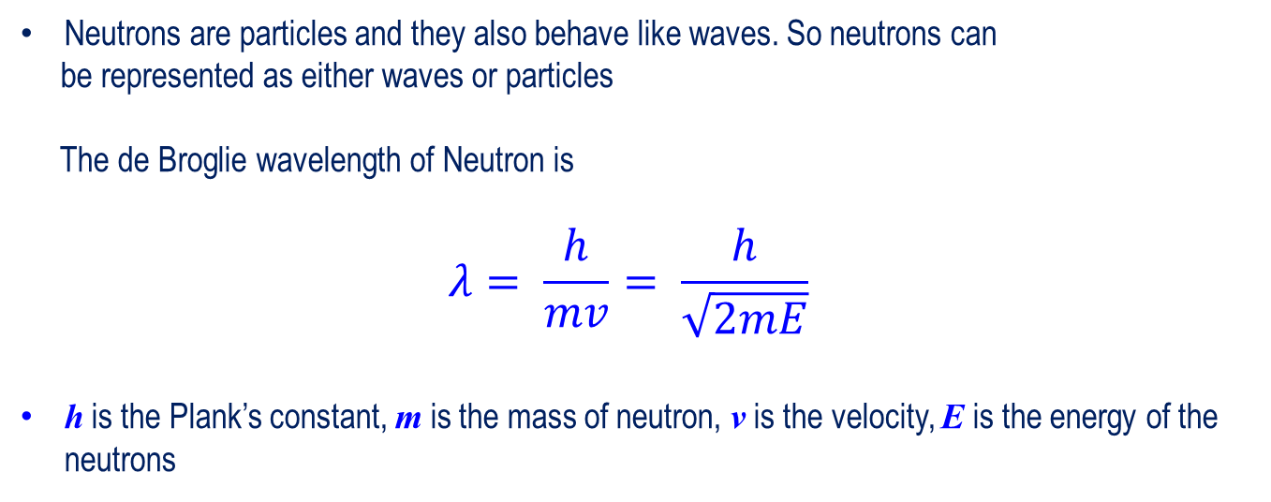
Properties of neutron
Neutrons are particles and they also behave like waves. So neutrons can
be represented as either waves or particles
The de Broglie wavelength of Neutron is
$$λ= \frac{h}{mv}= \frac{h}{\sqrt{2mE}}$$
h is the Plank’s constant, m is the mass of neutron, v is the velocity, E is the energy of the neutrons
 | Energy (meV) | Temperature (K) | Wavelength (nm)
Cold | 0.1- 10 | 1-120 | 0.4-3
Thermal | 5-100 | 60-1000 | 0.1-0.4
Hot | 100-500 | 1000-6000 | 0.04-0.1

Slide 7
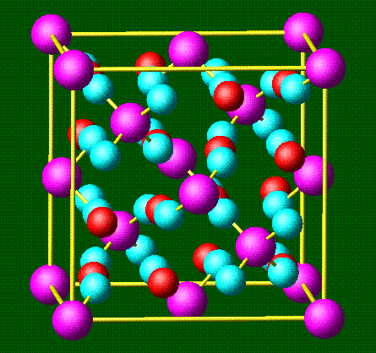
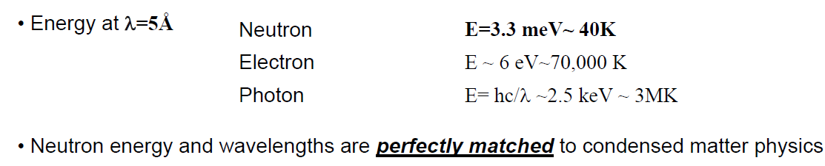
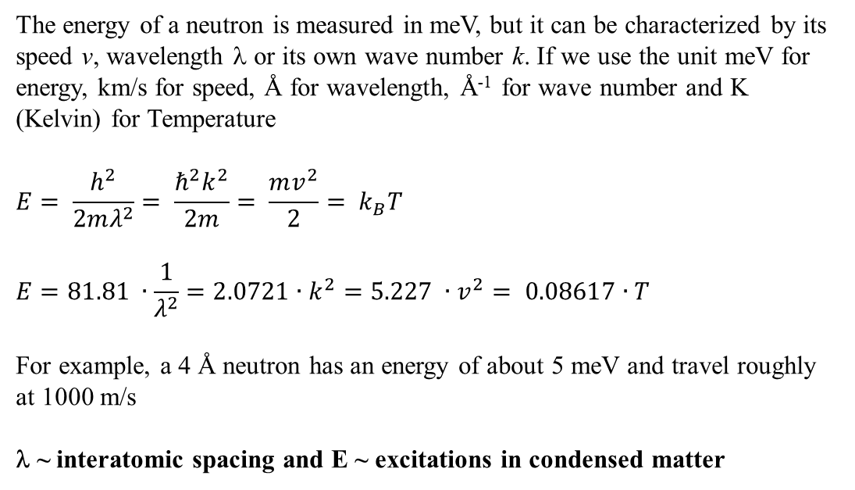
Properties of neutron
The energy of a neutron is measured in meV, but it can be characterized by its speed v, wavelength λ or its own wave number k. If we use the unit meV for energy, km/s for speed, Å for wavelength, Å⁻¹ for wave number and K (Kelvin) for Temperature
$$E= \frac{h^{2}}{2mλ^{2}}= \frac{ℏ^{2}k^{2}}{2m}= \frac{mv^{2}}{2}= k_{B}T$$
$$E=81.81 ∙\frac{1}{λ^{2}}=2.0721∙k^{2}=5.227 ∙v^{2}= 0.08617∙T$$
For example, a 4 Å neutron has an energy of about 5 meV and travel roughly
at 1000 m/s
λ ~ interatomic spacing and E ~ excitations in condensed matter

Slide 8
Magnetic properties of neutron
The magnetic moment associated with the spin of an electron is approximately 1000
times larger than the magnetic moment of a neutron.
The magnetic moment of the neutron is sufficiently large to give rise to an interaction with unpaired electrons in magnetic atoms. The strength of the interaction is comparable to the interaction of neutron with the nucleus.
In compound containing elements of the first transition series in the periodic table (Iron, Cobalt and Nickel) the 3d shell contains unpaired electrons. The magnetic field created by these unpaired electrons in the sample interact with the neutron magnetic moment to give magnetic scattering.
Elastic magnetic scattering or magnetic diffraction leads to the determination of the magnetic structure of crystal (the arrangement of the magnetic moments of atoms on the crystalline lattice).
Inelastic magnetic scattering yields information on the magnetic excitation in the sample. For example, spin wave, in which there are oscillations in the orientation of successive spins on the crystal lattice. The spin waves are quantized energy units called magnons

Slide 9
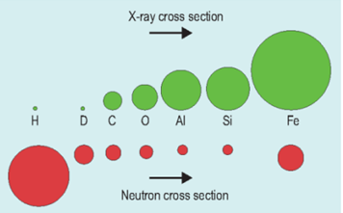
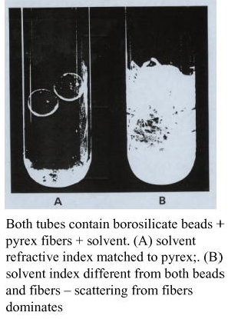
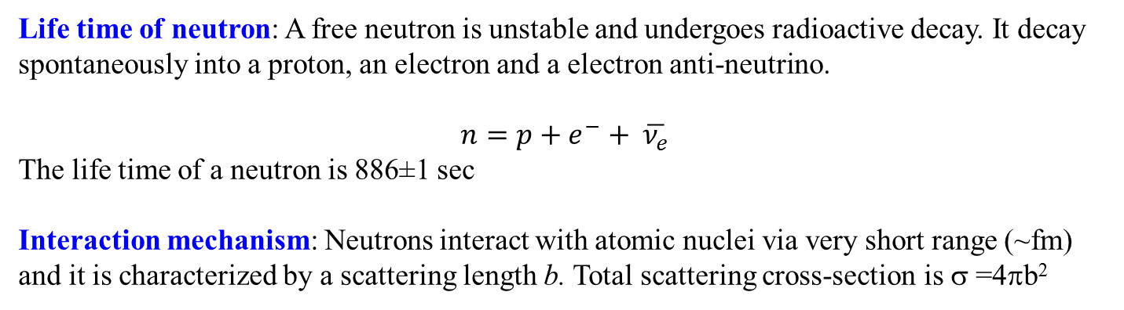
Properties of neutron
Life time of neutron: A free neutron is unstable and undergoes radioactive decay. It decay spontaneously into a proton, an electron and a electron anti-neutrino.
$$n=p+e^{−}+ \overline{ν_{e}}$$
The life time of a neutron is 886±1 sec
Interaction mechanism: Neutrons interact with atomic nuclei via very short range (~fm) and it is characterized by a scattering length b. Total scattering cross-section is σ =4πb²
Neutrons are more sensitive to light elements
Isotopic sensitivity
Contract variation to difference complex molecular structure

Slide 10
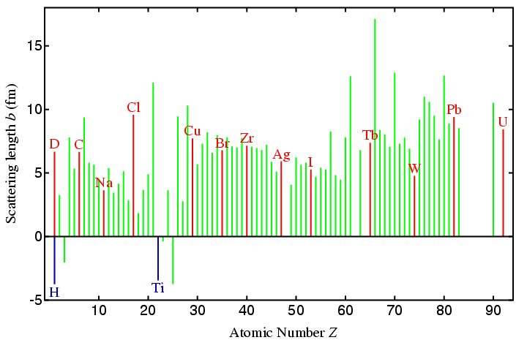
Properties of neutron
The scattering length of neutron is independent of atomic number
Positive neutron scattering length of a nucleus means repulsive potential the neutron is subject to as it approaches the nucleus whereas negative scattering length means the neutron is subjected to a attractive potential of the nucleus

Slide 11
Properties of neutron
Advantages:
Mass: Momentum transfer around interatomic distance
Zero charge: highly penetrating: measure bulk properties, can benefit from large samples, extreme sample environment (high/low temperature, magnetic field, pressure...)
Spin: polarization is possible
Magnetic dipole moment: Neutrons interact with unpaired electrons. Magnetic structure and spin excitations can be studied
Disadvantages
Low brilliance of sources: low intensity or resolution, large samples, statistical noise.
Penetrating: background hard to control, need large samples
Some elements (B, Cd, Gd,..) strongly absorb
Neutral: hard to manipulate, accelerate, detect, etc

Slide 12
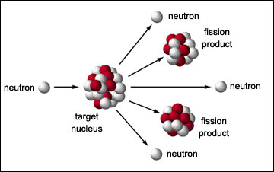
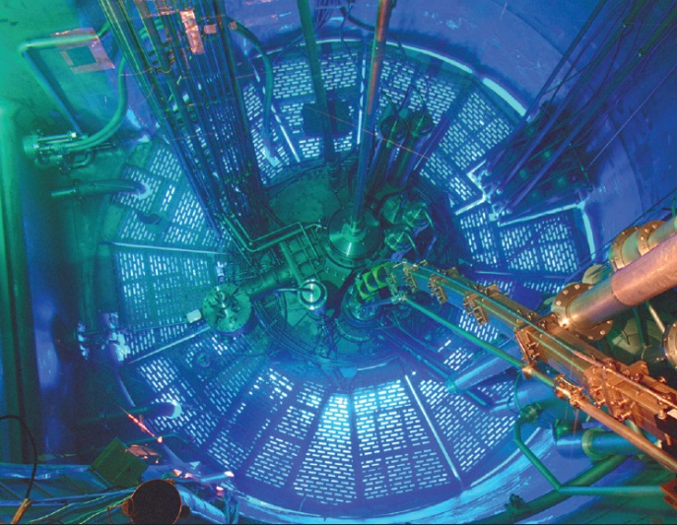
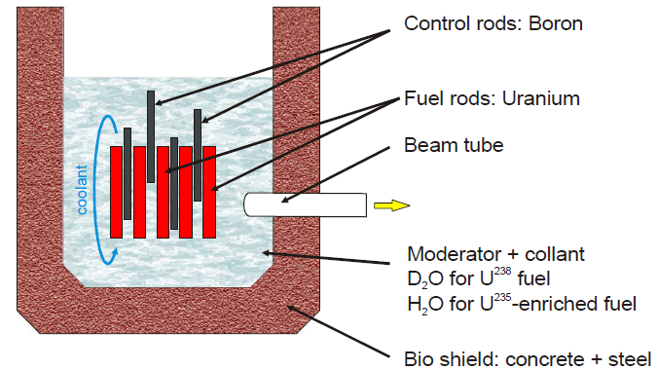
Production of neutrons
Nuclear fission reaction: is either a nuclear reaction or a radioactive decay process in which the nucleus of an atom splits into smaller parts
When a uranium-235 absorbs a neutron, it may undergo nuclear fission. The heavy nucleus splits into two or more lighter nuclei, releasing kinetic energy, gamma radiation, and free neutrons. A portion of these neutrons may later be absorbed by other fissile atoms and trigger further fission events, which release more neutrons.
Continuous neutrons
1 neutrons per fission
FRM II, Munich-Germany

Slide 13
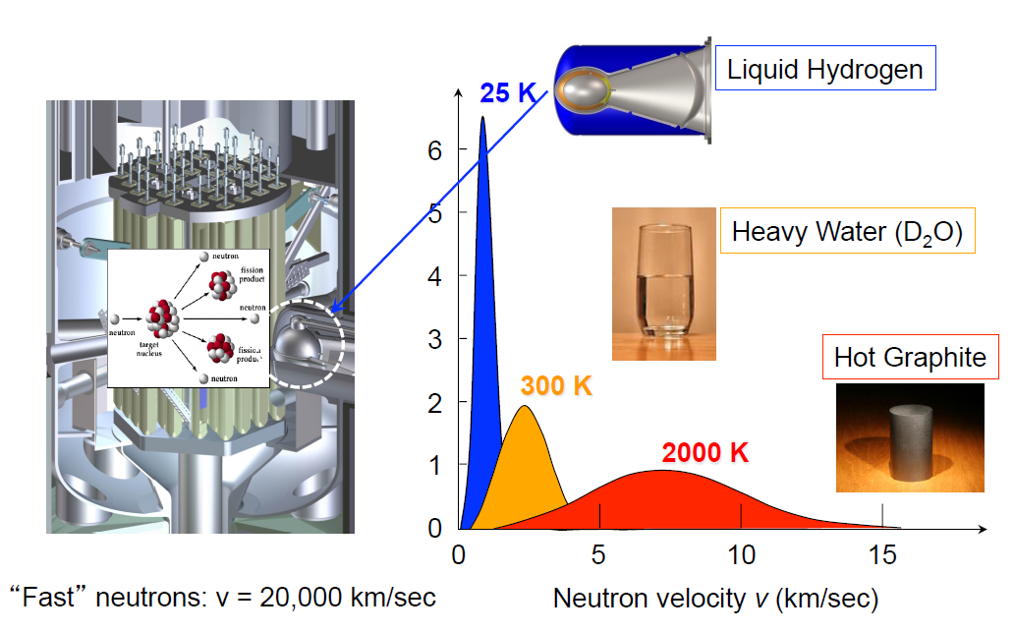
Production of neutrons

Slide 14
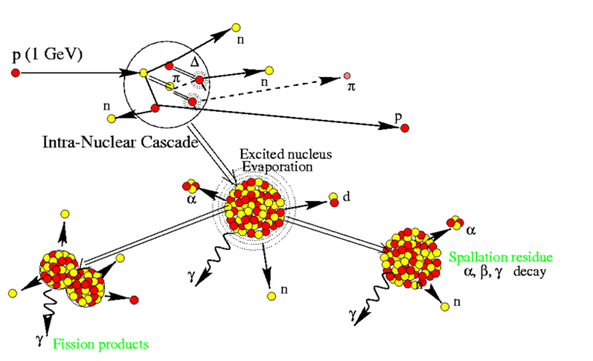
Production of neutrons
Spallation process: is a nuclear reaction which occurs when high energy particles bombarded the nuclei of heavy atoms.
Spallation process only take place above a certain threshold energy for the incident particles, typically 5-15 MeV.
The spallation process involves momentary incorporation of incident particle by a target nucleus followed by internal nucleon cascade.
Finally, the de-excitation of the target nuclei followed by the emission of many low energy neutrons and various other particles

Slide 15
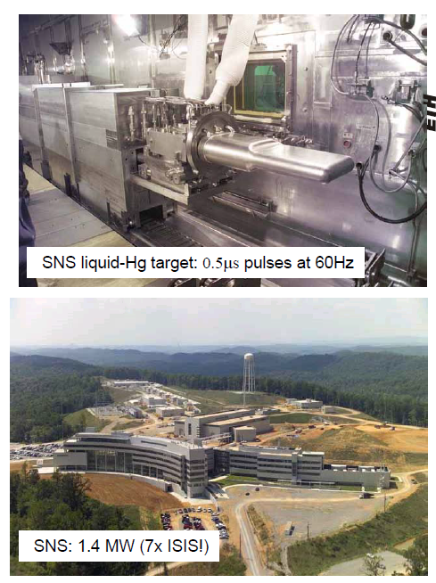
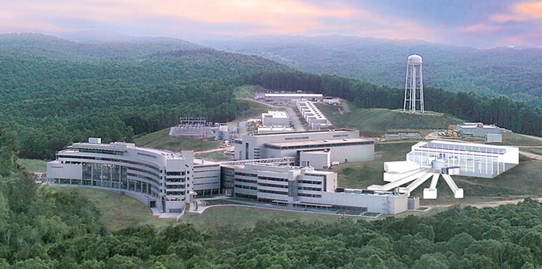
Production of neutrons
At Spallation Neutron Source (SNS) USA a high-energy proton beam to hit mercury target
No chain reaction
Pulsed neutrons
20-40 neutron per proton
SNS: 1.4 MW

Slide 16
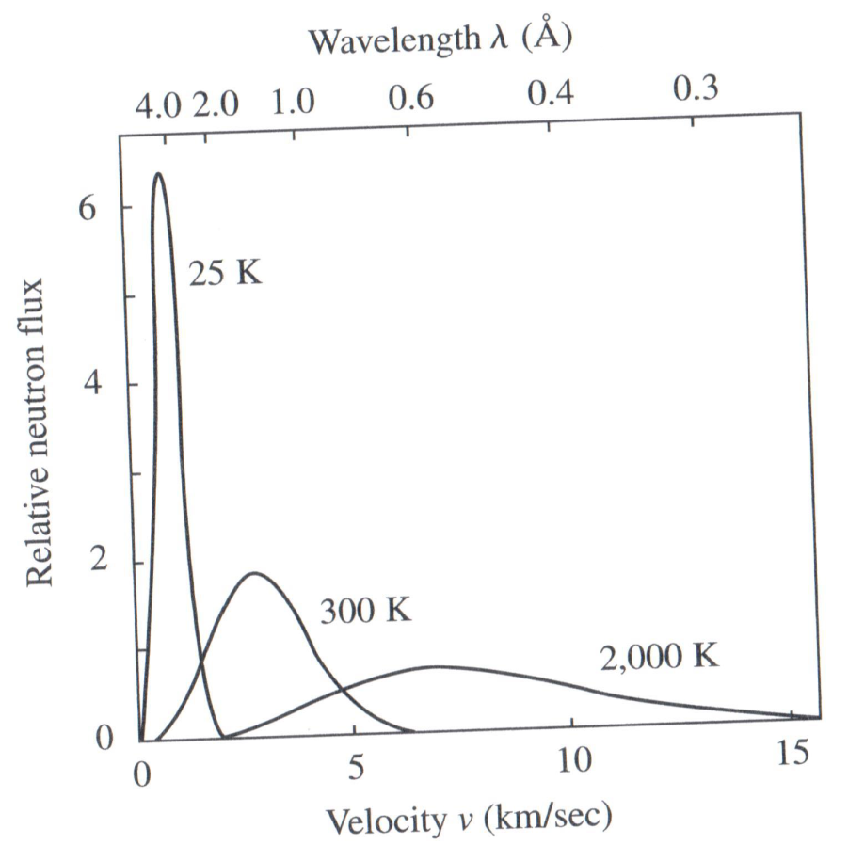
Neutron moderation: Hot and cold source
The energy spectrum of neutrons emitted from a reactor or from accelerator source depends on the temperature of the moderator surrounding the source and is a Maxwell-Boltzmann distribution function.
A neutron moderator is a medium that reduces the speed of fast neutrons.
Commonly used moderators include regular (light) water, solid graphite and heavy water.
A good neutron moderator is a material full of atoms with light nuclei which do not easily absorb neutrons. The neutrons strike the nuclei and bounce off. In this process, some energy is transferred between the nucleus and the neutron

Slide 17
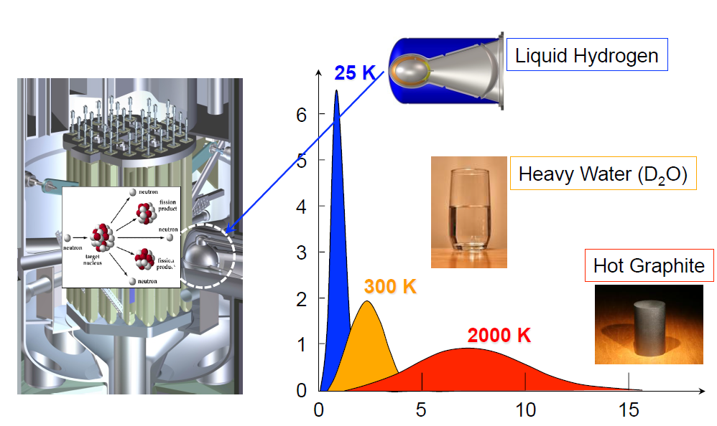
Neutron moderation: Hot and cold source
Cold source:
Typically liquid hydrogen or deuterium moderators operating at ~20K.
Placed in the highest neutron flux possible (ie. near the reactor core).
Outgoing neutrons are coupled to neutron guides which “guide” the neutrons to
experiments.

Slide 18
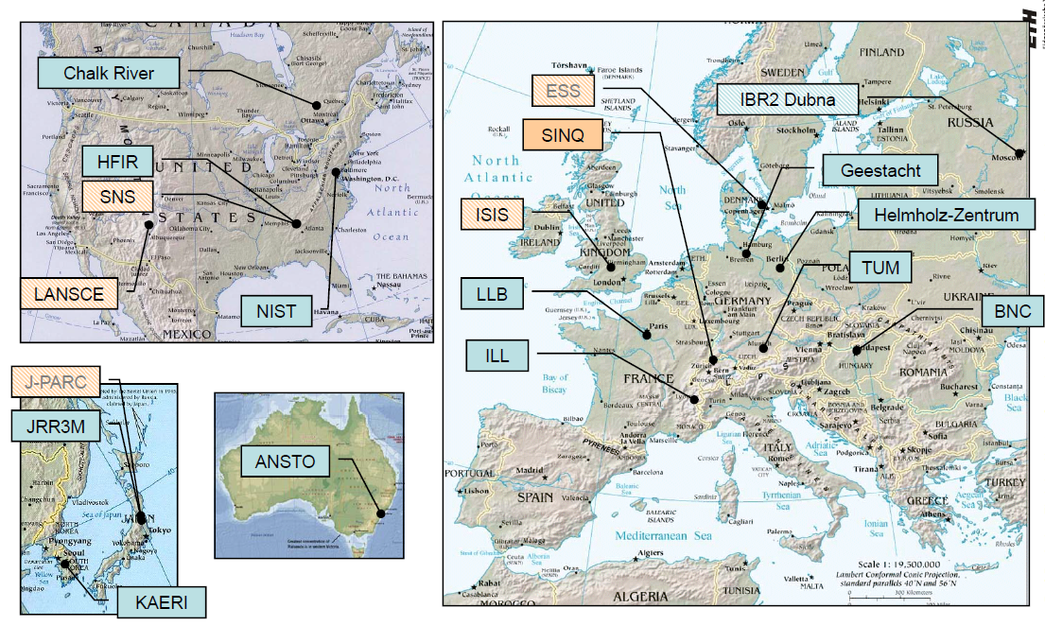
Neutron scattering centers in the world

Slide 19
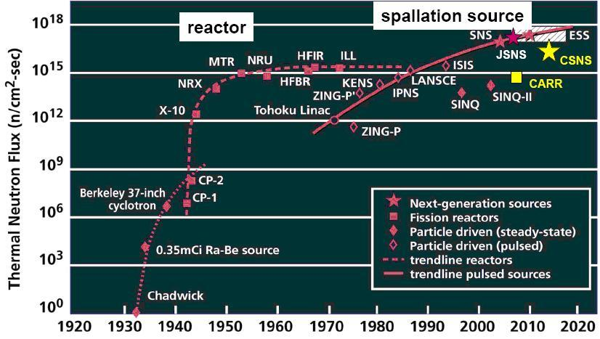
Neutron flux at various scattering centers

Slide 20
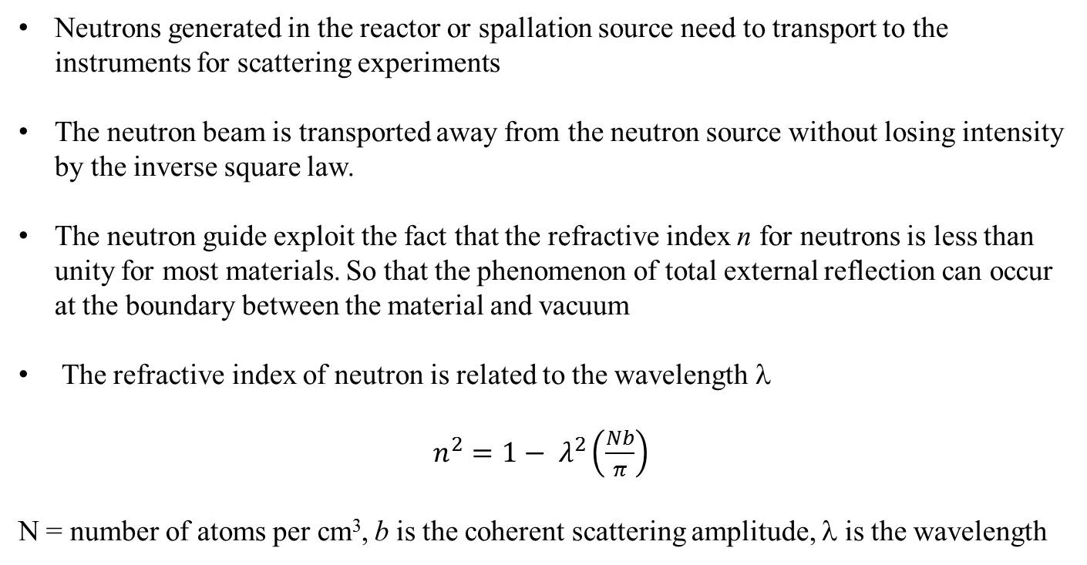
Transport of neutrons
Neutrons generated in the reactor or spallation source need to transport to the instruments for scattering experiments
The neutron beam is transported away from the neutron source without losing intensity by the inverse square law.
The neutron guide exploit the fact that the refractive index n for neutrons is less than unity for most materials. So that the phenomenon of total external reflection can occur at the boundary between the material and vacuum
The refractive index of neutron is related to the wavelength λ
$n^{2}=1− λ^{2}\left(\frac{Nb}{π}\right)$
N = number of atoms per cm³, b is the coherent scattering amplitude, λ is the wavelength

Slide 21
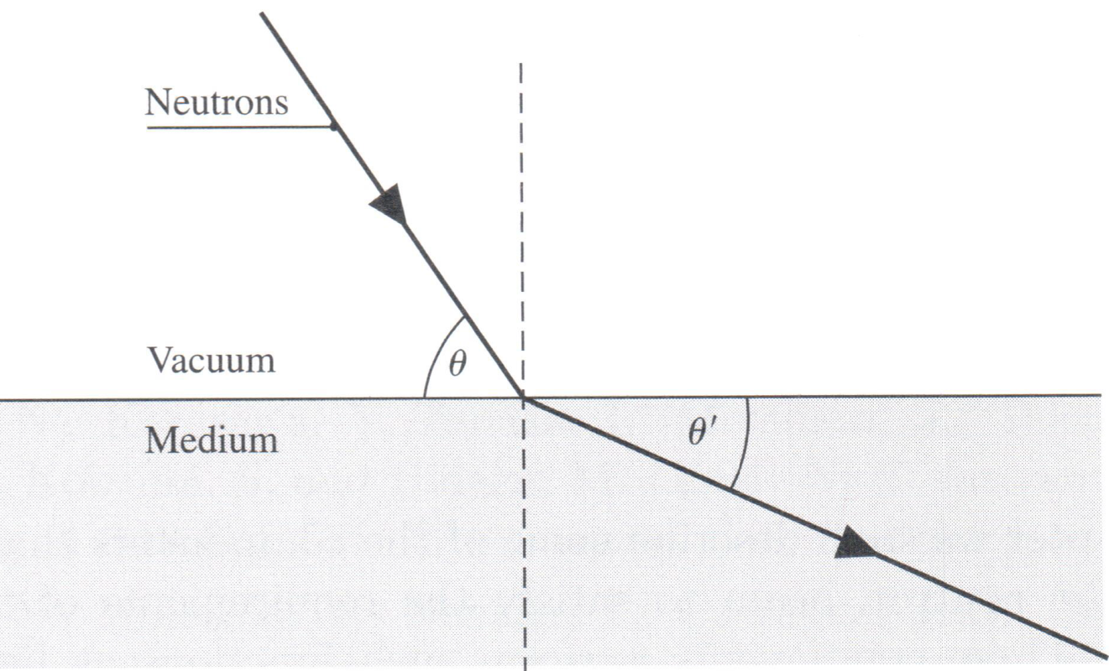
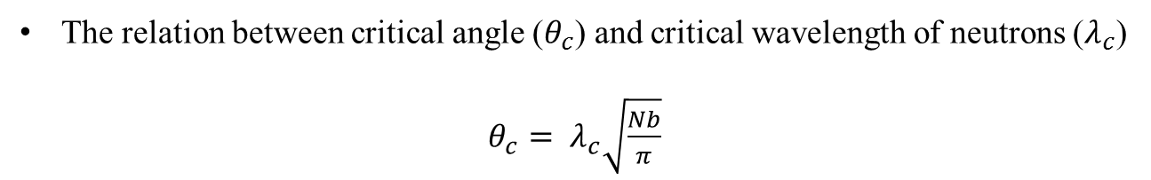
Transport of neutrons
The relation between critical angle ($θ_{c}$) and critical wavelength of neutrons ($λ_{c}$)
$θ_{c}= λ_{c}\sqrt{\frac{Nb}{π}}$
For natural Ni the critical angle is 2.03 mrad (1 mrad is 3.44 minutes of arc)
Natural nickel is the material most commonly used as a reflecting coating in the construction of neutron guide.

Slide 22
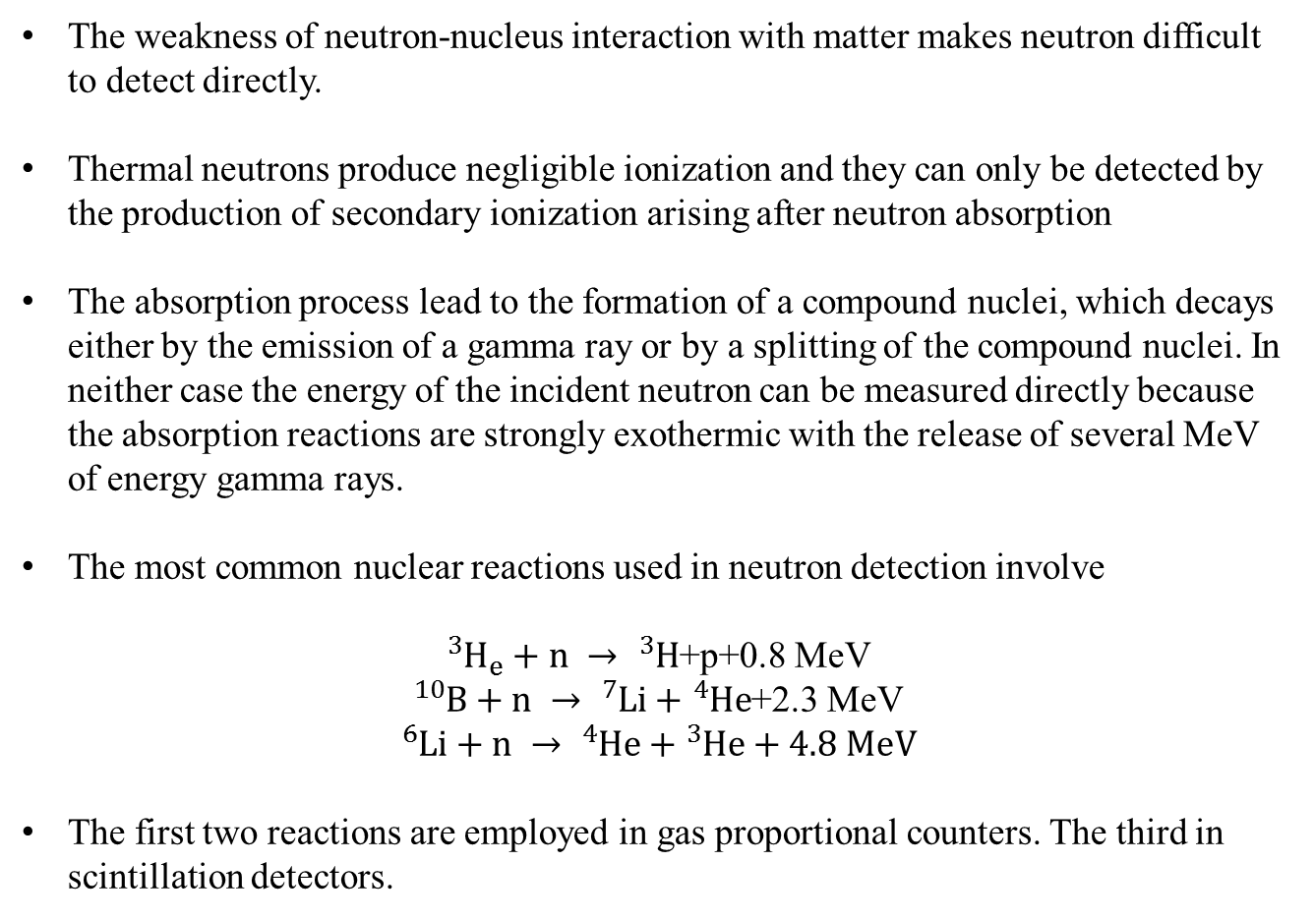
Detection of neutrons
The weakness of neutron-nucleus interaction with matter makes neutron difficult to detect directly.
Thermal neutrons produce negligible ionization and they can only be detected by the production of secondary ionization arising after neutron absorption
The absorption process lead to the formation of a compound nuclei, which decays either by the emission of a gamma ray or by a splitting of the compound nuclei. In neither case the energy of the incident neutron can be measured directly because
the absorption reactions are strongly exothermic with the release of several MeV
of energy gamma rays.
The most common nuclear reactions used in neutron detection involve
${}_{}^{3}{H_{e}+n → {}_{}^{3}H}$+p+0.8 MeV
${}_{}^{10}{B+n → {}_{}^{7}{Li}}+{}_{}^{4}{He}$+2.3 MeV
$${}_{}^{6}{Li+n → {}_{}^{4}{He}}+{}_{}^{3}{He}+4.8 MeV$$
The first two reactions are employed in gas proportional counters. The third in scintillation detectors.

Slide 23
Gas detectors
~25,000 ions and electrons produced per neutron (~4×10⁻¹⁵ coulomb)
A gas detector is usually consist of neutron sensitive gas enclosed in a cylindrical metal tube which forms the cathode of the detector. The anode is a fine central wire stretched along the axis of the tube an insulated from the cathode. The distribution of output charge per detected neutron can be measured using pulse height analyzer.

Slide 24
Gas detectors
Ionization Mode
electrons drift to anode, producing a charge pulse
Proportional Mode
if voltage is high enough, electron collisions ionize gas atoms producing even more electrons
gas amplification
gas gains of up to a few thousand are possible

Slide 25
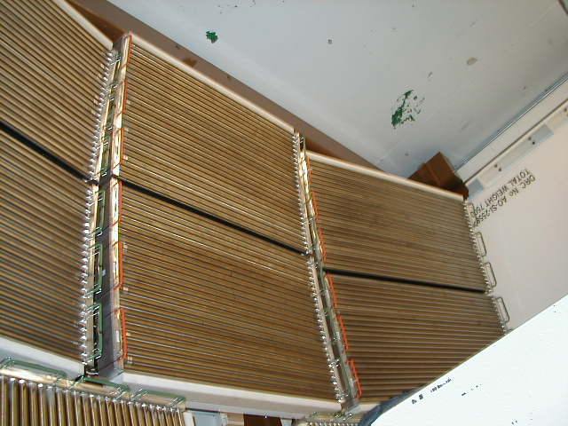
MAPS Detector bank

Slide 26
Scintillation detectors
In this type of detectors, typically ⁶Li in the form of lithium salt is mixed homogeneously with a scintillation material such as ZnS.
The burst of light which is emitted when a neutron is absorbed and ionizing secondary particles are formed is amplified by a photomultiplier.
Scintillation: re-emit the absorbed energy in the form of light

Slide 27
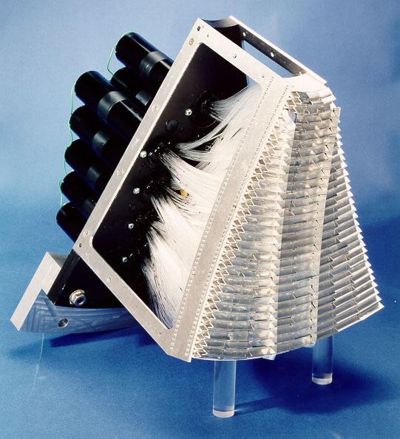
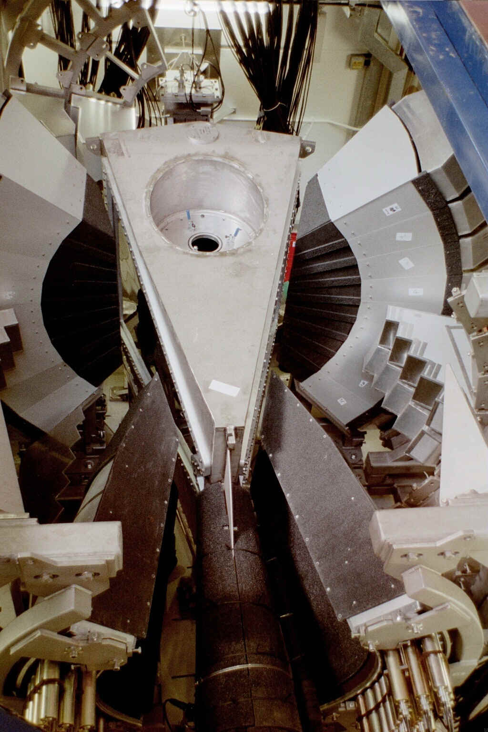
GEM Detector module

Slide 28
Why neutron scattering is important?
Neutrons have No Charge!
Highly penetrating
Nondestructive
Can be used in extremes
Neutrons have a Magnetic Moment!
Magnetic structure
Fluctuations
Magnetic materials
Neutrons have Spin!
Polarized beams
Atomic orientation
Coherent and incoherent scattering
The Energies of neutrons are similar to the energies of elementary excitations!
Molecular Vibrations and Lattice modes
Magnetic excitations
The Wavelengths of neutrons are similar to atomic spacing!
Sensitive to structure
Gathers information from 10⁻¹⁰ to 10⁻⁷ m
Crystal structures and atomic spacing
Neutrons probe Nuclei!
Light atom sensitive
Sensitive to isotopic substitution

Slide 29
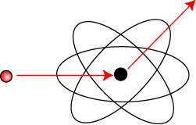
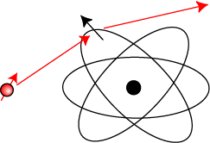
Interaction of neutron with matter
Neutrons are neutral particle hence can pass large distance through matter.
Energy change and momentum transfer occur from
Nucleus
Crystal excitations (eg. Phonons)
Unpaired electrons via dipole scattering
Magnetic structure and excitations
Diffusion (atomic or molecular)
Nuclear scattering
Magnetic dipole scattering

Slide 30
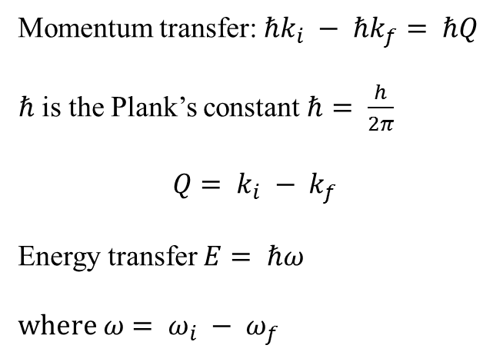
Neutron scattering
scattered neutron
detector
Momentum transfer: $ℏk_{i} − ℏk_{f}= ℏQ$
$ℏ$ is the Plank’s constant $ℏ= \frac{h}{2π}$
$$Q= k_{i} − k_{f}$$
Energy transfer $E= ℏω$
$where ω= ω_{i} − ω_{f}$
incident neutron
sample
In a scattering experiment the quantities of interest are changes in the momentum P, and Energy E
The momentum and energy gained by the neutron is equal to that lost by the sample

Slide 31
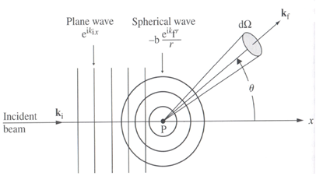
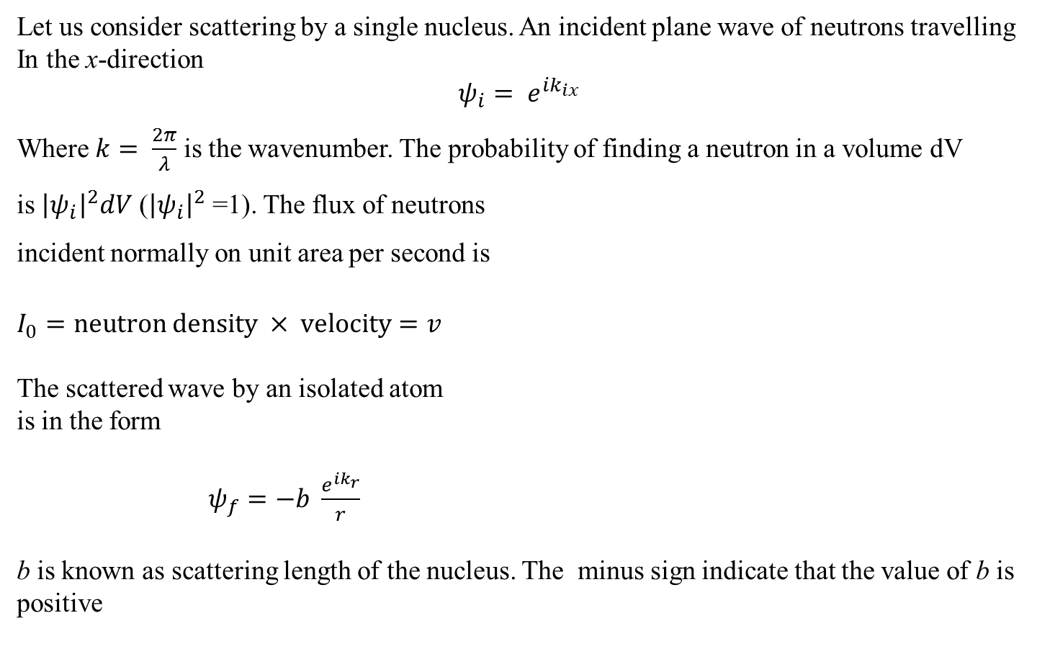
Total cross-section
Let us consider scattering by a single nucleus. An incident plane wave of neutrons travelling
In the x-direction
$$ψ_{i}= e^{ik_{ix}}$$
Where $k= \frac{2π}{λ}$ is the wavenumber. The probability of finding a neutron in a volume dV
is ${\left|ψ_{i}\right|}^{2}dV$ (${\left|ψ_{i}\right|}^{2}$ =1). The flux of neutrons
incident normally on unit area per second is
$I_{0}=neutron density × velocity=v$
The scattered wave by an isolated atom
is in the form
$ψ_{f}=−b \frac{e^{ik_{r}}}{r}$
b is known as scattering length of the nucleus. The minus sign indicate that the value of b is positive

Slide 32
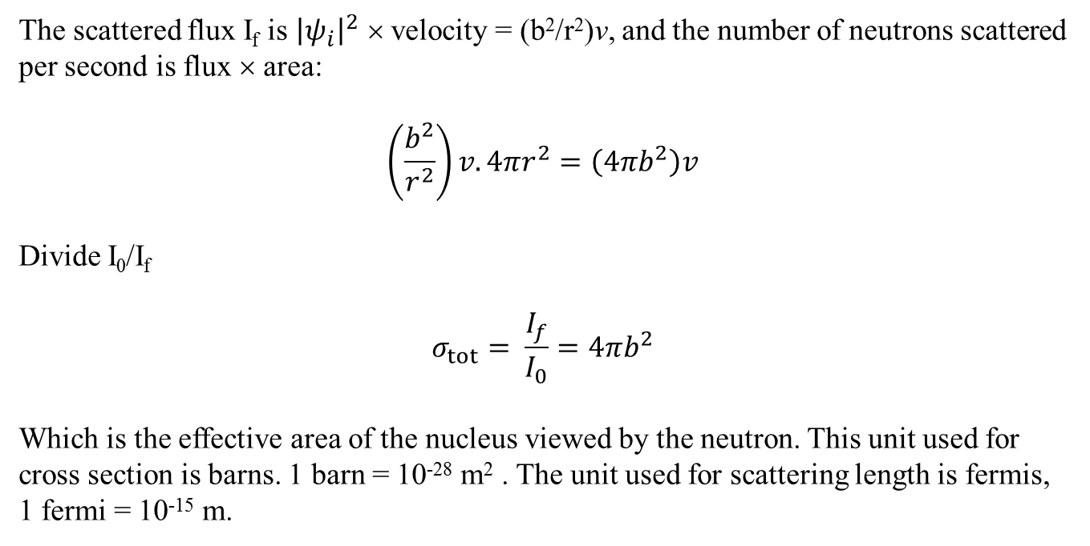
Total cross-section
The scattered flux I_{f} is ${\left|ψ_{i}\right|}^{2}$ × velocity = (b²/r²)v, and the number of neutrons scattered per second is flux × area:
$$\left(\frac{b^{2}}{r^{2}}\right)v.4πr^{2}=\left(4πb^{2}\right)v$$
Divide I₀/I_{f}
$$σ_{tot}= \frac{I_{f}}{I_{0}}=4{πb}^{2}$$
Which is the effective area of the nucleus viewed by the neutron. This unit used for cross section is barns. 1 barn = 10⁻²⁸ m² . The unit used for scattering length is fermis,
1 fermi = 10⁻¹⁵ m.

Slide 33
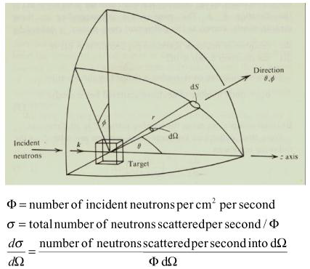
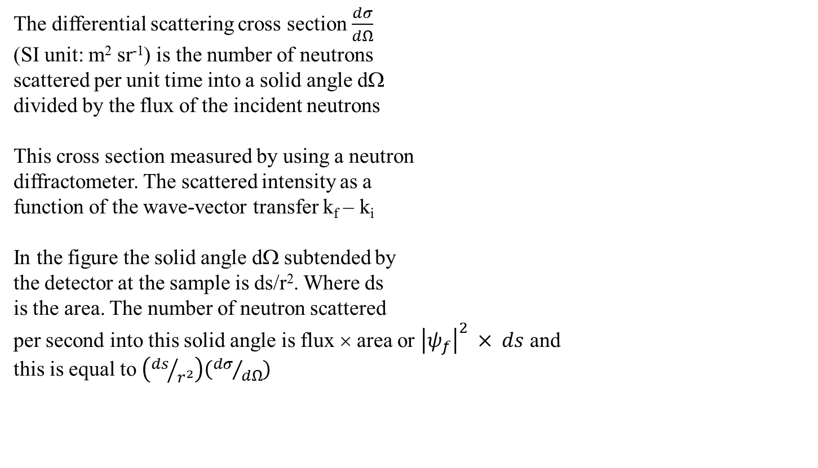

Differential cross-section
The differential scattering cross section $\frac{dσ}{dΩ}$
(SI unit: m² sr⁻¹) is the number of neutrons
scattered per unit time into a solid angle dΩ
divided by the flux of the incident neutrons
This cross section measured by using a neutron
diffractometer. The scattered intensity as a
function of the wave-vector transfer k_{f} – k_{i}
In the figure the solid angle dΩ subtended by
the detector at the sample is ds/r². Where ds
is the area. The number of neutron scattered
per second into this solid angle is flux × area or ${\left|ψ_{f}\right|}^{2} × ds$ and
this is equal to $\left({ds}/{r^{2}}\right)\left({dσ}/{dΩ}\right)$
$\frac{dσ}{dΩ}= {\left|ψ_{f}\right|}^{2}r^{2}$, for a spherical wave ${\left|ψ_{f}\right|}^{2}$ = b²/r² and so
$\frac{dσ}{dΩ}= b^{2}= \frac{σ_{tot}}{4π}$ , unit is barns/steradian

Slide 34
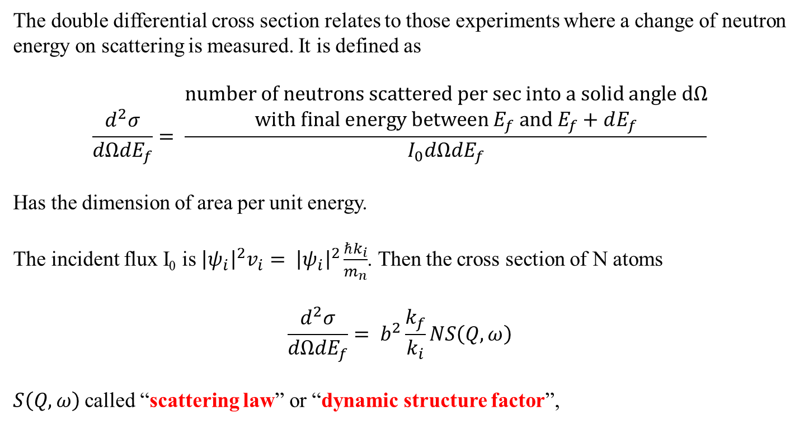
Double differential cross-section
The double differential cross section relates to those experiments where a change of neutron energy on scattering is measured. It is defined as
$$\frac{d^{2}σ}{dΩdE_{f}}= \frac{\begin{aligned}number of neutrons scattered per sec into a solid angle dΩ \\ with final energy between E_{f} and E_{f}+dE_{f}\end{aligned}}{I_{0}dΩdE_{f}}$$
Has the dimension of area per unit energy.
The incident flux I₀ is ${\left|ψ_{i}\right|}^{2}v_{i}= {\left|ψ_{i}\right|}^{2}\frac{ℏk_{i}}{m_{n}}$. Then the cross section of N atoms
$$\frac{d^{2}σ}{dΩdE_{f}}= b^{2}\frac{k_{f}}{k_{i}}NS\left(Q,ω\right)$$
$S\left(Q,ω\right)$called “scattering law” or “dynamic structure factor”,

Slide 35
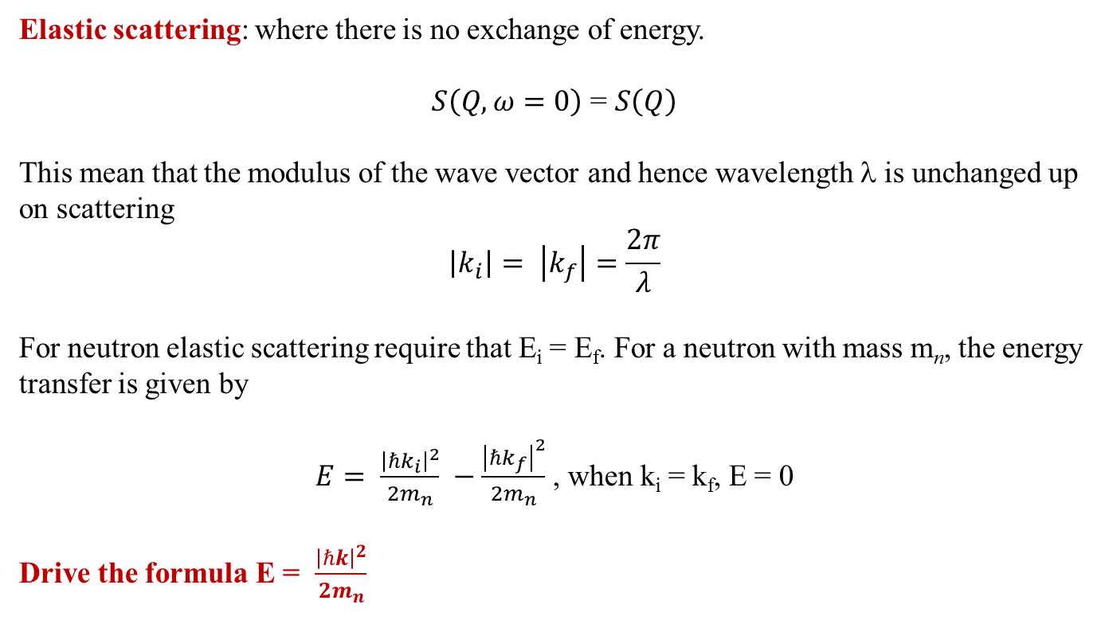
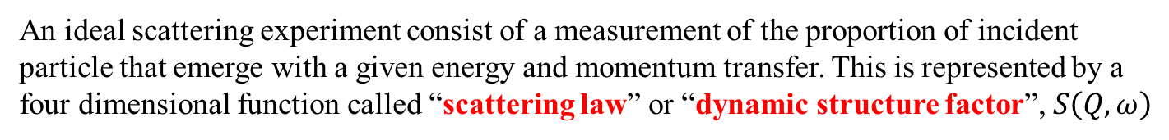
Neutron scattering
An ideal scattering experiment consist of a measurement of the proportion of incident particle that emerge with a given energy and momentum transfer. This is represented by a four dimensional function called “scattering law” or “dynamic structure factor”, $S\left(Q,ω\right)$
Elastic scattering: where there is no exchange of energy.
$S\left(Q,ω=0\right)$ = $S\left(Q\right)$
This mean that the modulus of the wave vector and hence wavelength λ is unchanged up on scattering
$$\left|k_{i}\right|= \left|k_{f}\right|=\frac{2π}{λ}$$
For neutron elastic scattering require that E_{i} = E_{f}. For a neutron with mass m_{n}, the energy transfer is given by
$E= \frac{{\left|ℏk_{i}\right|}^{2}}{2m_{n}} −\frac{{\left|ℏk_{f}\right|}^{2}}{2m_{n}}$ , when k_{i} = k_{f}, E = 0
Drive the formula E = $\frac{{\left|ℏk\right|}^{2}}{2m_{n}}$

Slide 36

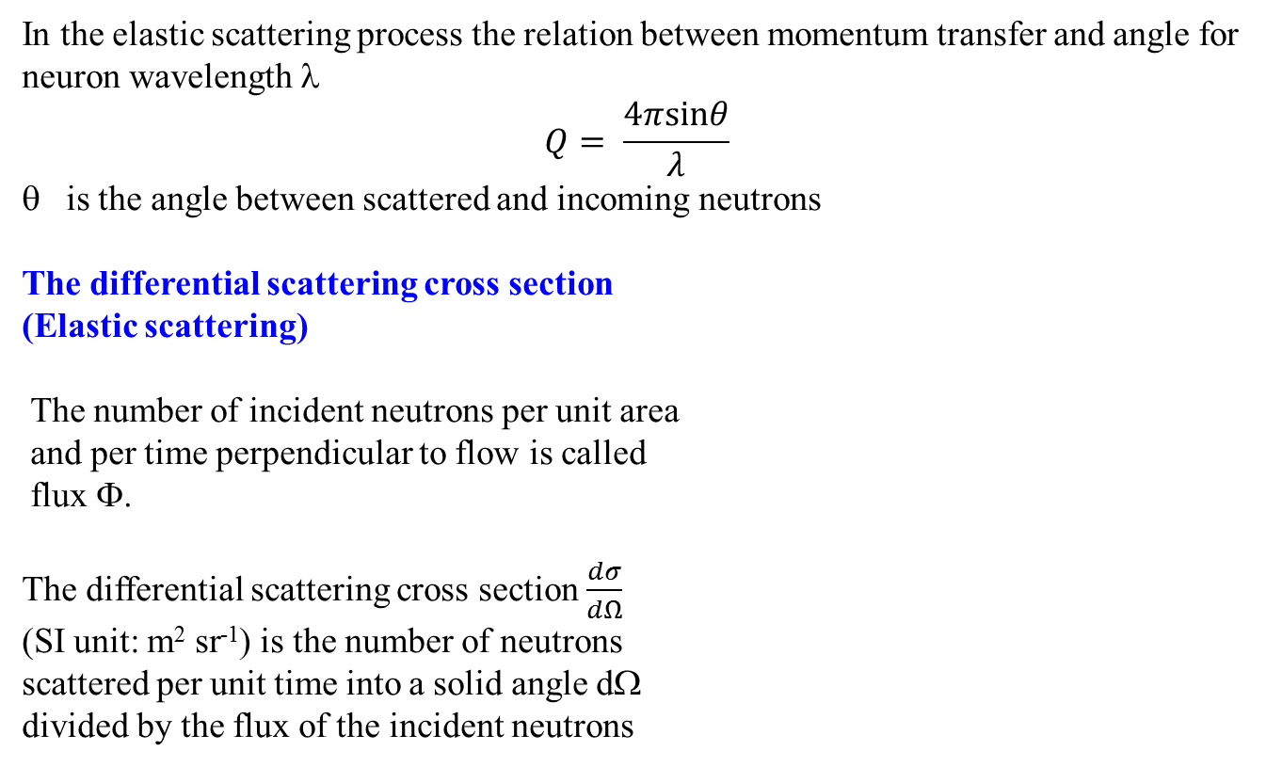
Elastic neutron scattering
In the elastic scattering process the relation between momentum transfer and angle for
neuron wavelength λ
$$Q= \frac{4πsinθ}{λ}$$
is the angle between scattered and incoming neutrons
The differential scattering cross section
(Elastic scattering)
The number of incident neutrons per unit area
and per time perpendicular to flow is called
flux Φ.
The differential scattering cross section $\frac{dσ}{dΩ}$
(SI unit: m² sr⁻¹) is the number of neutrons
scattered per unit time into a solid angle dΩ
divided by the flux of the incident neutrons

Slide 37
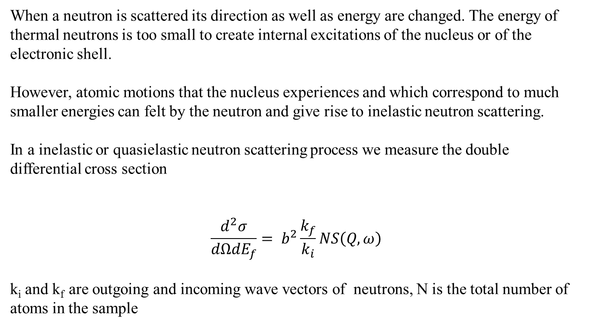
Inelastic neutron scattering
When a neutron is scattered its direction as well as energy are changed. The energy of thermal neutrons is too small to create internal excitations of the nucleus or of the electronic shell.
However, atomic motions that the nucleus experiences and which correspond to much smaller energies can felt by the neutron and give rise to inelastic neutron scattering.
In a inelastic or quasielastic neutron scattering process we measure the double differential cross section
$$\frac{d^{2}σ}{dΩdE_{f}}= b^{2}\frac{k_{f}}{k_{i}}NS\left(Q,ω\right)$$
k_{i} and k_{f} are outgoing and incoming wave vectors of neutrons, N is the total number of atoms in the sample

Slide 38
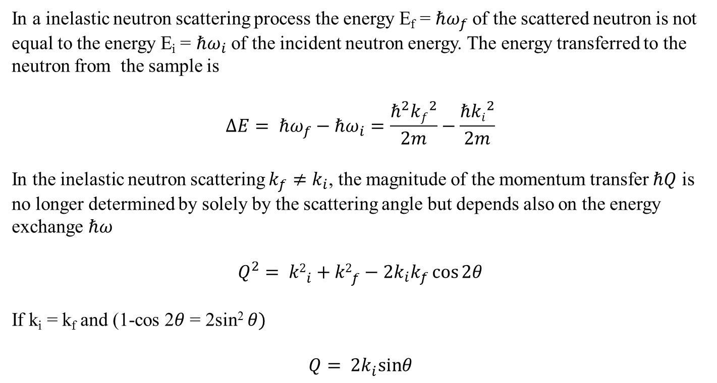
Inelastic neutron scattering
In a inelastic neutron scattering process the energy E_{f} = $ℏω_{f}$of the scattered neutron is not equal to the energy E_{i} = $ℏω_{i}$of the incident neutron energy. The energy transferred to the neutron from the sample is
$$ΔE= ℏω_{f}−ℏω_{i}=\frac{ℏ^{2}{kf}^{2}}{2m}−\frac{ℏ{ki}^{2}}{2m}$$
In the inelastic neutron scattering $k_{f}≠k_{i}$, the magnitude of the momentum transfer $ℏQ$ is no longer determined by solely by the scattering angle but depends also on the energy exchange $ℏω$
$$Q^{2}= {k2}_{i}^{}+{k2}_{f}^{}−2k_{i}k_{f}\cos{2θ}$$
If k_{i} = k_{f} and (1-cos 2$θ$ = 2sin² $θ)$
$$Q= {2k}_{i}^{}sinθ$$

Slide 39
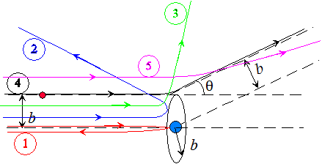

Neutron scattering
The efficacy of neutron scattering by a nucleus is expressed by the scattering length b of the nucleus is
$$\frac{dσ}{dΩ}= b^{2}$$
The value of the scattering length is independent of the wavelength of the incident neutron but depends on the spin state of the nucleus-neutron system.
If nucleus has nonzero spin i the spin of the nucleus-neutron system is either i+1/2 or i-1/2 and the associated scattering length is either b⁺ or b⁻, respectively.

Slide 40

Neutron scattering
Neutron with spin ½ interact with a nucleus with spin i
either i+1/2 or i-1/2. The number of state associated with spin i+1/2 is
$$2\left(i+\frac{1}{2}\right)+1=2i+2$$
And the number of state associated with spin i-1/2 is
$$2\left(i−\frac{1}{2}\right)+1=2i$$
Giving a total of (4i+2) states. Each spin state has the same a priori probability when the neutron beam is unpolarized so that the nuclear spin is randomly oriented. Therefore the probability that the b+ scattering length realized is
$b^{+}= \frac{2i+2}{4i+2}= \frac{i+1}{2i+1}$

Slide 41

Coherent and incoherent scattering
And for the b⁻ scattering length the probability is
$$b^{−}= \frac{2i}{4i+2}= \frac{i}{2i+1}$$
The random variability in the scattering length resulting from the presence of isotope or from nonzero nuclear spin
Let the differential scattering cross section dσ/dΩ
$$\frac{dσ}{dΩ}= \sum_{j,k}{\left\langle b_{j}b_{k}\right\rangle }e^{−iq(r_{j}−r_{k})}$$
Where $\left\langle b_{j}b_{k}\right\rangle$ is expectation value of $b_{j}b_{k}$ in view of the random variability of b_{j} and b_{k}. For j = k,
$\left\langle b_{j}b_{j}\right\rangle = \left\langle {b2}_{j}^{}\right\rangle = \left\langle b^{2}\right\rangle$

Slide 42

Coherent and incoherent scattering
For j ≠ k
$$\left\langle b_{j}b_{k}\right\rangle = \left\langle b_{j}^{}\right\rangle \left\langle b_{k}\right\rangle = {\left\langle b\right\rangle }^{2}$$
$$\left\langle b_{j}b_{k}\right\rangle ={\left\langle b\right\rangle }^{2}+δ_{j,k}\left(\left\langle b^{2}\right\rangle −{\left\langle b\right\rangle }^{2}\right)$$
$δ_{j,k}$ is the delta function which is equal to 1 if j = k and equal to 0 otherwise
$$\frac{dσ}{dΩ}= {\left\langle b\right\rangle }^{2}\sum_{j,k}{e^{−iq(r_{j}−r_{k})}+N\left(\left\langle b^{2}\right\rangle −{\left\langle b\right\rangle }^{2}\right)}$$
The first term in the above equation is equal to the total intensity that obtained from all nuclei has the identical scattering length equal to the average $\left\langle b\right\rangle$
The second term does not depend on r_{j} and therefore contains no information on structure of the sample. This is proportional to the variance of $\left\langle b^{2}\right\rangle −{\left\langle b\right\rangle }^{2}$ and arise from the fluctuation in the scattering lengths The first tem is called coherent and the second term called incoherent scattering cross section
The average $\left\langle b_{j}\right\rangle$ of $b_{j}$ over all the isotope and spin states is called the coherent scattering length and the root mean square deviation of $b_{j}$ from $\left\langle b_{j}\right\rangle$ is called incoherent scattering length.

Slide 43

Coherent and incoherent scattering
Therefore the coherent and incoherent length of an element or an isotope are defined as
$b_{coh}= \left\langle b\right\rangle$
$$b_{inc}= {\left(\left\langle b^{2}\right\rangle −{\left\langle b\right\rangle }^{2}\right)}^{1/2}$$
Total cross section σ_{tot} is equal to 4πb²
$$σ_{coh}=4π{\left\langle b\right\rangle }^{2}$$
$$σ_{inc}=4π\left(\left\langle b^{2}\right\rangle −{\left\langle b\right\rangle }^{2}\right)$$
Incoherent component arises because of the random variability in the scattering lengths of individual nuclei.
http://www.ncnr.nist.gov/resources/n-lengths/

Slide 44

Coherent and incoherent scattering
Let us consider in the case of a single isotope, with nuclear spin s, interacting with a neutron spin ½. Therefore there are two scattering length b⁺ and b⁻ associated with two possible spin states. S⁺ = s+ ½ and S⁻ = s-½ . Because there are n⁺ = 2S⁺+1 and n⁻ = 2S⁻+1 states of spin S⁺ and S^{-,} respectively. If each of them has the probability
$\left\langle b\right\rangle = \frac{1}{n^{+}+n^{−}}\left[n^{+}b^{+}+n^{−}b^{−}\right]$
= $\frac{1}{2s+1}\left[(s+1)b^{+}+sb^{−}\right]$
$\left\langle b^{2}\right\rangle = \frac{1}{n^{+}+n^{−}}\left[n^{+}\left(b^{+}\right)2+n\left(b^{−}\right)2\right]$
= $\frac{1}{2s+1}\left[(s+1){(b}^{+})2+s{(b}^{−})2\right]$
$$σ_{coh}=4π{\left\langle b\right\rangle }^{2}$$
$$σ_{inc}=4π\left(\left\langle b^{2}\right\rangle −{\left\langle b\right\rangle }^{2}\right)$$

Slide 45

Coherent and incoherent scattering
In the case of hydrogen a single proton with spin ½ . The relevant scattering length are
b⁺ = 1.04 × 10⁻¹² cm
For the triplet state total spin state S⁺ = 1, n⁺ = 3
b⁻ = - 4.7 ×10⁻¹² cm
And singlet state S⁻ = 0, n⁻ = 1
Therefore
$$\left\langle b\right\rangle = \frac{1}{4}\left[3b^{+}+b^{−}\right]=−0.38 ×{10}^{−12} cm$$
$$\left\langle b^{2}\right\rangle = \frac{1}{4}\left[3\left(b^{+}\right)2+{(b}^{−})2\right]=6.49 ×{10}^{−24} {cm}^{2}$$
$σ_{coh}=4π{\left\langle b\right\rangle }^{2}$= 1.8 barns
$σ_{inc}=4π\left(\left\langle b^{2}\right\rangle −{\left\langle b\right\rangle }^{2}\right)$ = 79.9 barns

Slide 46

Source: Peter M. Gehring (NIST, USA)

Slide 47

Coherent and incoherent scattering
Coherent
Incoherent

Slide 48

Principle of detailed balance
The double differential cross section is related to the dynamic structure factor we measure
in the experiments
$\frac{d^{2}σ}{dΩdω}= \frac{k_{f}}{k_{i}} b^{2}NS\left(Q,ω\right)$
The function S(Q,ω) is called the dynamic structure factor and is the quantity of interest in the inelastic or quasielastic neutron scattering experiments
In the inelastic scattering process the energy transfer may be positive or negative, corresponding to neutron energy loss or energy-gain, respectively. Due to Boltzmann factor the lower energy states in the sample are more likely to be occupied than higher ones. As a result, it is more probable that the neutron will lose energy in the scattering process than gain it, the ratio between the two possibilities is called detailed balance

Slide 49


Principle of detailed balance
We obtain
$$S\left(−Q,−ω\right)= e^{{−ℏω}/{k_{B}T}}S(Q,ω)$$

