Slide 1
neutron Diffrakció-II
Ungár Tamás
Anyagfizikai Tanszék
Doktori Kurzus
2010 november 21

Slide 2
A szórási kép és az akadály kapcsolata:
FF* = |F|² = | ρ(r) e^{-ikr} dr |²
a szórási képet megadó
függvény:
szerkezeti tényező
az „akadály” formfaktora
a szórócentrumok pozíciója
F a ρ(r) függvény Fourier transzformáltja

Slide 3
az anyagtudomány sugárzásai
- röntgen sugárzás
- elektronok
- neutronok
elektromágneses hullám
fotonok
véges tömegű részecskék
DeBroglie hullámhossz:
λ =
200 keV elektron
λ = 0.0025 nm
= 0.025 Å
h
p

Slide 4
szórási mechanizmusok
röntgen: elktromágneses kölcsönhatás
elektronok: Coulomb kölcsönhatás
neutronok: magszórás („billiárd golyók ütközése”)
mágneses kölcsönhatás

Slide 5
A szerkezeti anyagtudományban leginkább használható sugárzások

Slide 6
LEED: low energy electron diffraction
AES: Auger electron scattering
EELS: electron energy loss spectroscopy
SEM: scanning electron microscopy
HEED: high energy electron diffraction
TEM: transmission electron microscopy
XRD: X-ray diffraction

Slide 7
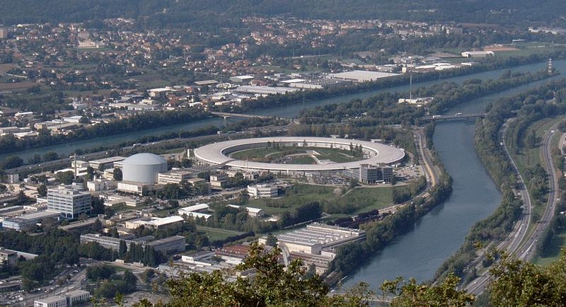
ESRF, Grenoble
European Synchrotron Radiation Facility
ILL

Slide 8
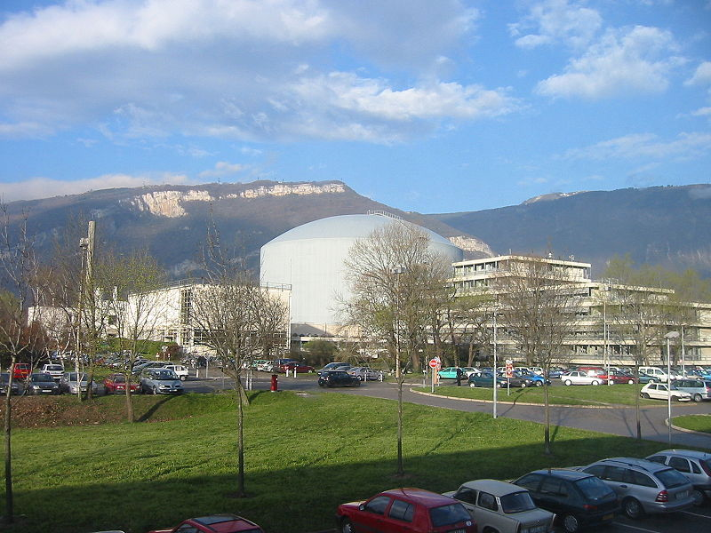
Institute Laue-Langevin, ILL, Grenoble
EMBL

Slide 9
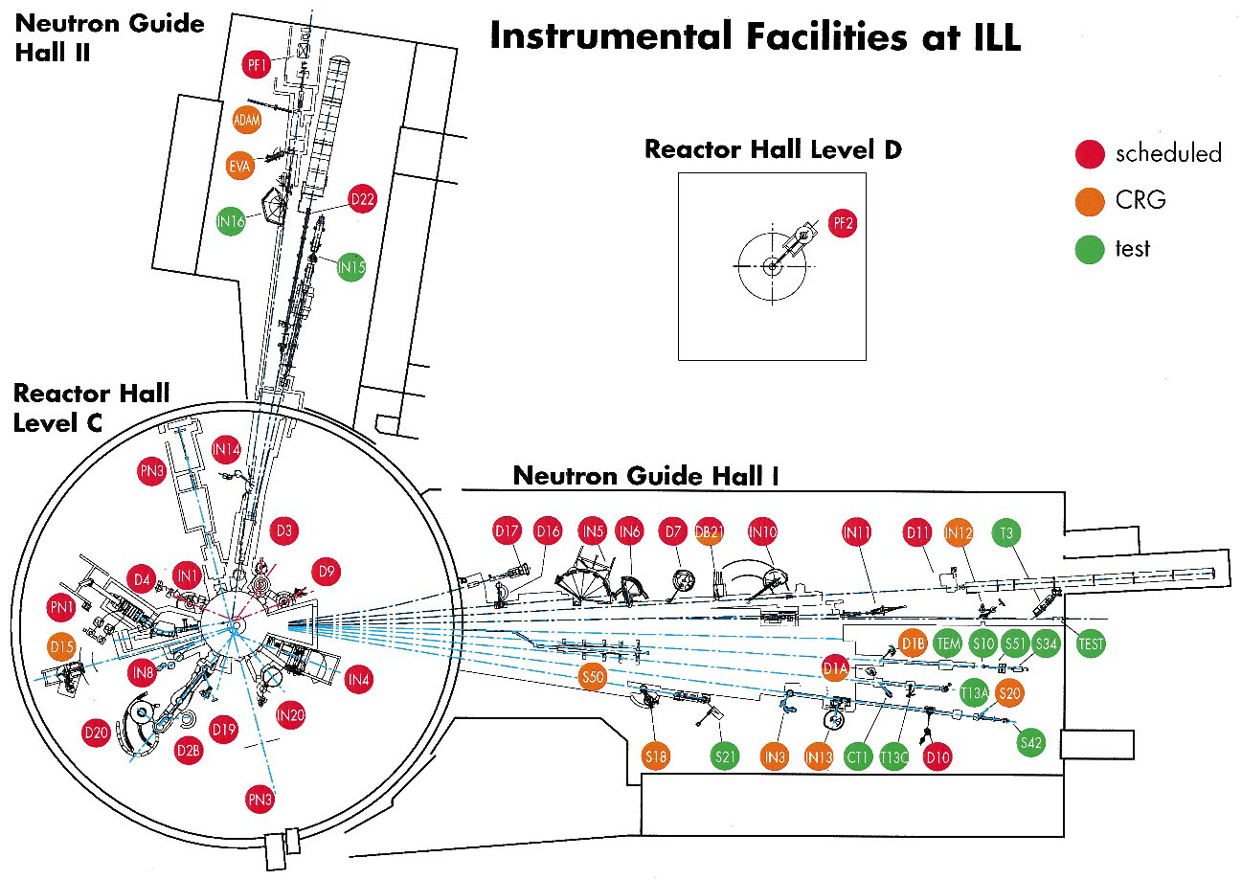
Institute Laue-Langevin, ILL, Grenoble (1997-es állapot)

Slide 10
ILL, Grenoble: az utolsó kutatóreaktor
ami megépült

Slide 11
Spallációs neutron források

Slide 12
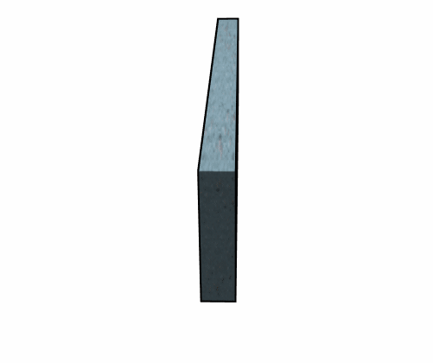
Spalláció
keletkezett
neutronok
nagyenergiás
proton

Slide 13
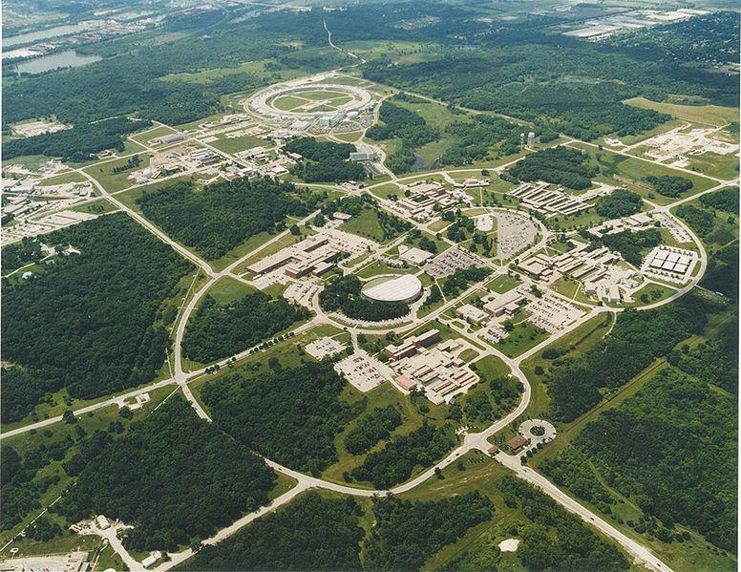
Az első spallációs neutron forrás: Argonne-Chicago-ban
APS szinkrotron
50 – es évek végén

Slide 14
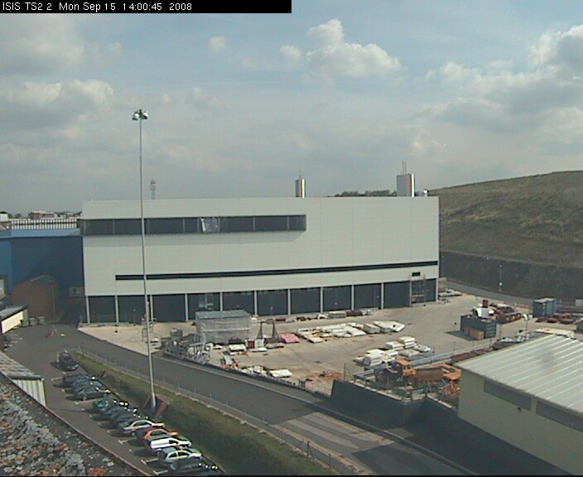
Az első nagy spallációs n forrás: ISIS Harwell, Anglia

Slide 15
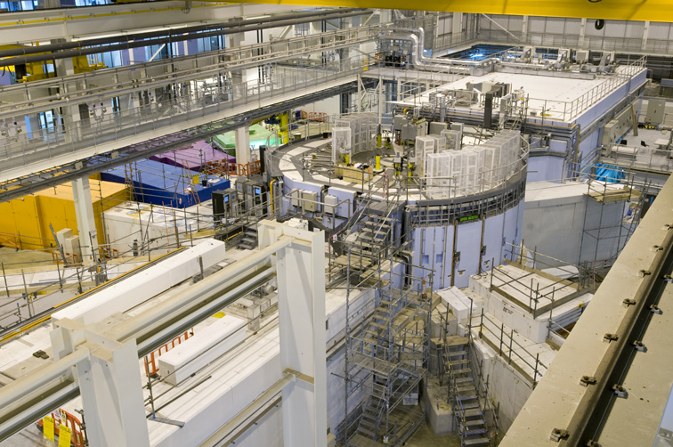
Az első nagy spallációs n forrás: ISIS Harwell, Anglia
Target
Csatornák

Slide 16
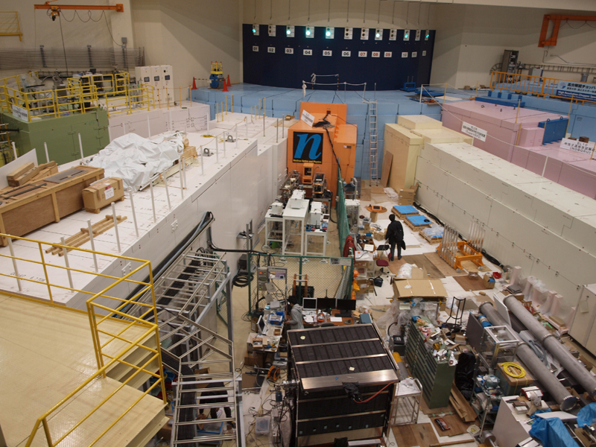
J-Parc, Ibaraki, Japan
n vezető
csatornák

Slide 17
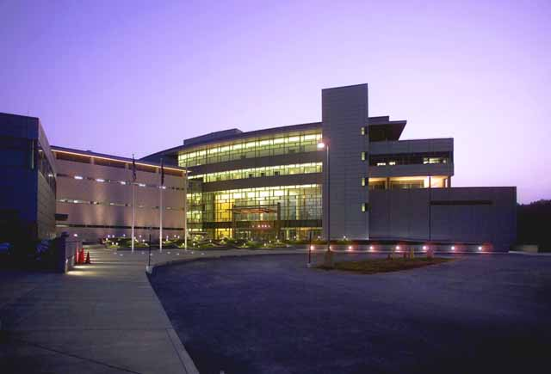
A legújabb spallációs n forrás: SNS, Oak Ridge, Tennessee, USA

Slide 18
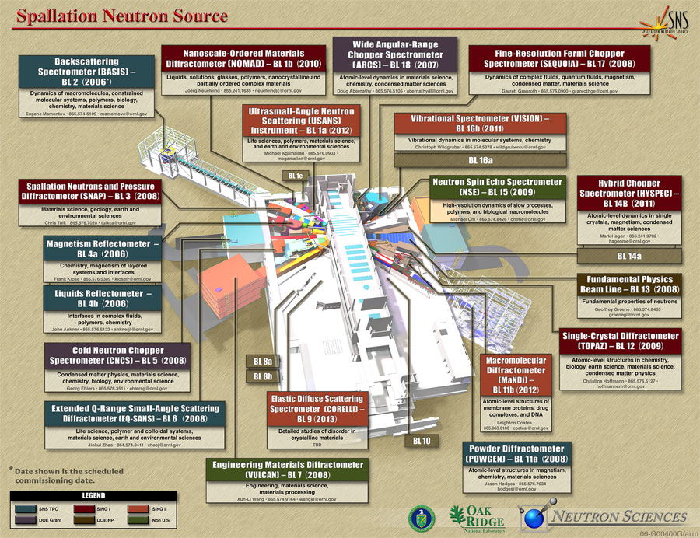

Slide 20
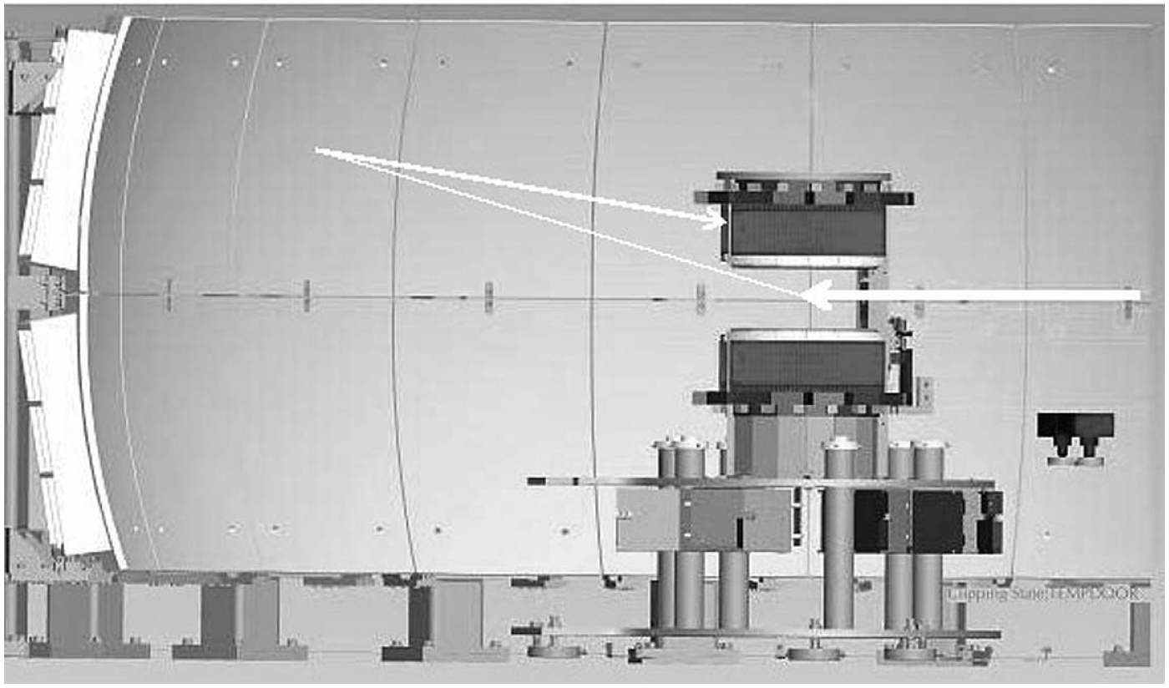
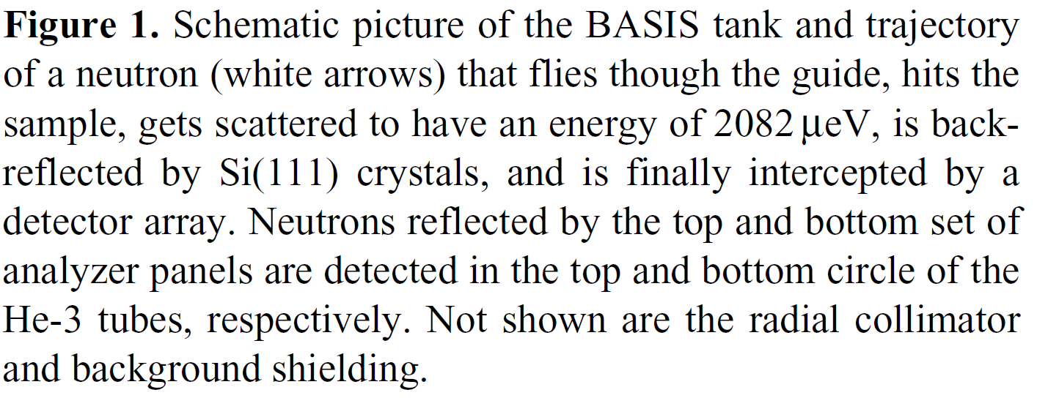

Slide 22
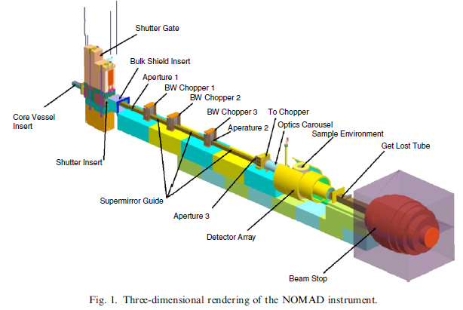
The Nanoscale Ordered Materials Diffractometer (NOMAD) is
a high-flux, medium-resolution diffractometer for SNS
using a large bandwidth of neutron energies and extensive
detector coverage to carry out structural determinations of
local order in crystalline and amorphous materials.

Slide 23
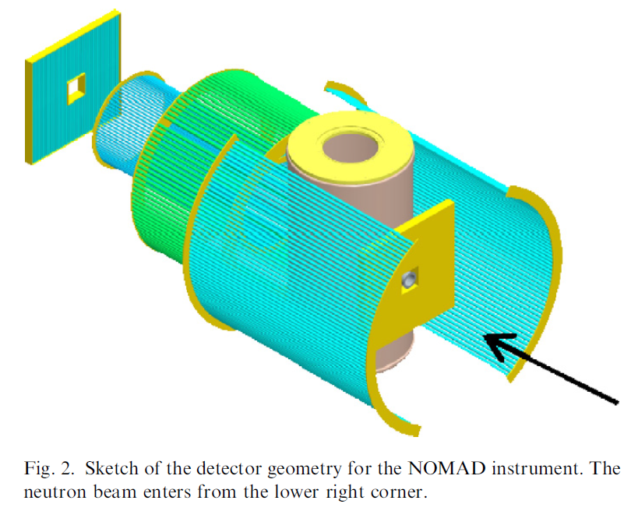
The Nanoscale Ordered Materials Diffractometer (NOMAD) is
a high-flux, medium-resolution diffractometer for SNS
using a large bandwidth of neutron energies and extensive
detector coverage to carry out structural determinations of
local order in crystalline and amorphous materials.

Slide 24
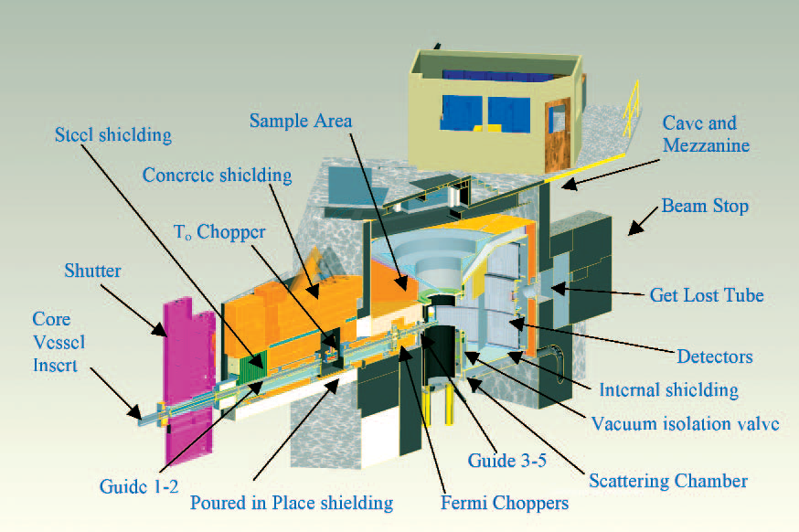
Wide angular-range spectrometer, ARCS

Slide 25
Wide angular-range spectrometer, ARCS
ARCS, a wide angular-range thermal to epithermal neutron
spectrometer, is one of an extensive suite of inelastic instruments
in operation or under construction at the Spallation
Neutron Source (SNS) at Oak Ridge National Laboratory. By
providing a high flux of neutrons with moderate resolution
and a large detector coverage, ARCS will enable studies of excitations
from a few to several hundreds of meV in fields such
as lattice dynamics and quantum magnetism.

Slide 26
A fine resolution chopper spectrometer (SEQUOIA) recently received first neutrons
at the SNS. The commissioning phase of the instrument is underway. SEQUOIA is designed
to utilize neutrons of an incident energy (Ei) between 10-2000 meV. A monochromatic beam
is provided on a sample, 20 m from the decoupled ambient temperature H2O moderator, by
filtering the white beam with a Fermi chopper located 18 m from the source. After interacting
with the sample, neutrons are detected by an array of 3He linear position sensitive tubes located
on a vertical cylinder with a radius of 5.5 m.

Slide 27
Pharos is designed for studies of fundamental
excitations in condensed-matter systems. The
instrument provides 2% to 4% incident energy
resolution and uses a high-speed Fermi chopper
to obtain monochromatic incident energies in
the range from 10 meV to 2 eV. The sample is
positioned 20 m from a chilled-water moderator.
The spectrometer consists of an evacuated, shielded
flight path with 10 m2 of meter-long position-sensitive
detectors located at a distance of 4 m from the
sample and covering scattering angles between
-10° and 145°. Pharos can accommodate the full
range of inelastic scattering experiments on liquid,
polycrystalline, and single-crystal samples. This
includes phonon and spin-wave dispersions, phonon
density of states, magnetic excitations, momentum
distributions, spin-orbit and crystal-field levels,
chemical spectroscopy, and measurements of S(Q,ω)
in disordered systems. In addition, the low-angle
detectors are available for use at distances between
4 and 10 m with scattering angles down to 0.65°,
thus making it suitable for high-resolution inelastic
studies (< 1% resolution) at low Q.

Slide 28
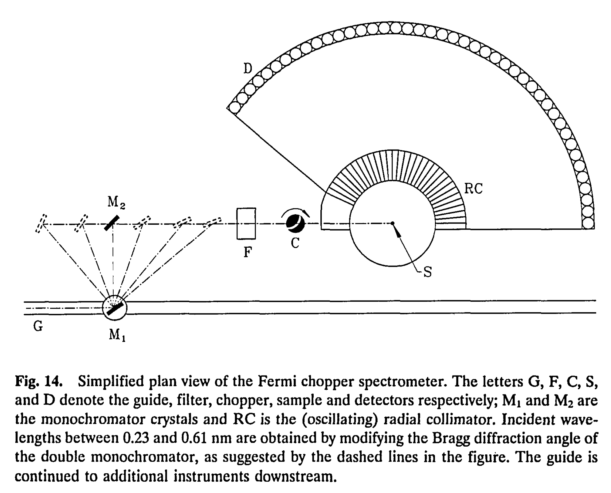
Fermi-chopper

Slide 30
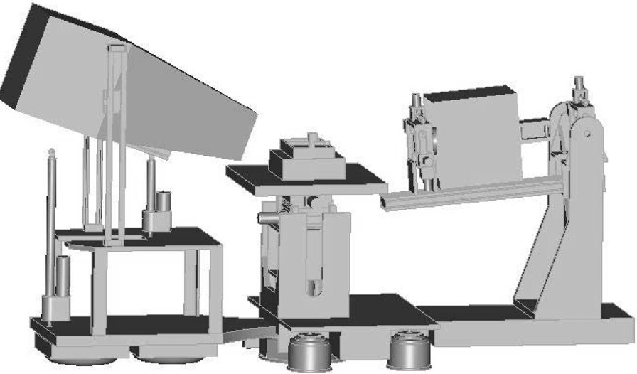

Slide 31
Fig. 1. SNS liquids reflectometer concept. Neutrons are incident from the right,
passing through two slits onto a sample stage (a
Langmuir trough is shown). The detector (left) will be either
a 2D PSD or a single 3He tube and can be positioned both in and out of
the specular reflection plane. Extensive sample and
detector motions are required in order to collect complete data sets using the
Δλ= 3.75 Å bandwidth of the incident neutrons.

Slide 33
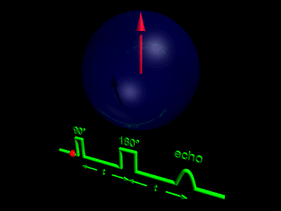
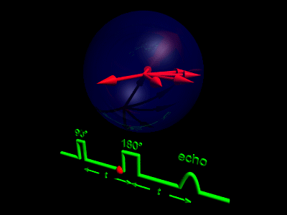
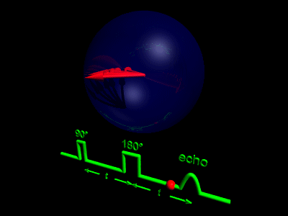
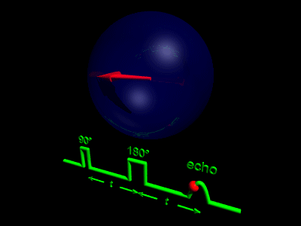
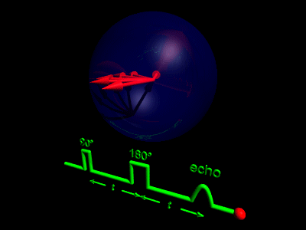

Slide 34
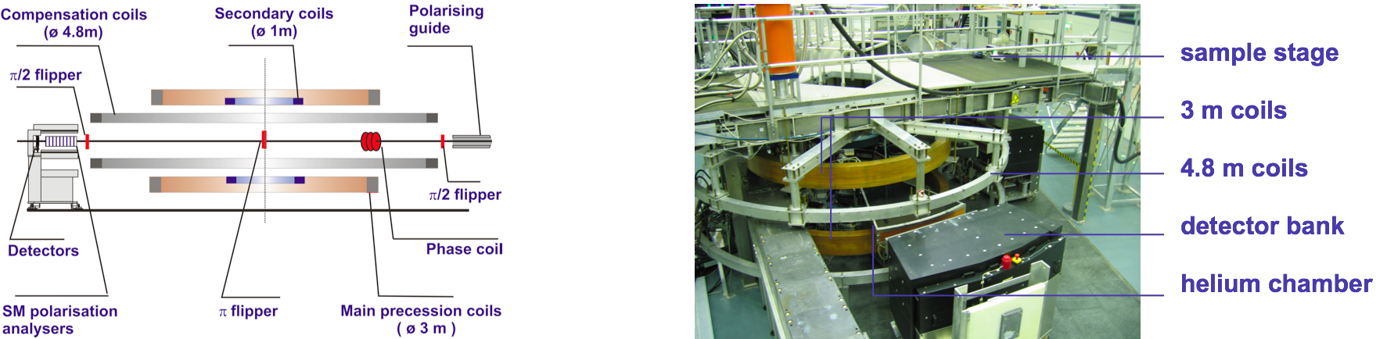
Neutron-Spin-Echo NSE (Mezei Ferenc)
Berlin HMI

Slide 35
Neutron-Spin-Echo NSE (Mezei Ferenc)
Berlin HMI

Slide 36
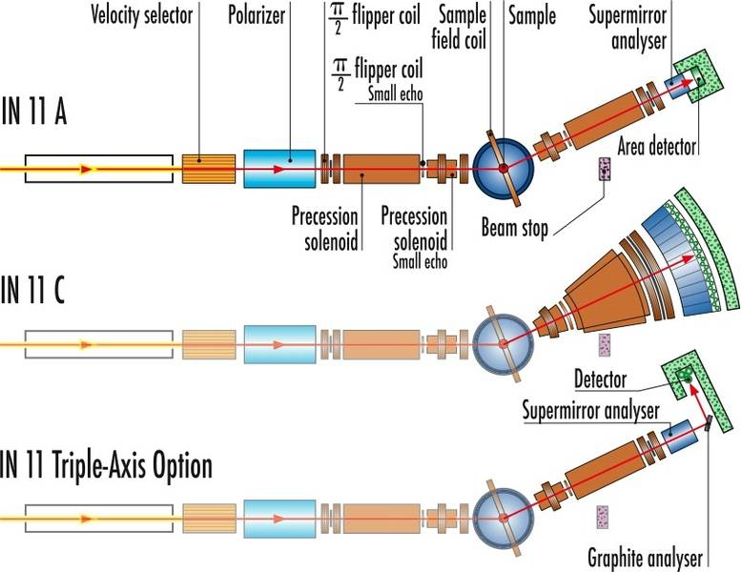
ILL-IN11 Grenoble (Mezei Ferenc)

Slide 37
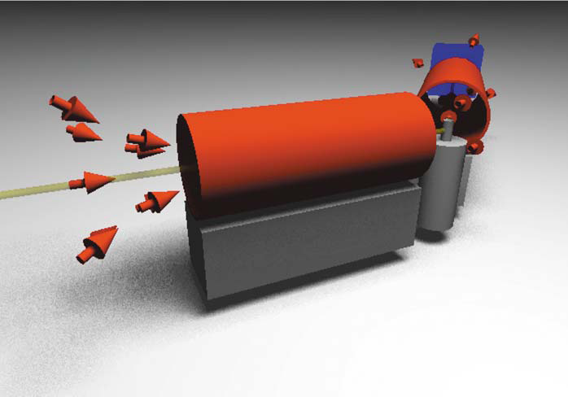
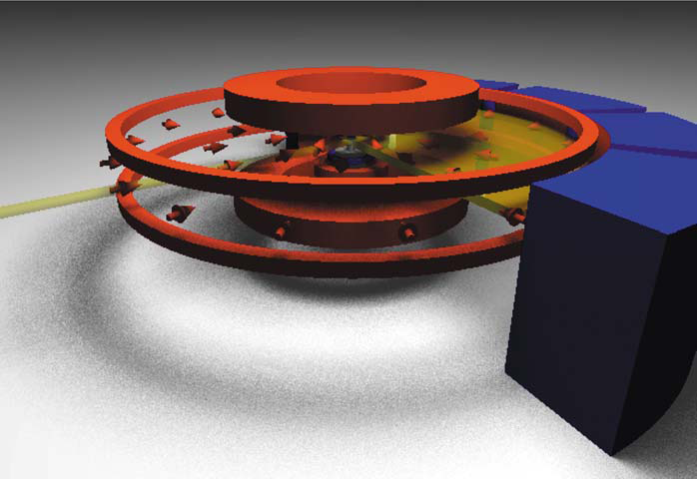
Supertükör NSE-hoz

Slide 39
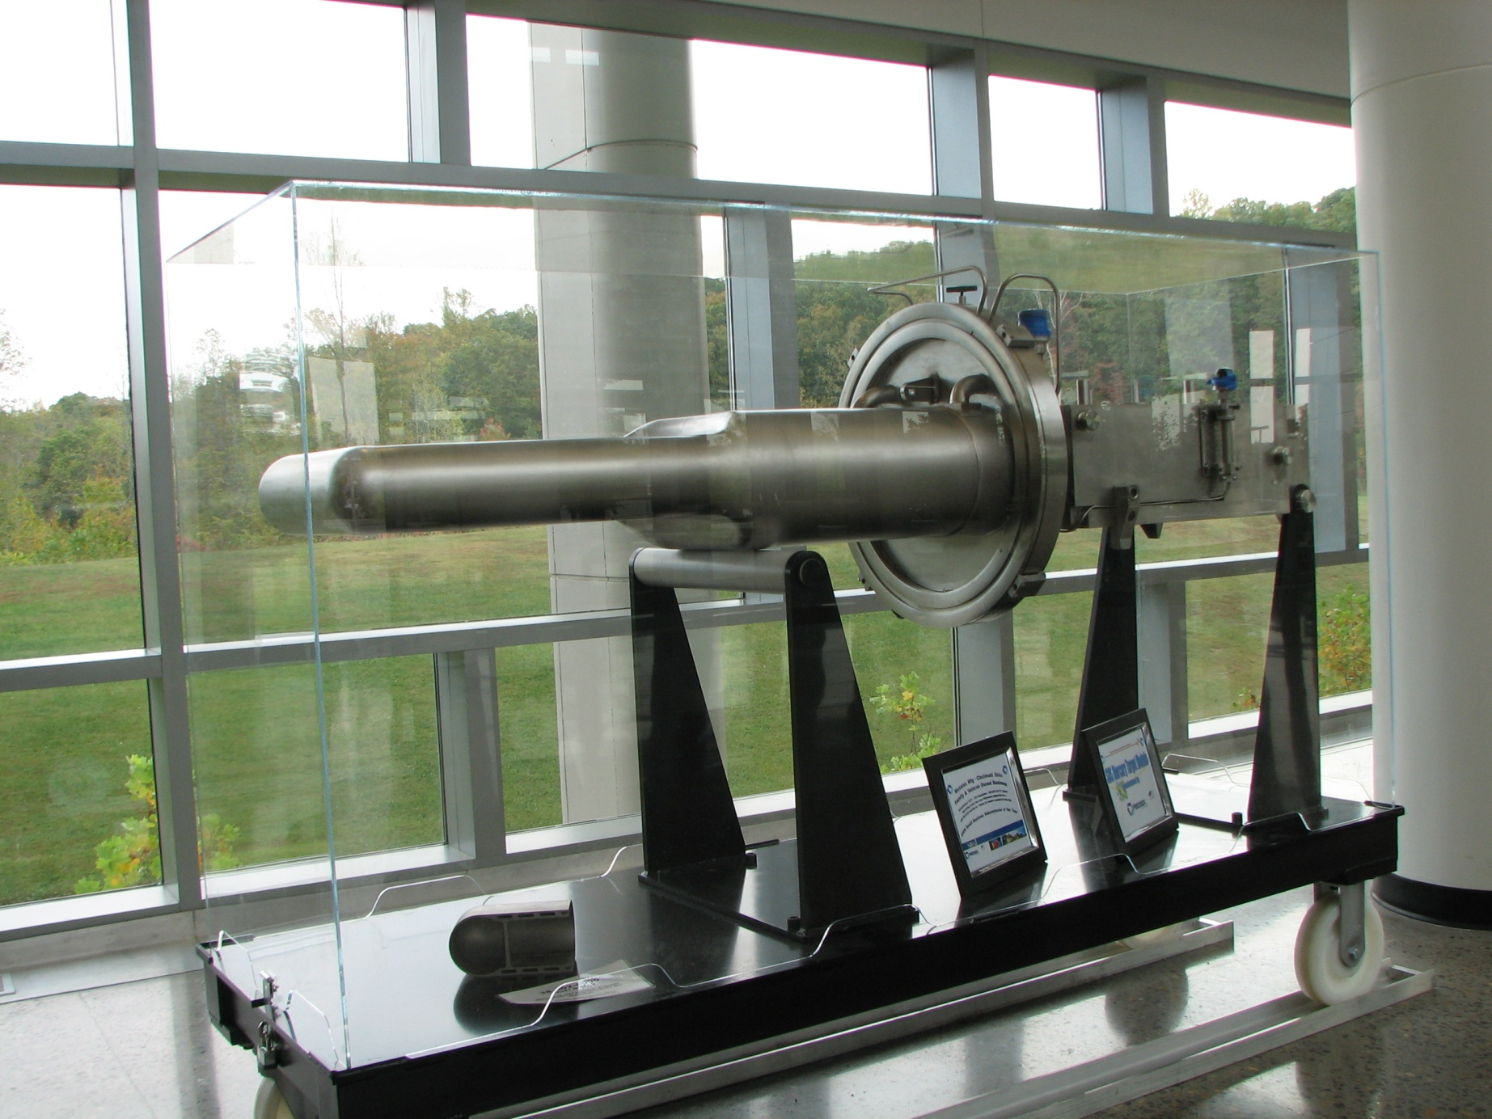
a Target

Slide 40
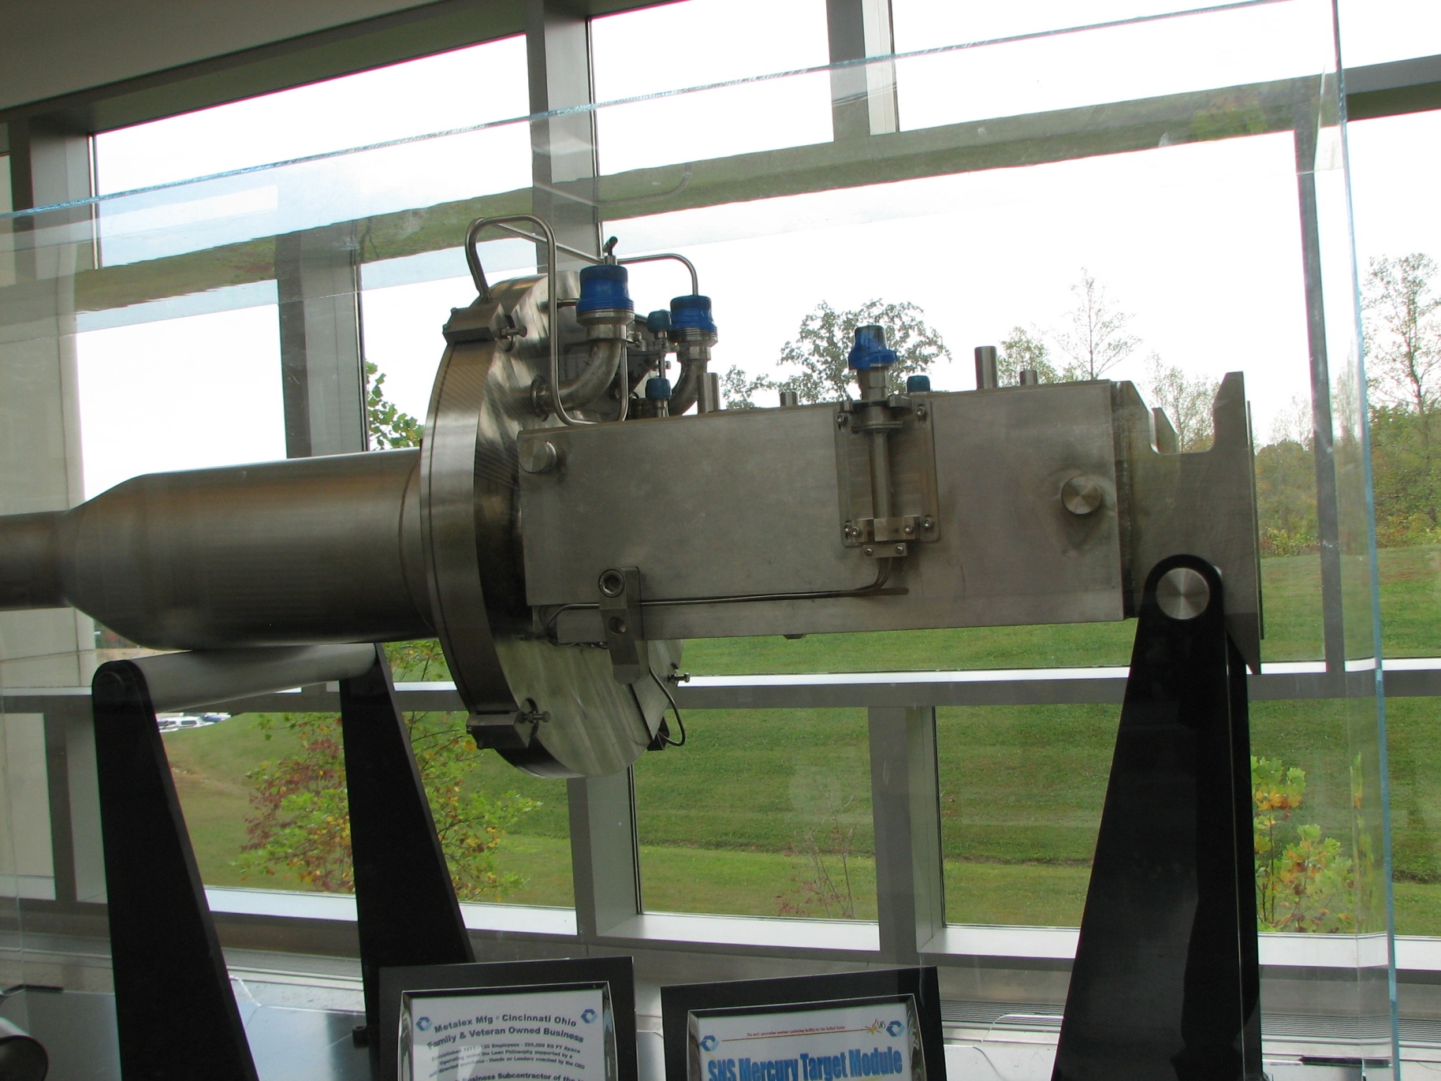
a Target

Slide 41
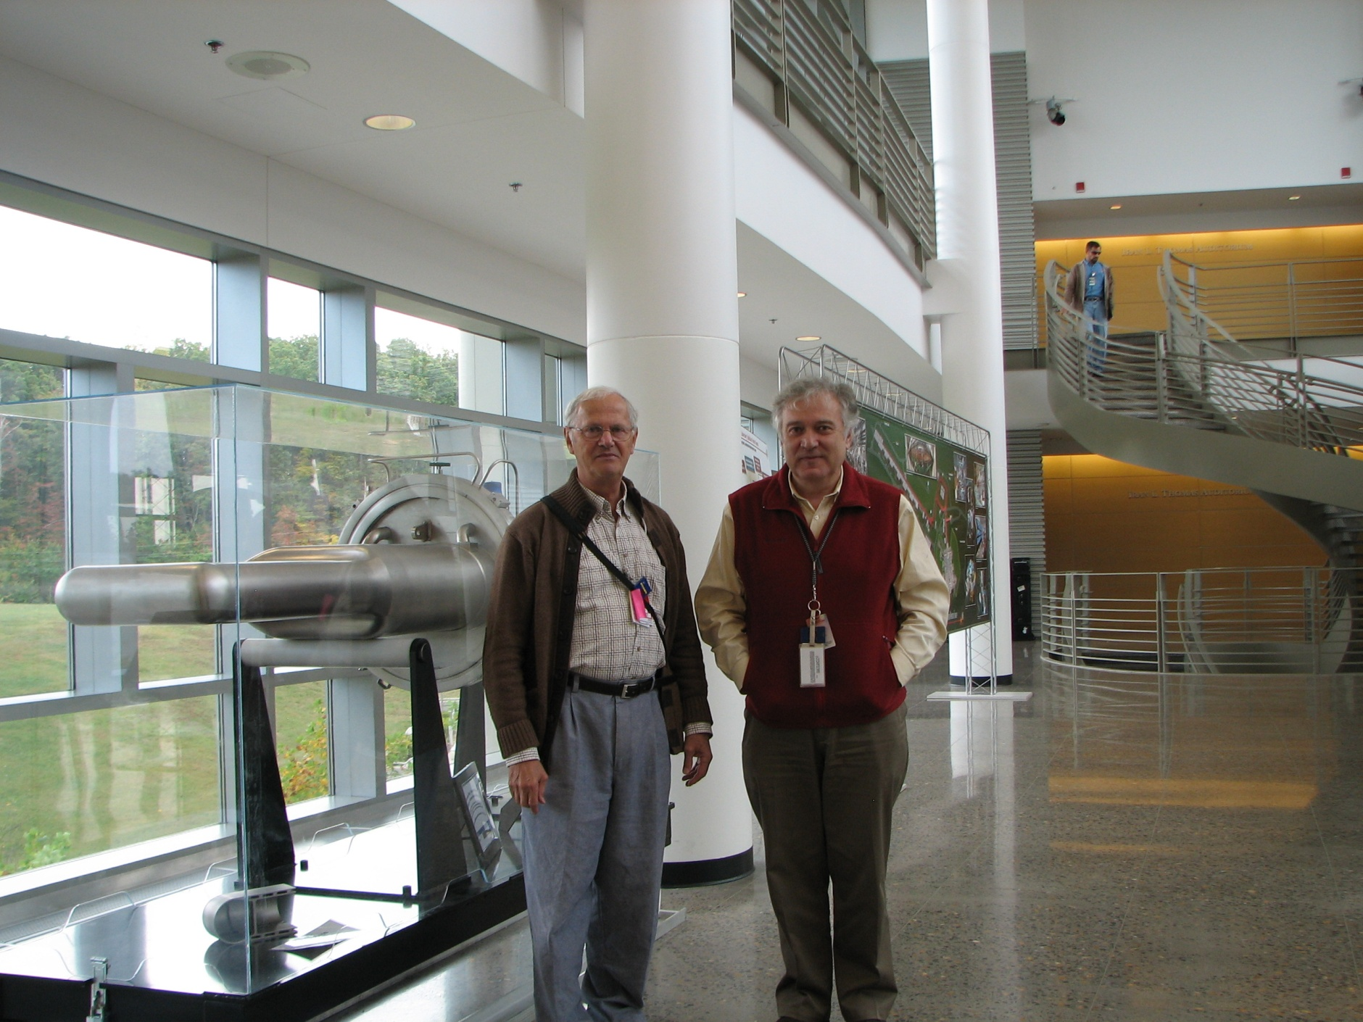
a Target

Slide 42
A következő fóliákért Alexander Stoica -nak
köszönettel tartozom

Slide 43
VULCAN: Guide – filter & focus
3
5
1-2
4
6
7-8

Slide 44
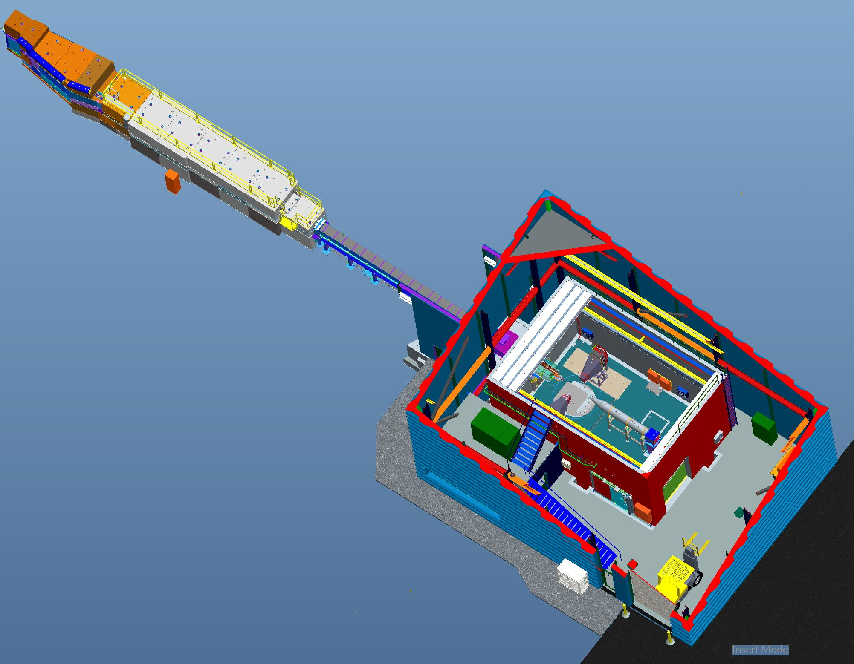
VULCAN: Overview
Removable Cave Roof
Front End Safety Rail
Sample Environment (Instrument Cave)
Front End Shielding
Truck Bay
Beamline Shielding
Chopper Rack
8707 Satellite Building
Electrical Mezzanine (Power Panels / DAS Racks)
Control Office

Slide 45
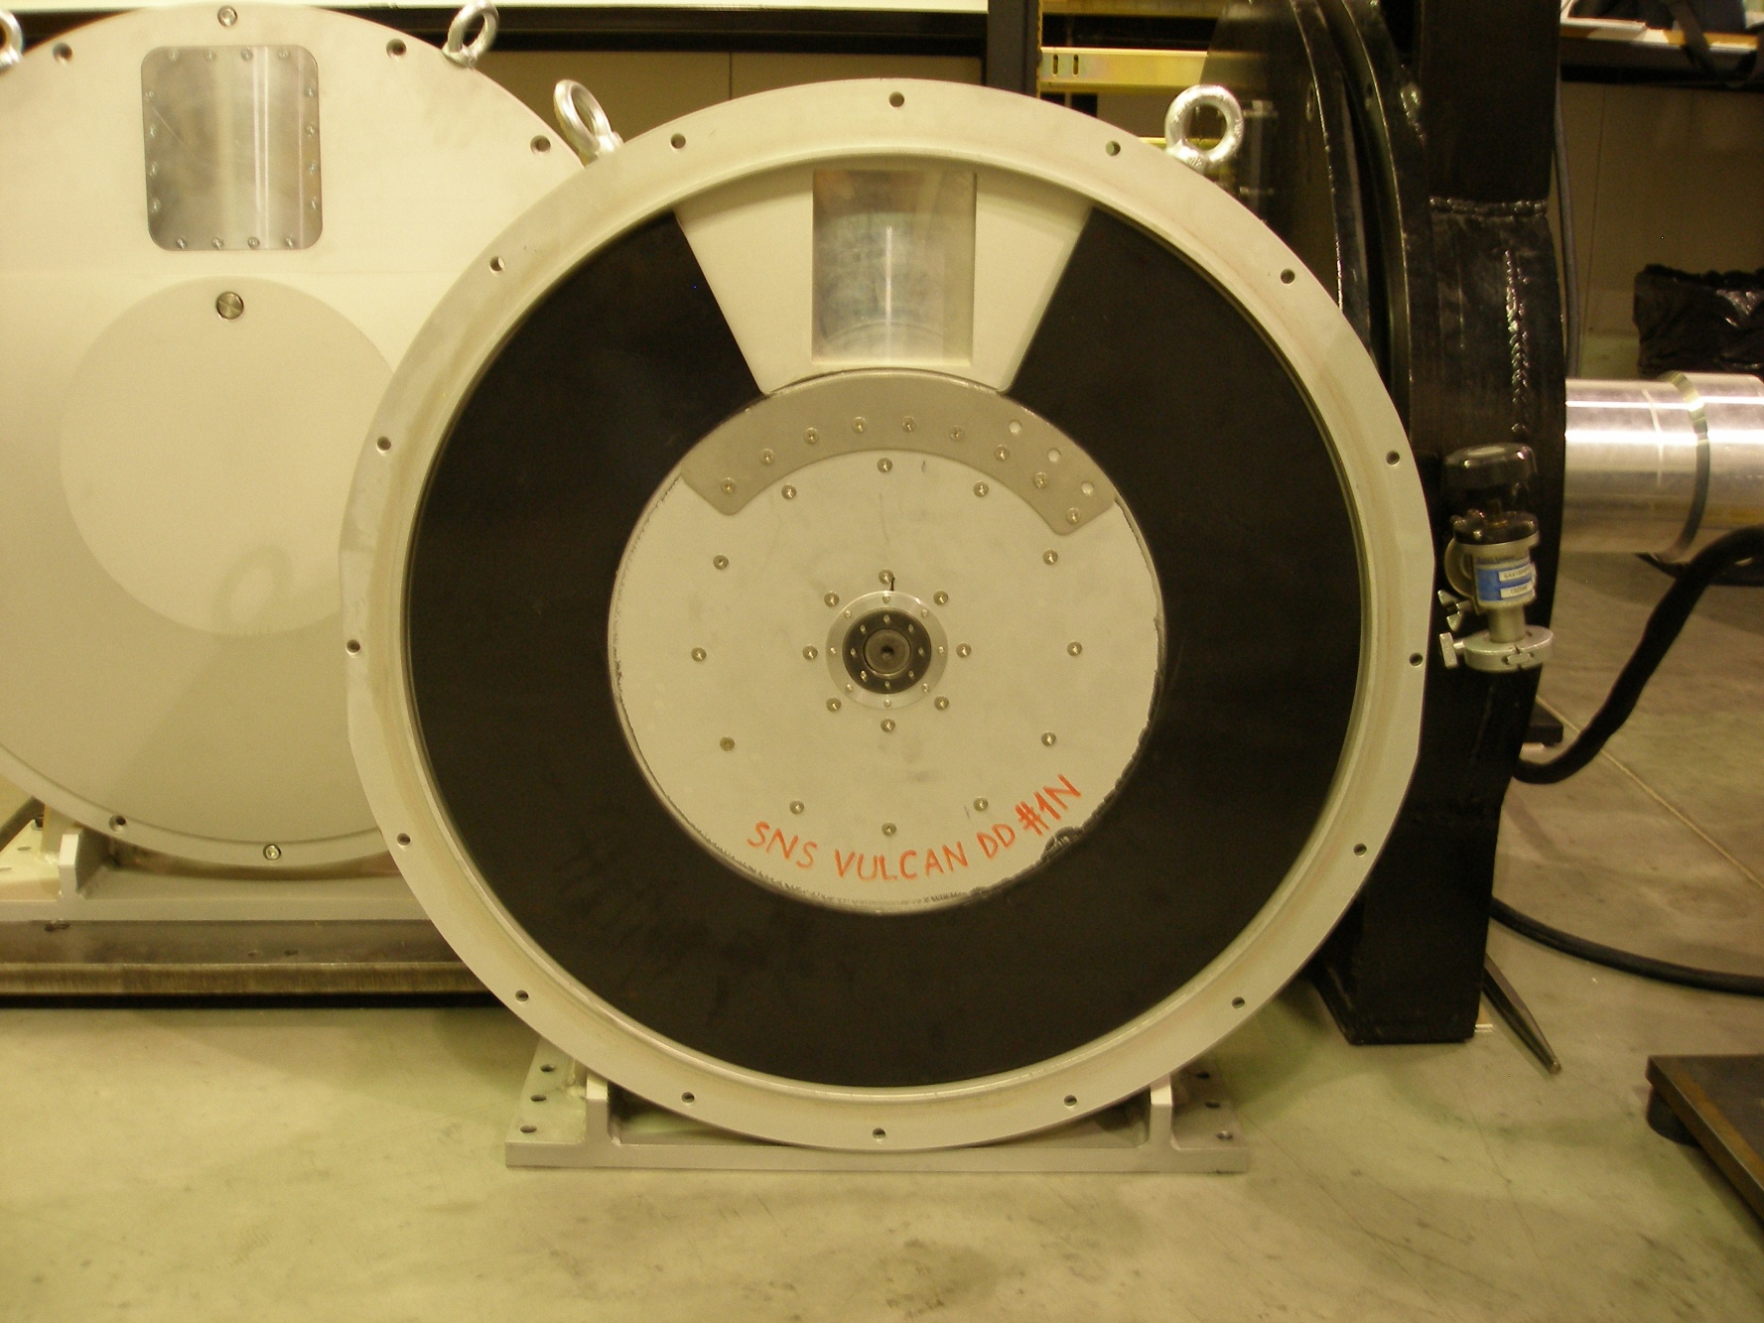
Double Disc Chopper: made in Hungary

Slide 46
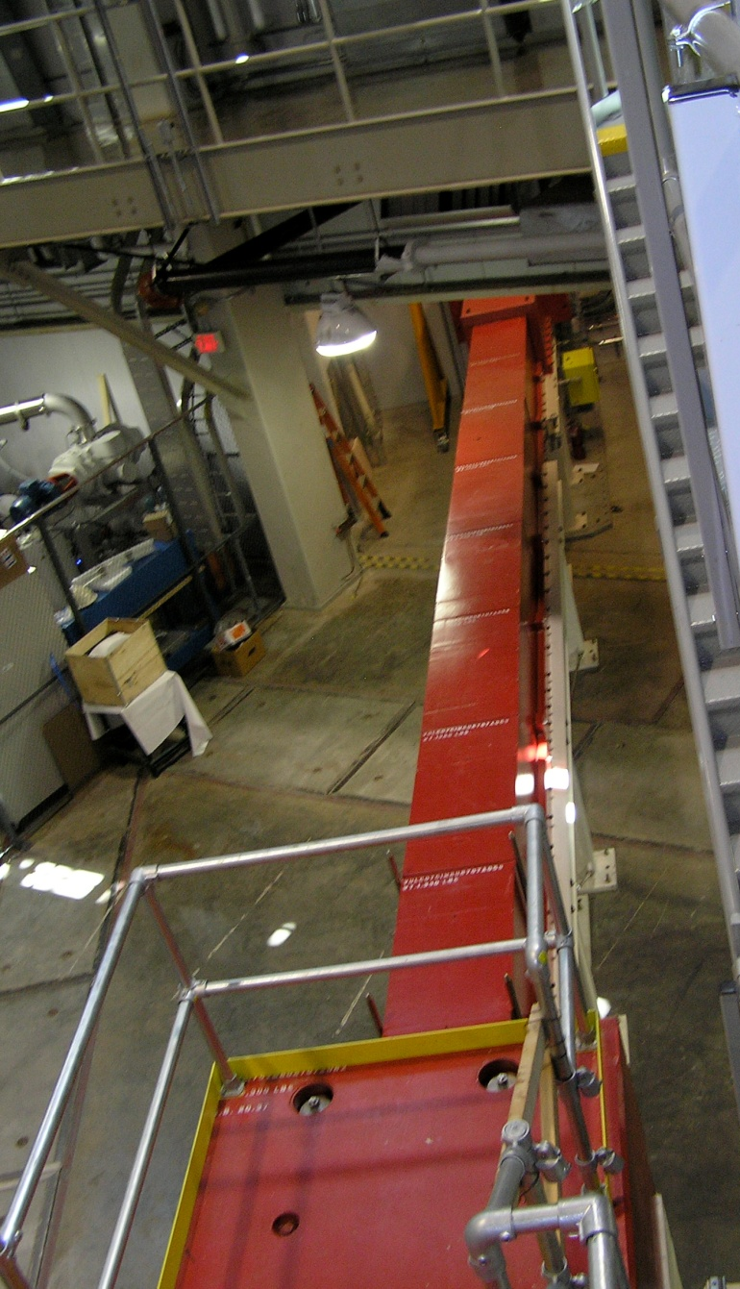
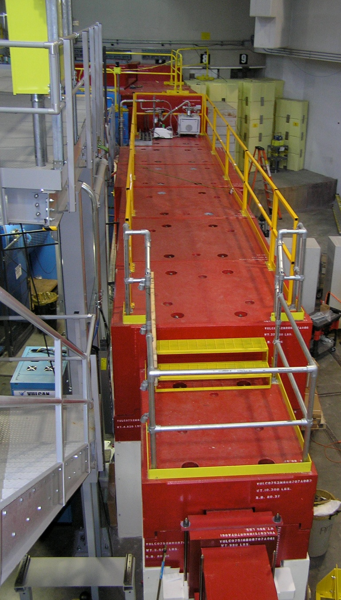
Vulcan: shielding

Slide 47
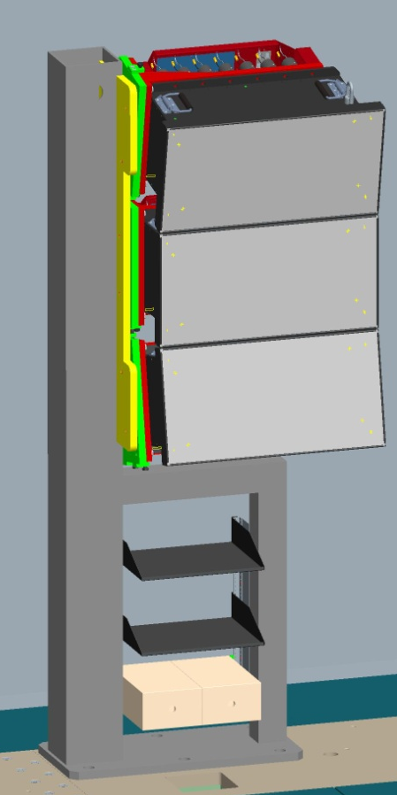
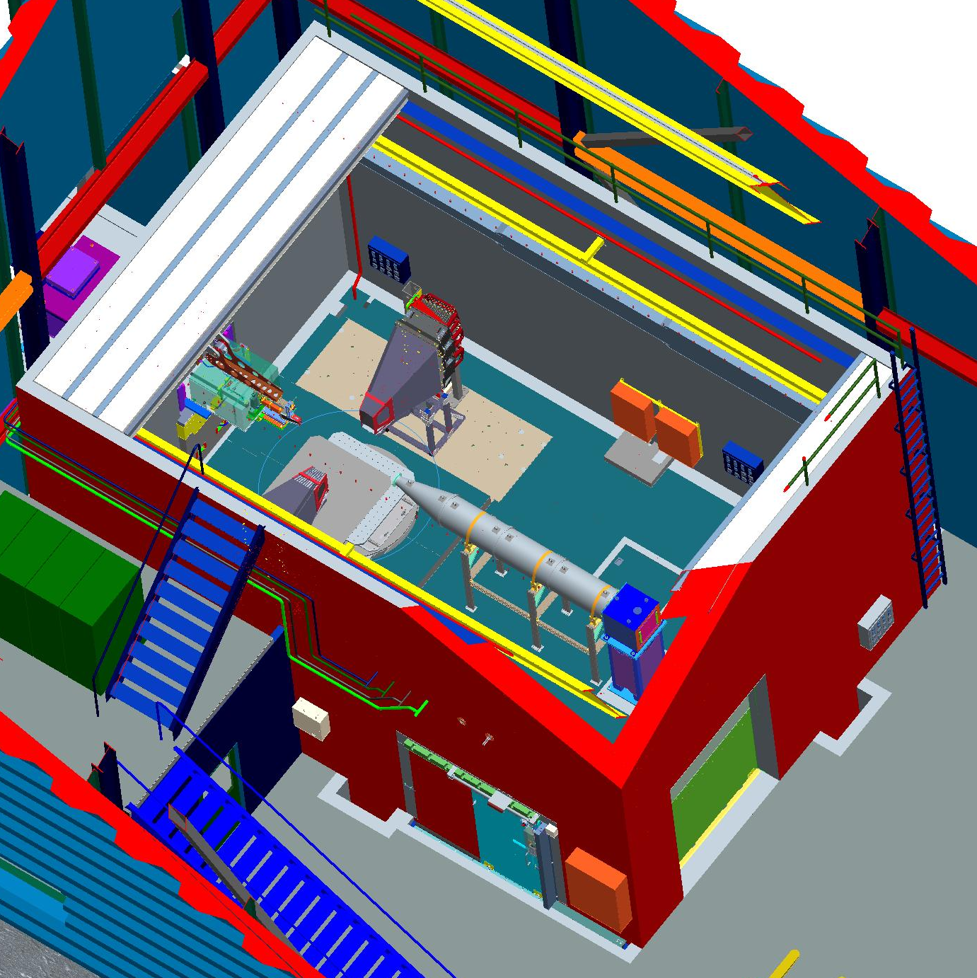
Vulcan: hutch (kuckó)
90° Detector
Collimator
Basement Hatch
Get-Lost-Tube
Beamstop
SPS
Utility Door
Personnel Door
PPS Main Control Panel / Door Control

Slide 48
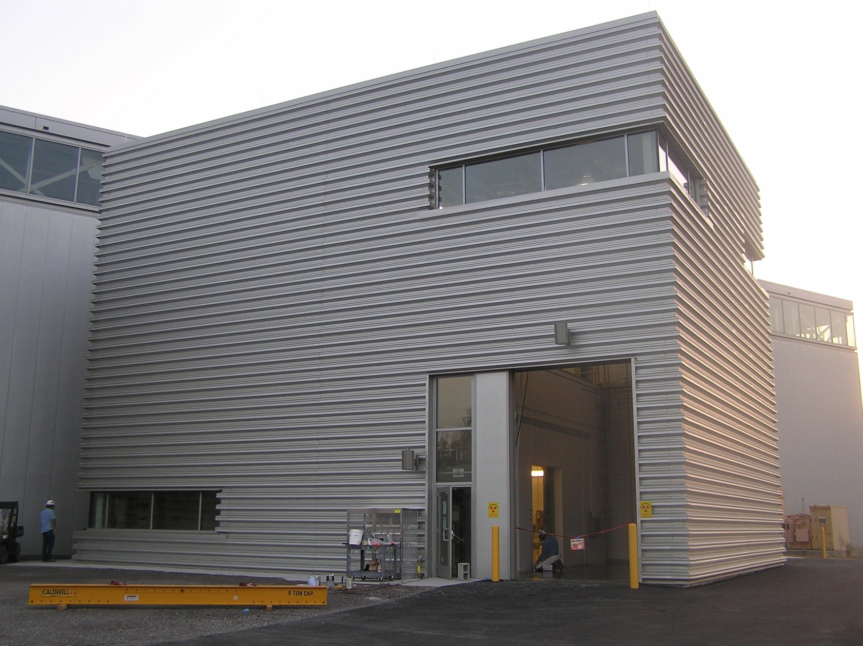
VULCAN: kintről

Slide 49
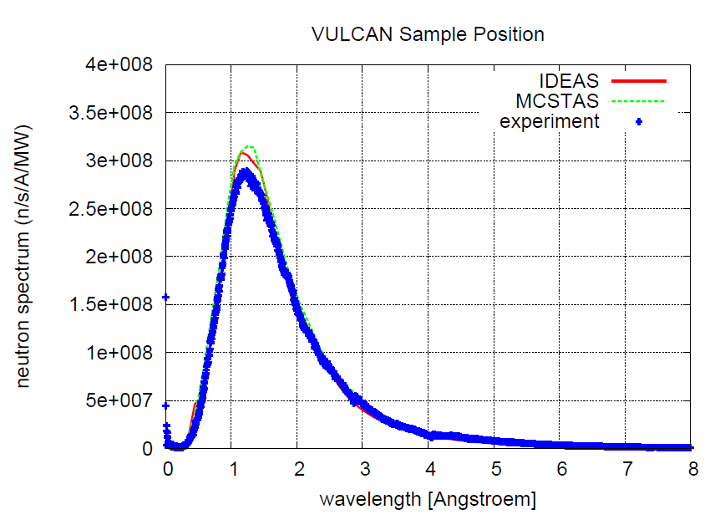
Flux Measurements

Slide 50
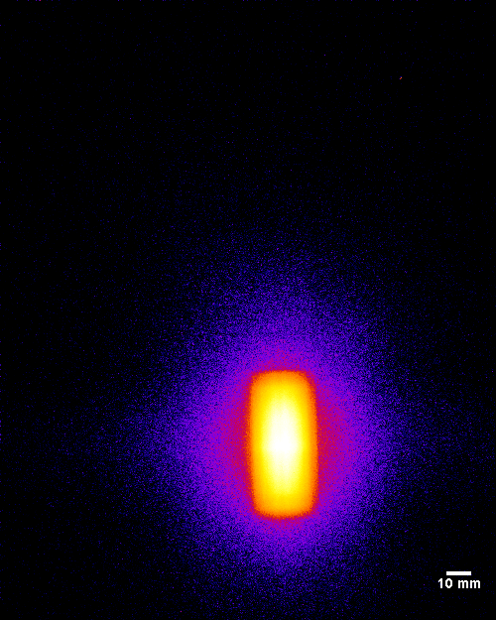
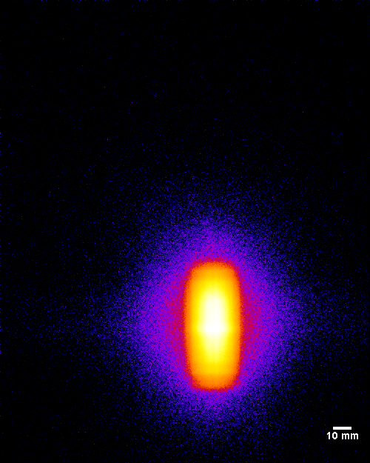
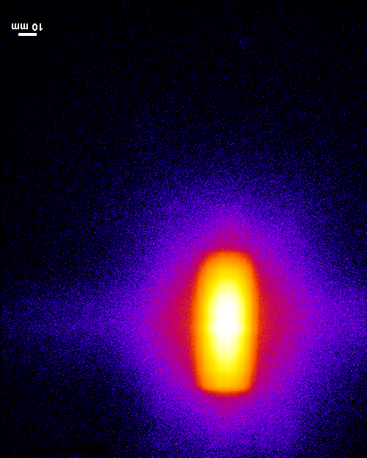
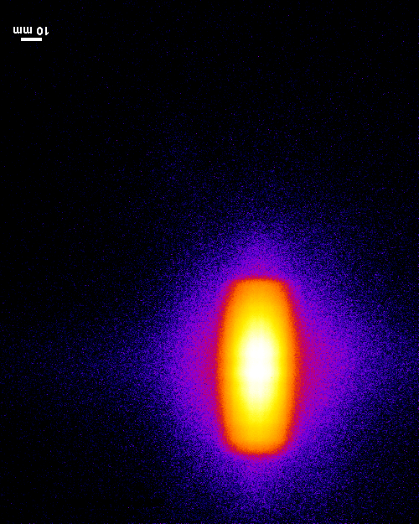
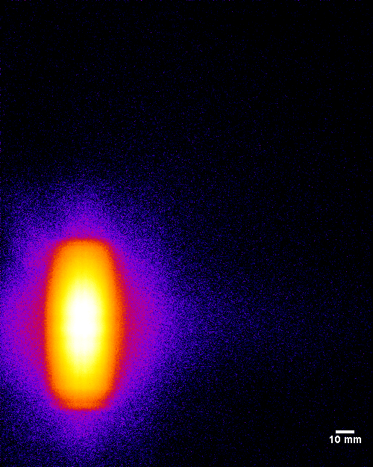
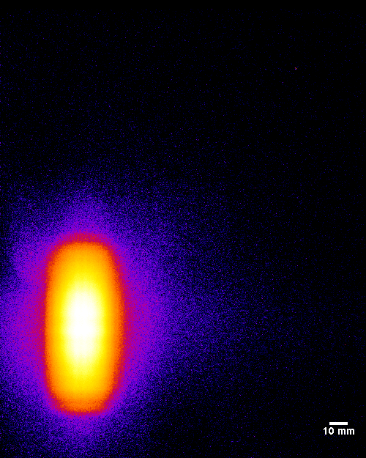
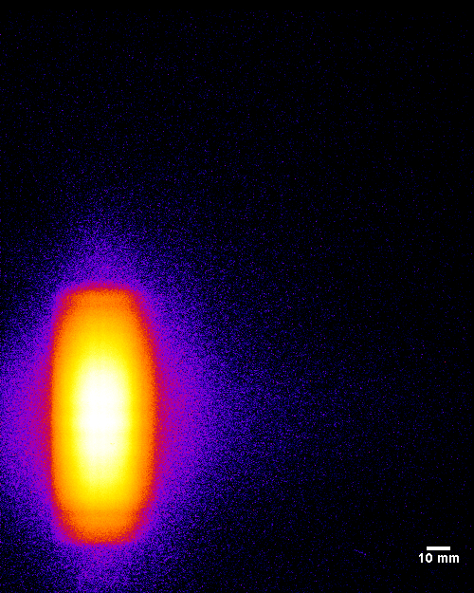
High Intensity – Beam Profile
1.0
1.3
1.6
1.9
2.2
2.5
3.0
λ

Slide 51
High Intensity – Flux Estimation
60Hz ~ 6.7×10⁷ n/cm²/s/MW
30Hz ~ 3.8×10⁷ n/cm²/s/MW

Slide 52
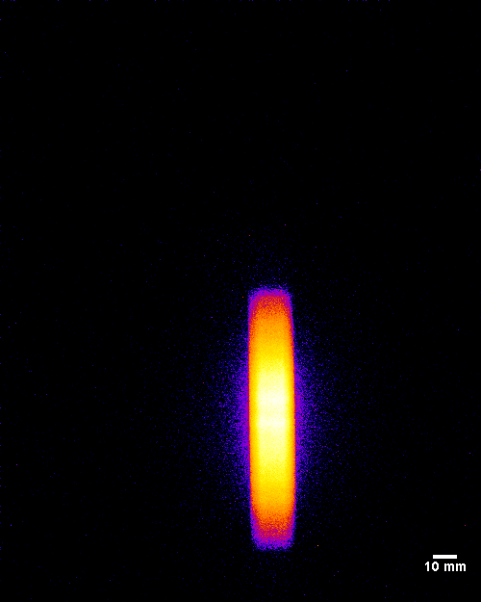
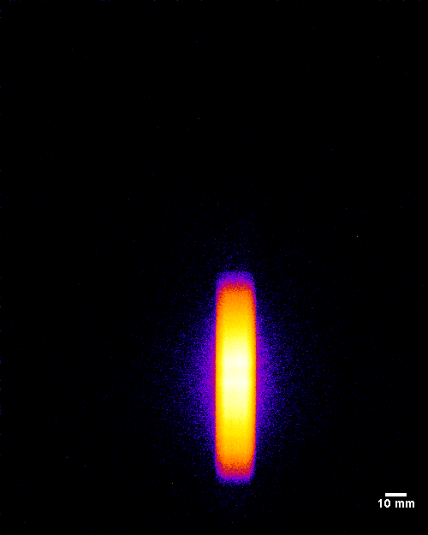
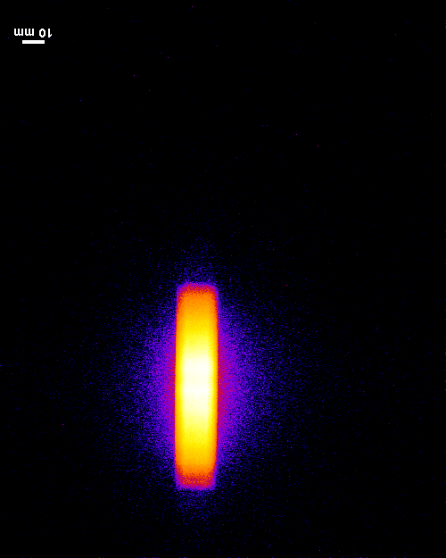
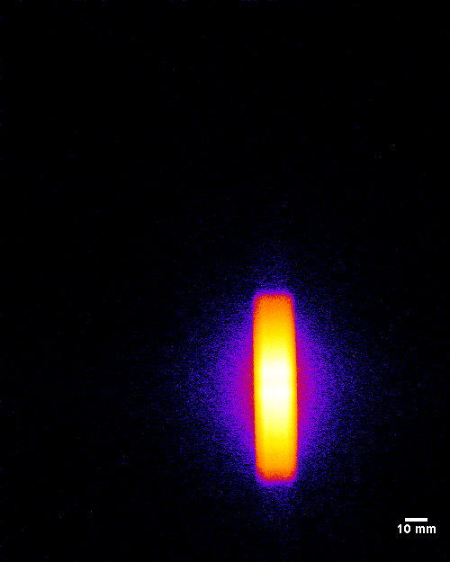
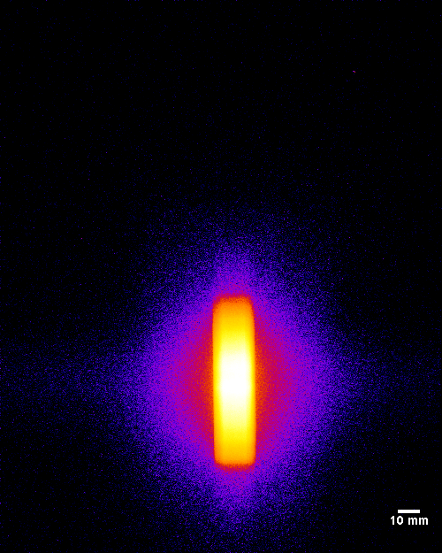
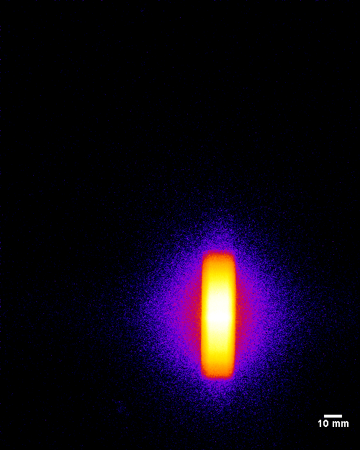

High Resolution – Beam Profile: no collimation
λ: 3.0
2.5
2.2
1.9
1.6
1.3
1.0

Slide 53







High Resolution Option: + collimation
λ: 1.0
1.3
1.6
1.9
2.2
2.5
3.0
Vertical: 1.60⁰
Horizontal: 0.20⁰
ANGULAR
DIVERGENCE

Slide 54


Detector Module

Slide 55

Detector Banks + Collimators

Slide 56
Q₁
Q₂
Detector Bank #1
-90°
Detector Bank #2
+90°

Slide 57

400 kW
Chopper running
at 30 Hz
2X at 60 Hz

Slide 58

Sample Table

Slide 59

Sample Table in the hutch

Slide 60

In-situ measurements with vacuum furnace
Notes:
Poisson ratio is about 0.37

Slide 61

In-situ data collected on extruded Ti rod
α
β
α
{20.0} missing
Bank 1
Bank 2

Slide 62
Load Frame

Slide 63
0.5 mm
0.5 mm
TOF miatt az anyag belseje (0.5 mm)³ térfogat felbontással pásztázható

