Slide 1

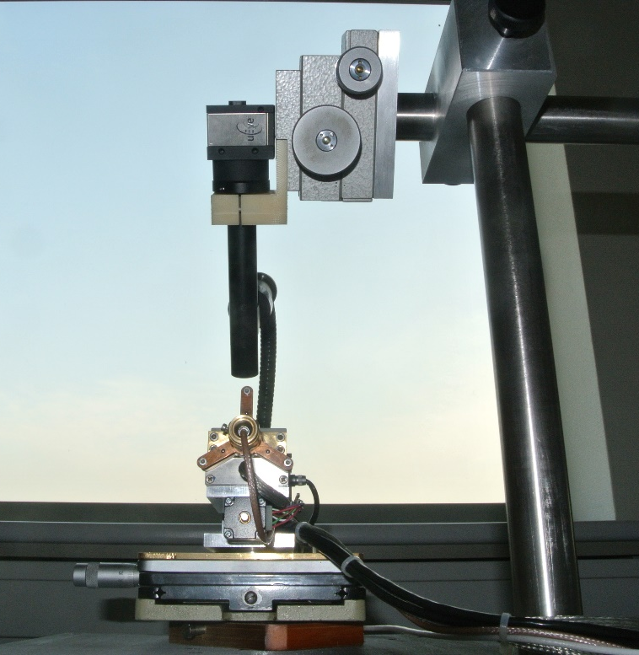
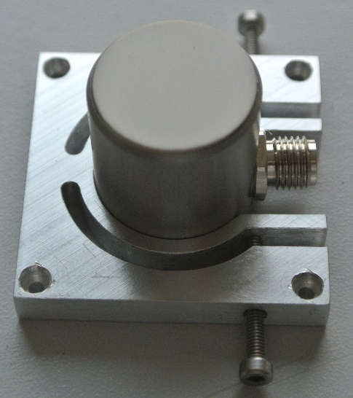
Plasticity on microscopic scale: stress fluctuations and the role of the specimen size
9th Seminar for Central European
PhD Students
Ádám István Hegyi
Prague, 20-21. November 2014

Slide 2
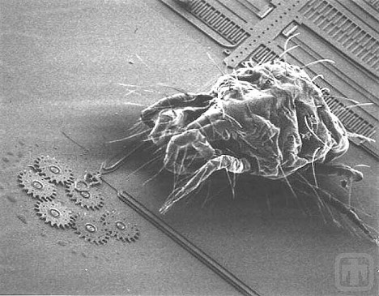
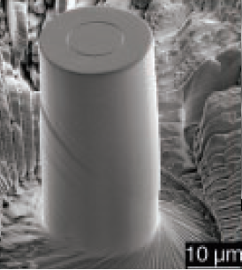
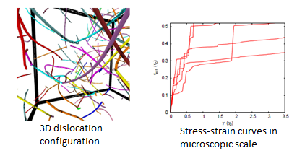
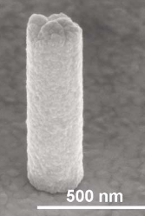
Motivation
Microscopic deformation:
Inhomogenity in space
Inhomogenity in time
Intermittent deformation
Yield stress can be defined only in statistic way
Micromechanical engineering:
The first measured dislocation avalanche
I. Groma G. Györgyi F. F. Csikor D. Weygand P. D. Ispanovity, Physical
Review Letters, (2010)
FIB-less, grown micropillar

Slide 3
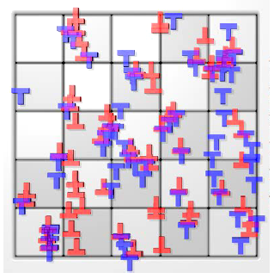
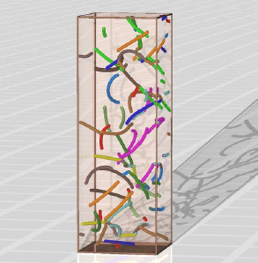
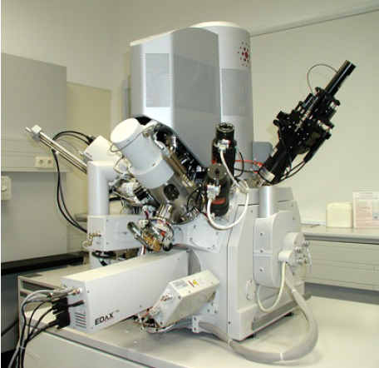
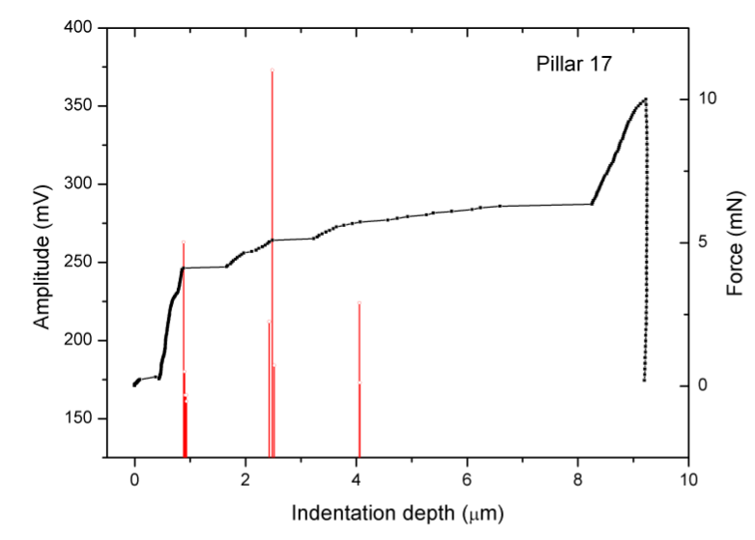
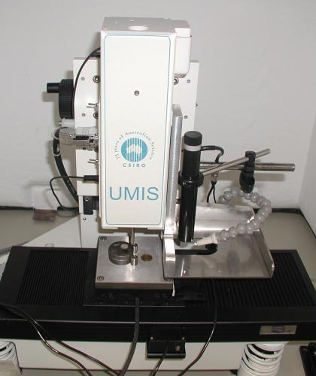
Methods
2D 3D
Acoustic emission
Micro compression

Slide 4
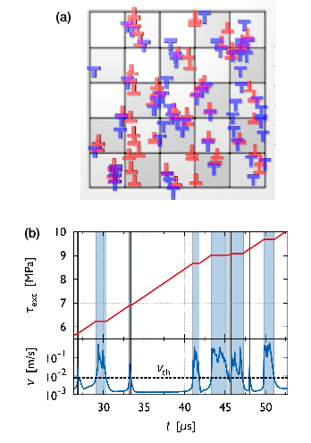
2(3)D-DDD simulations
2D system
Paralell edge dislocations
Overdamped dynamics (v ~ f)
Periodic boundary conditions
Allowed dislocation annihilation
An equal number of + and - dislocations
Quasi force-controll
No creation or hardening
3D is almost the same!
2D simuation configuration
2D deformation curve

Slide 5
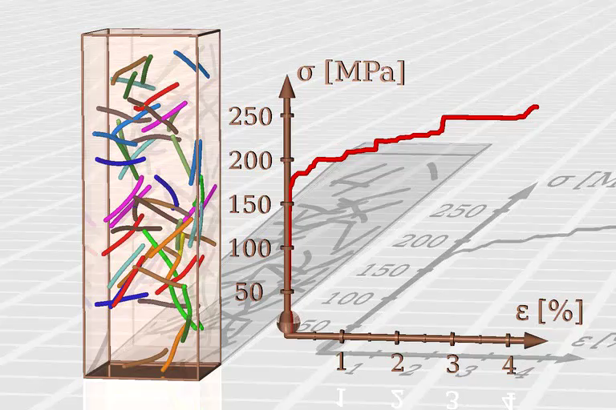
MOVIE!

Slide 6
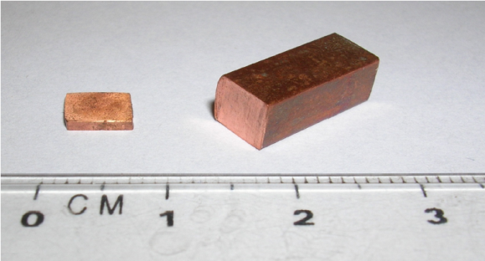
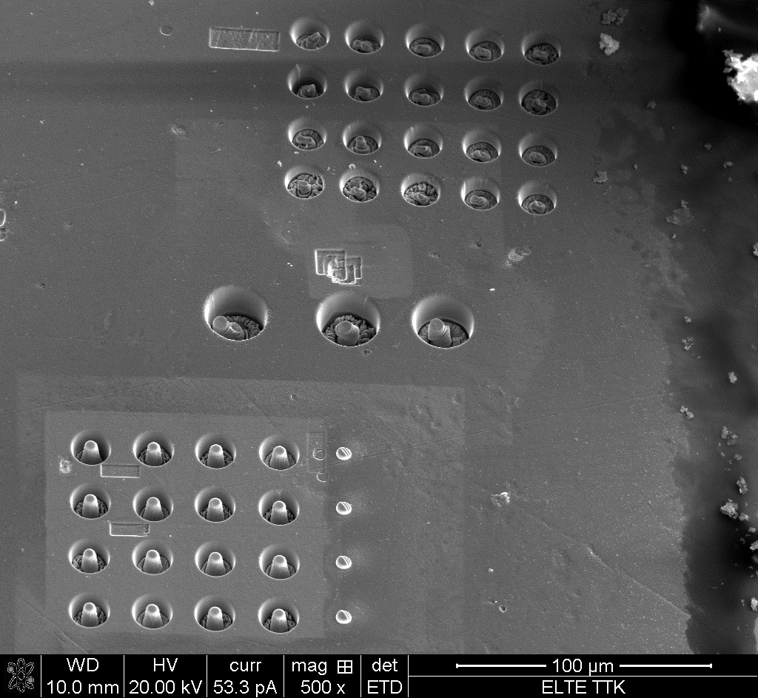
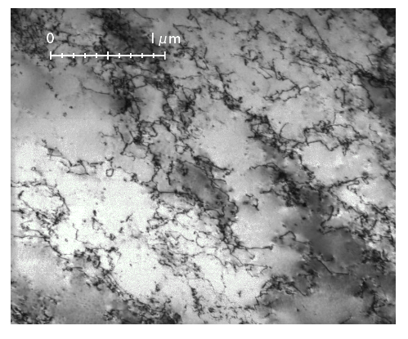
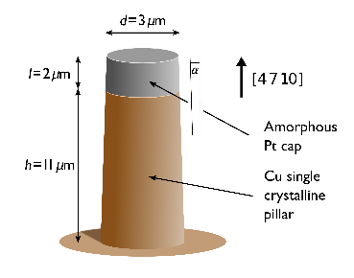
The sample
Cu SX
Mechanical and electropolished surface
[4 7 10] (single slip) orientation (EBSD and XLPA)
ρ=10¹⁴ m⁻² dislocation density (TEM)
The aspect ratio is about 4
3 µm: 42 pcs., 6 µm: 22 pcs., 12 µm: 16 pcs.
Pt cap

Slide 7
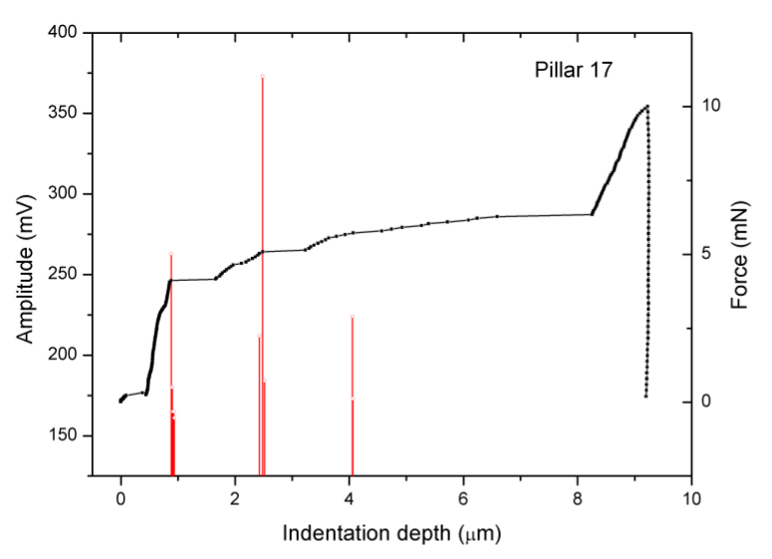
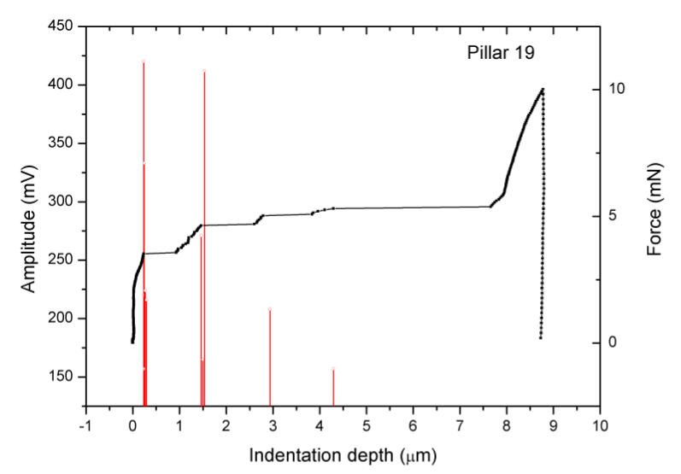
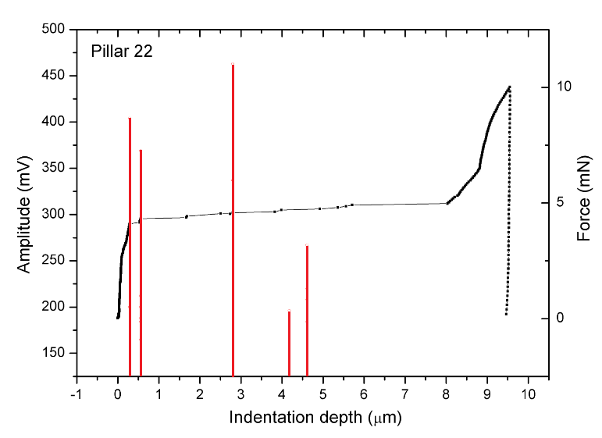
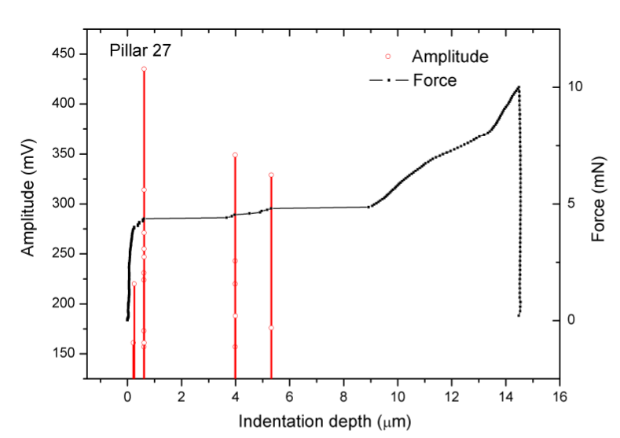
Acoustic Emission

Slide 8
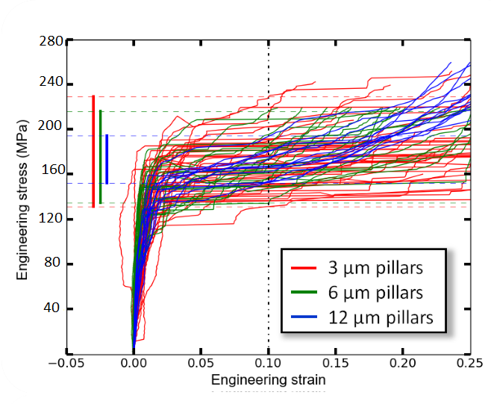
Micropillar compressions
High flow stress
Deceasing yield stress fluctuacion
Geometrical shape
Averaging direction

Slide 9
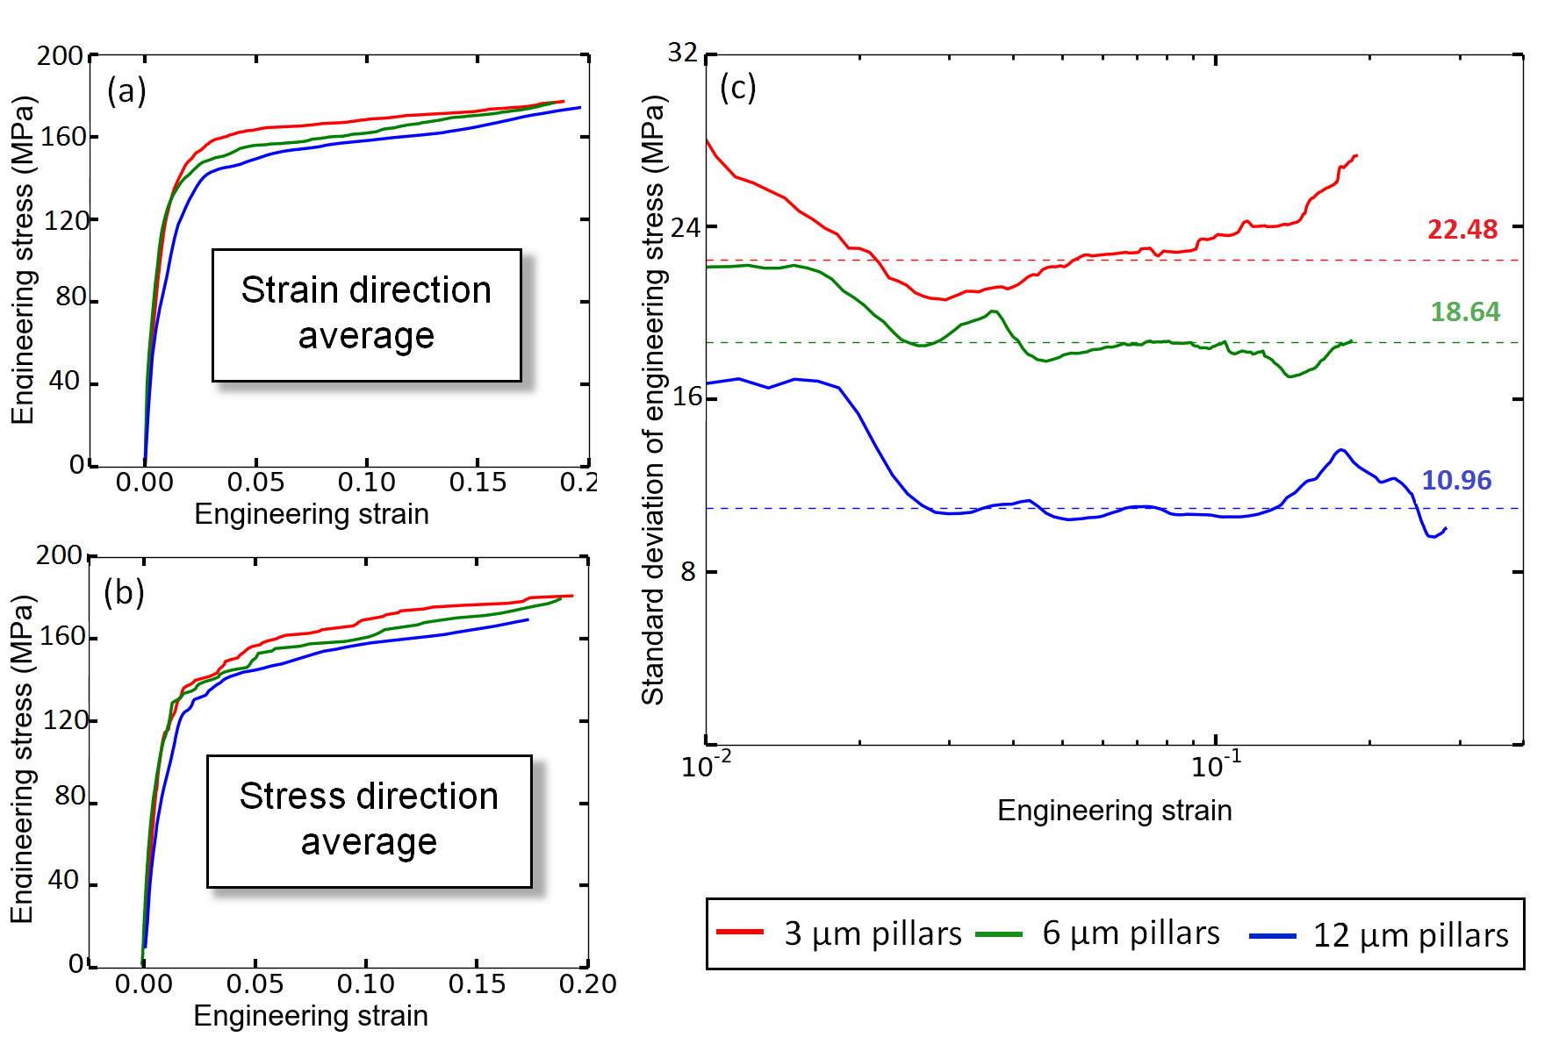
Deformation statistics

Slide 10
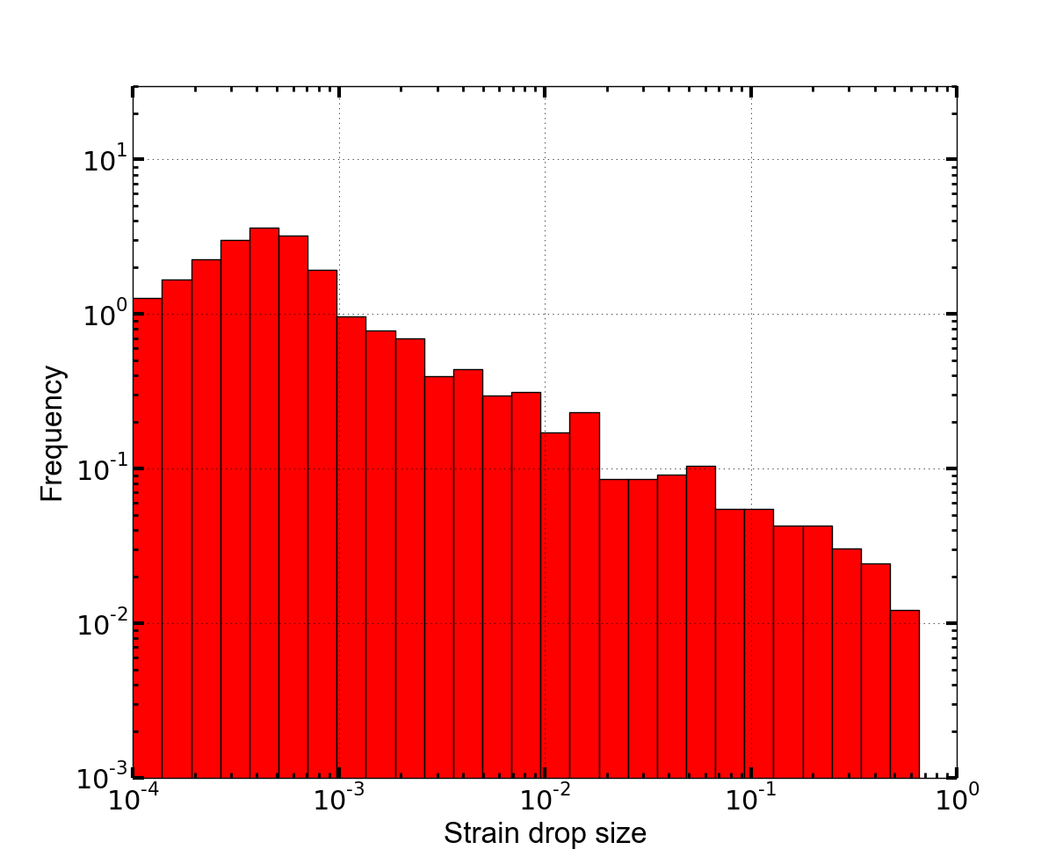
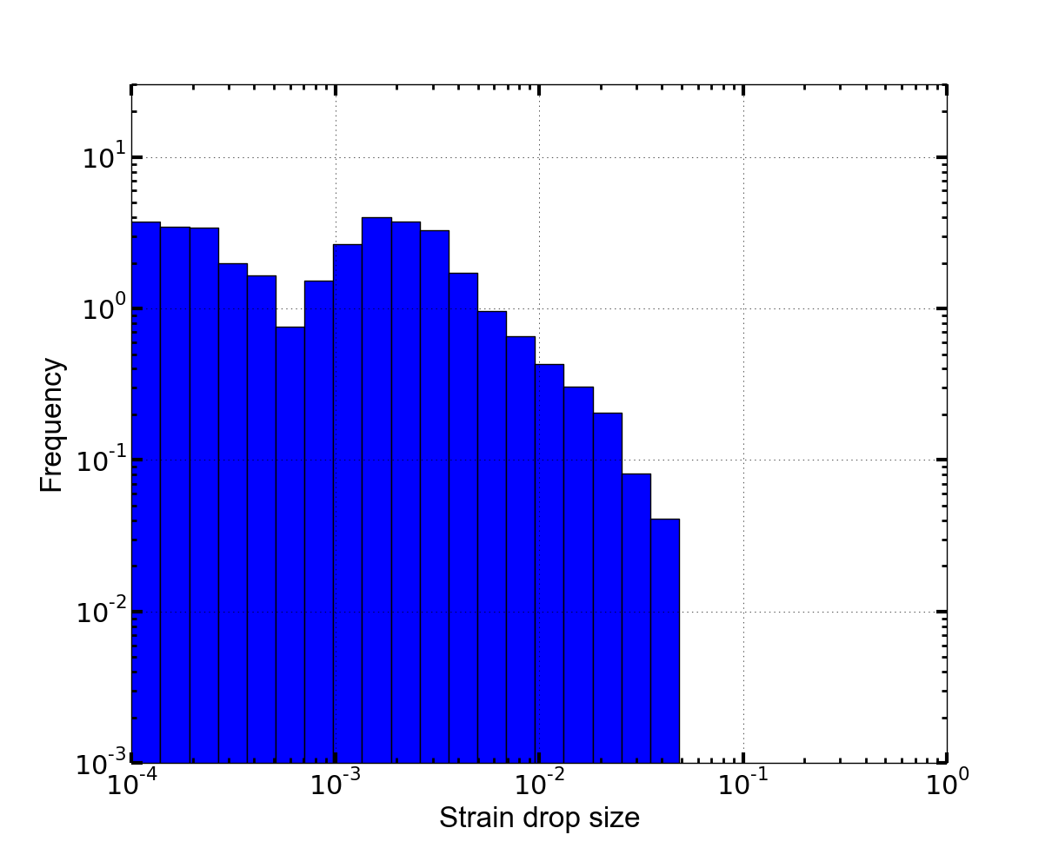
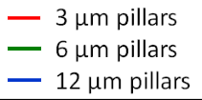
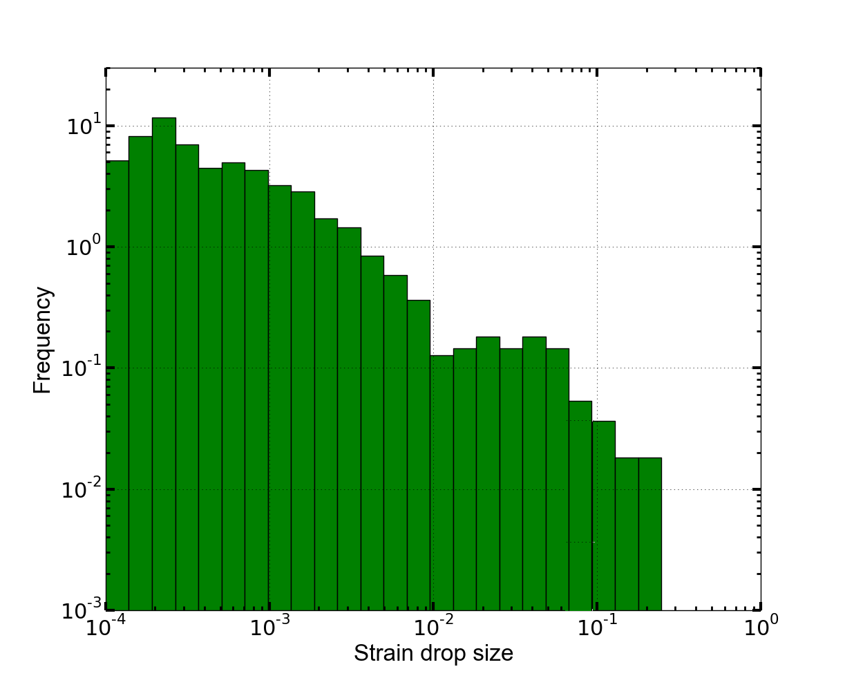
Avalanche distributions
Increasing power-law exponent with increasing size
Constant avalanche size in microns

Slide 11
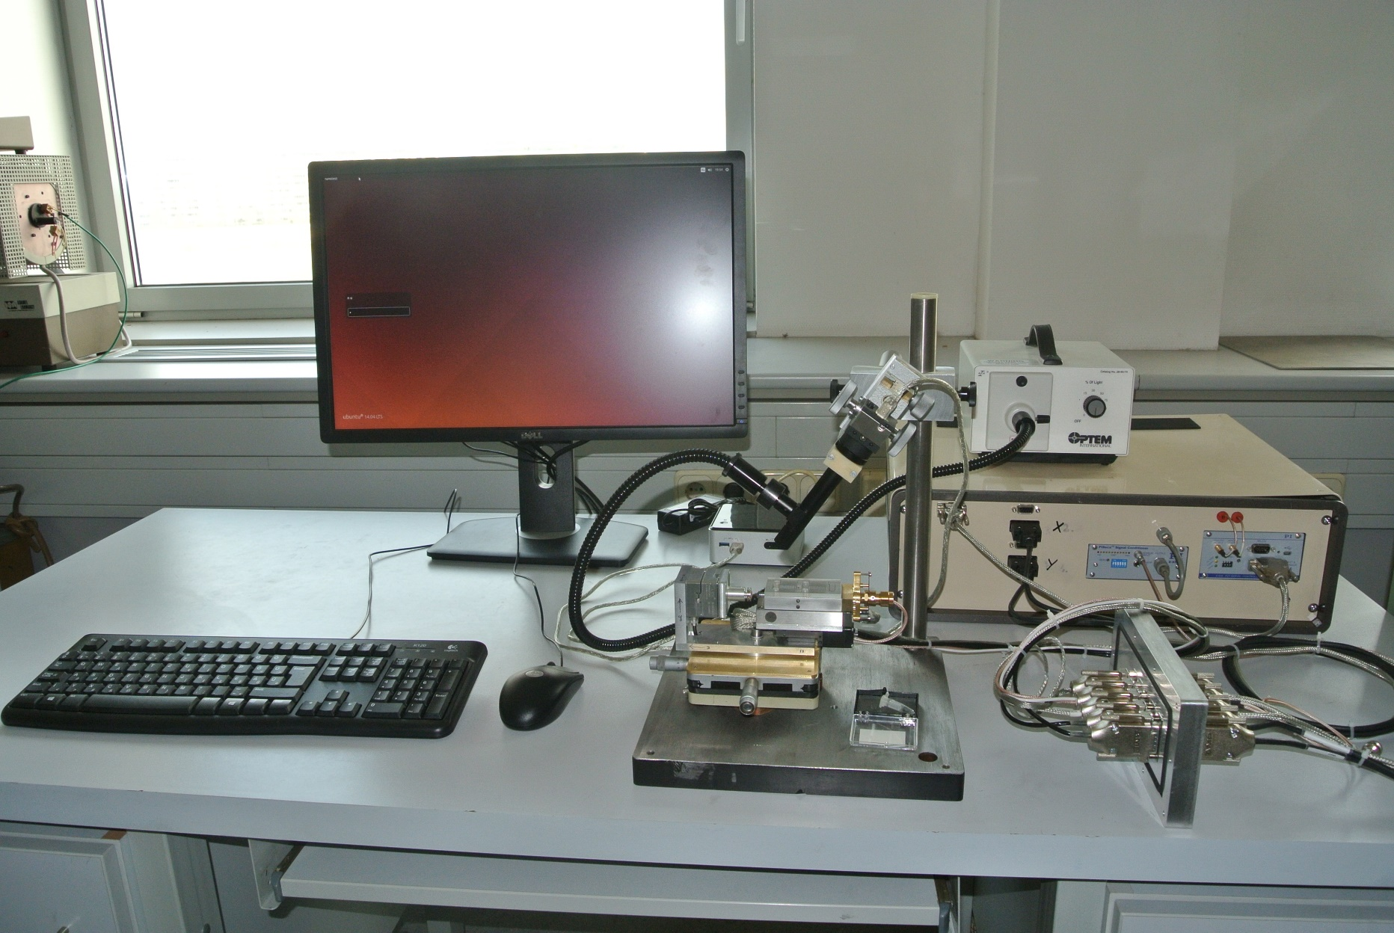

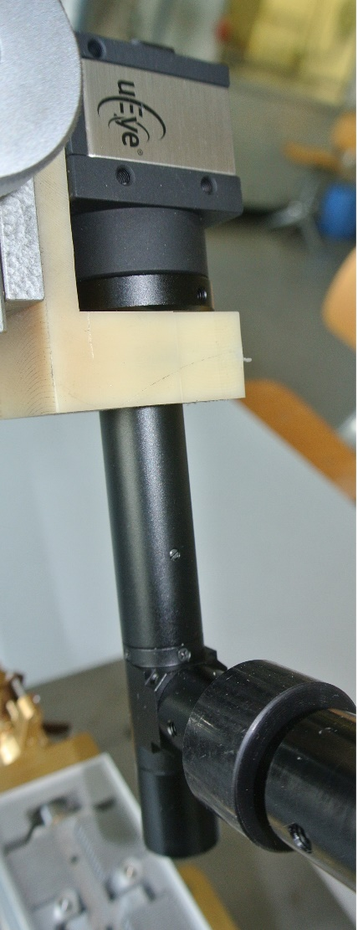
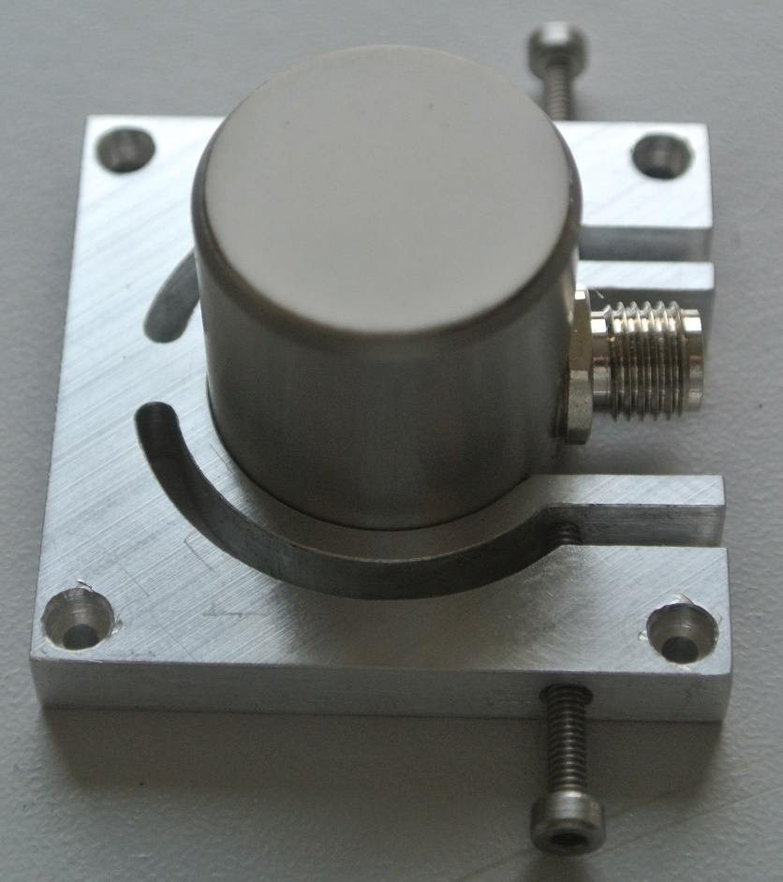
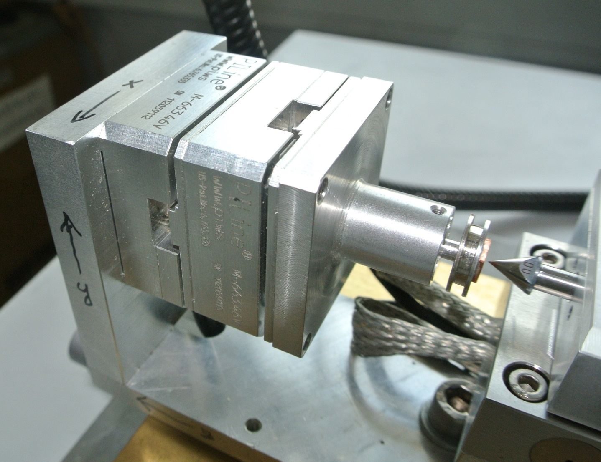
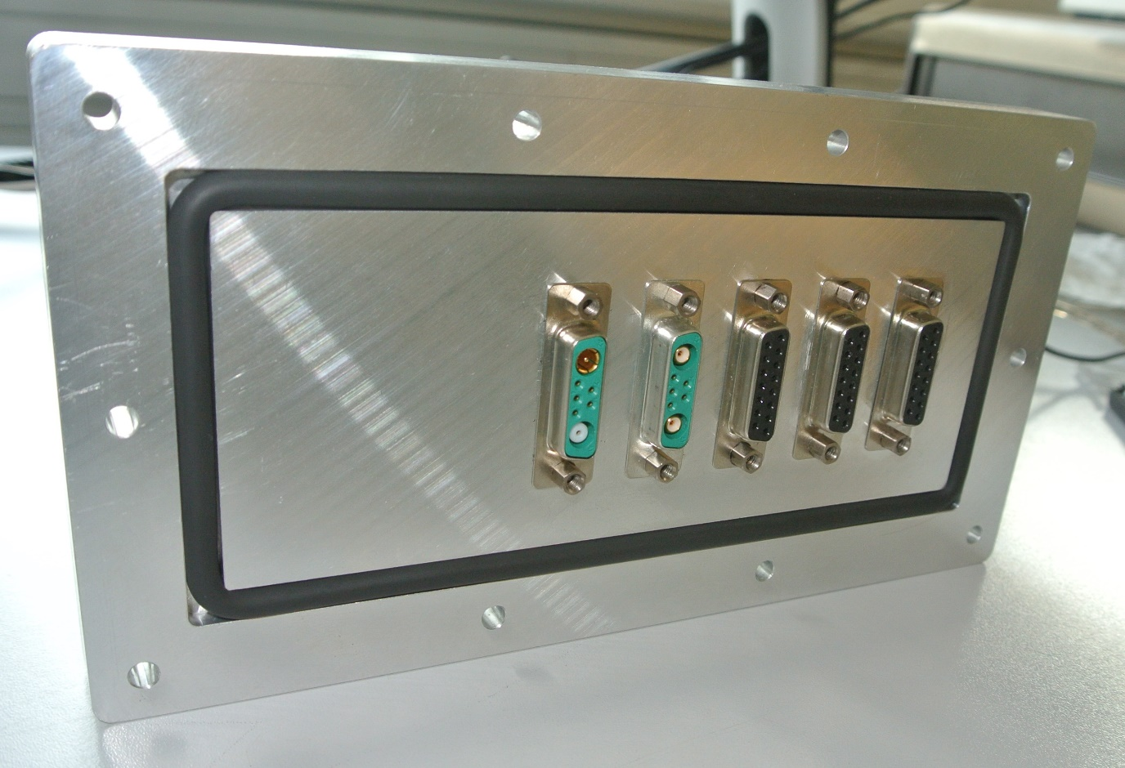
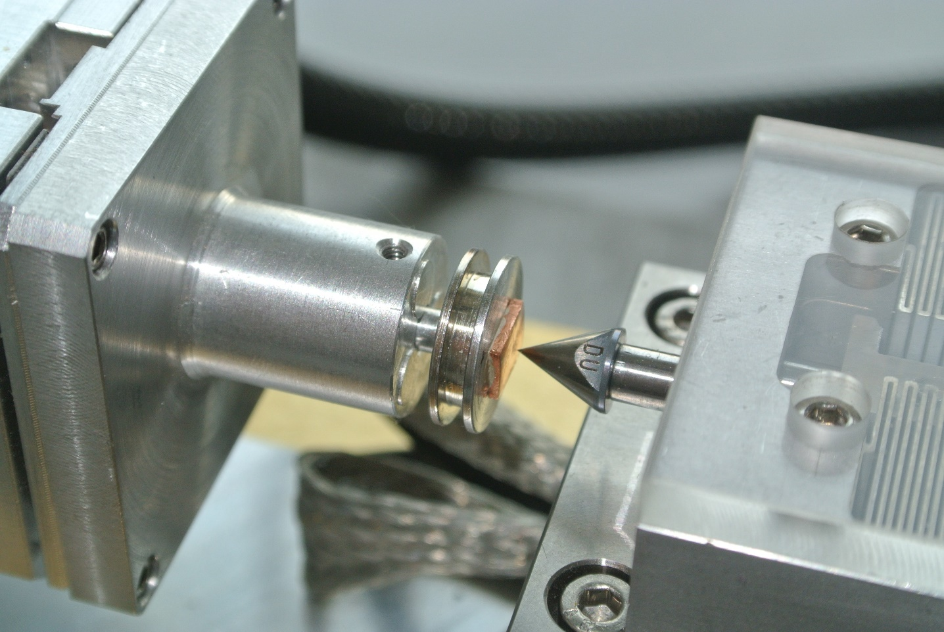
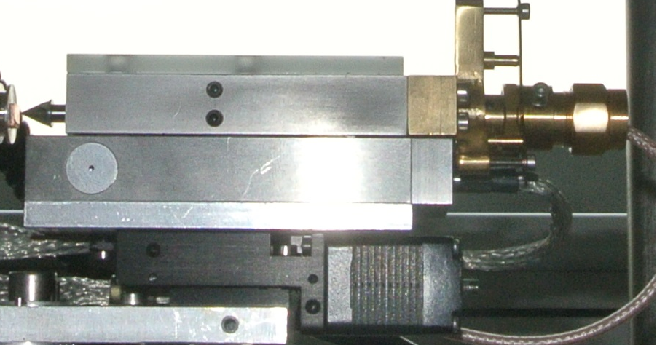
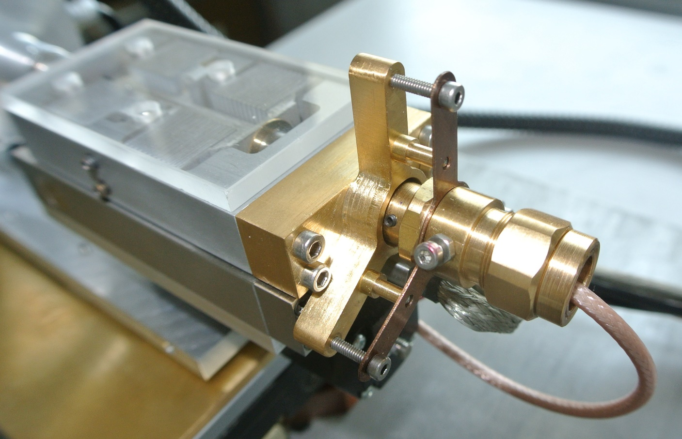
NANOTEST: In-situ indenter

Slide 12
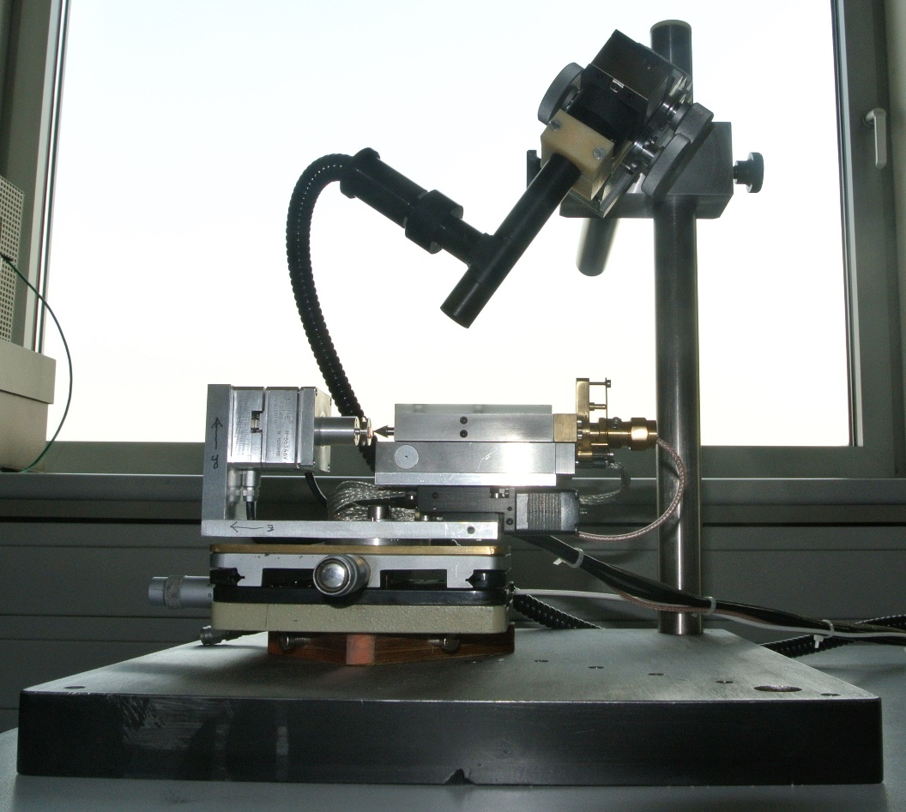
NANOTEST: In-situ indenter
Details:
High vacuum proof
1 nm precision X-Y moving
1 um coarse and 1 nm fine Z moving
Up to 10 mN with 0.01 uN precision
Camera resolution up to 0.1 um/px
Force-control, Strain-control, Hybrid-control due to analogous feedback
Spring constant can be varied
Camera objective can be changed

Slide 13
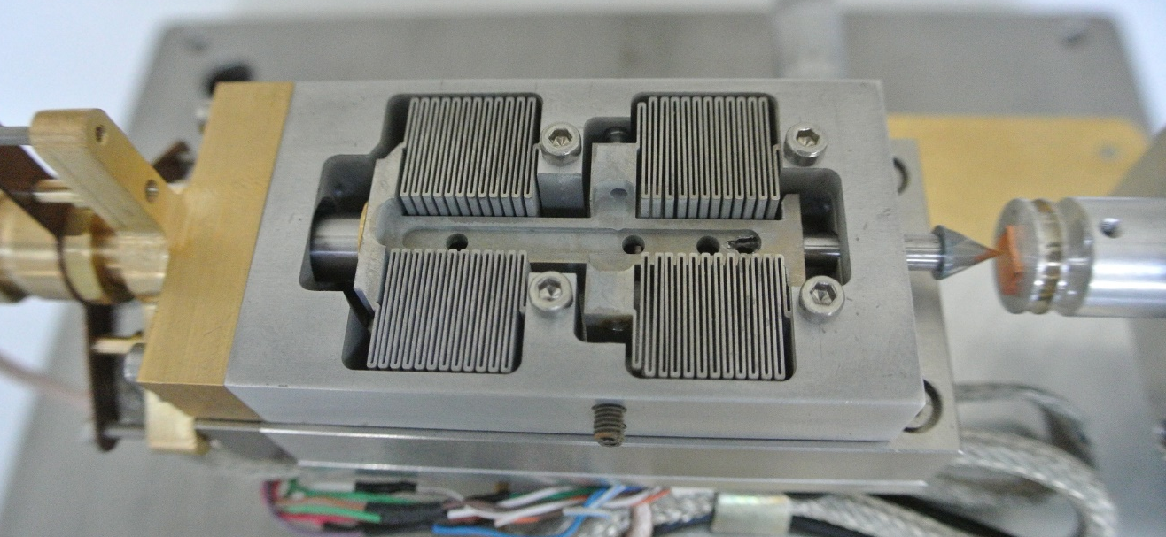
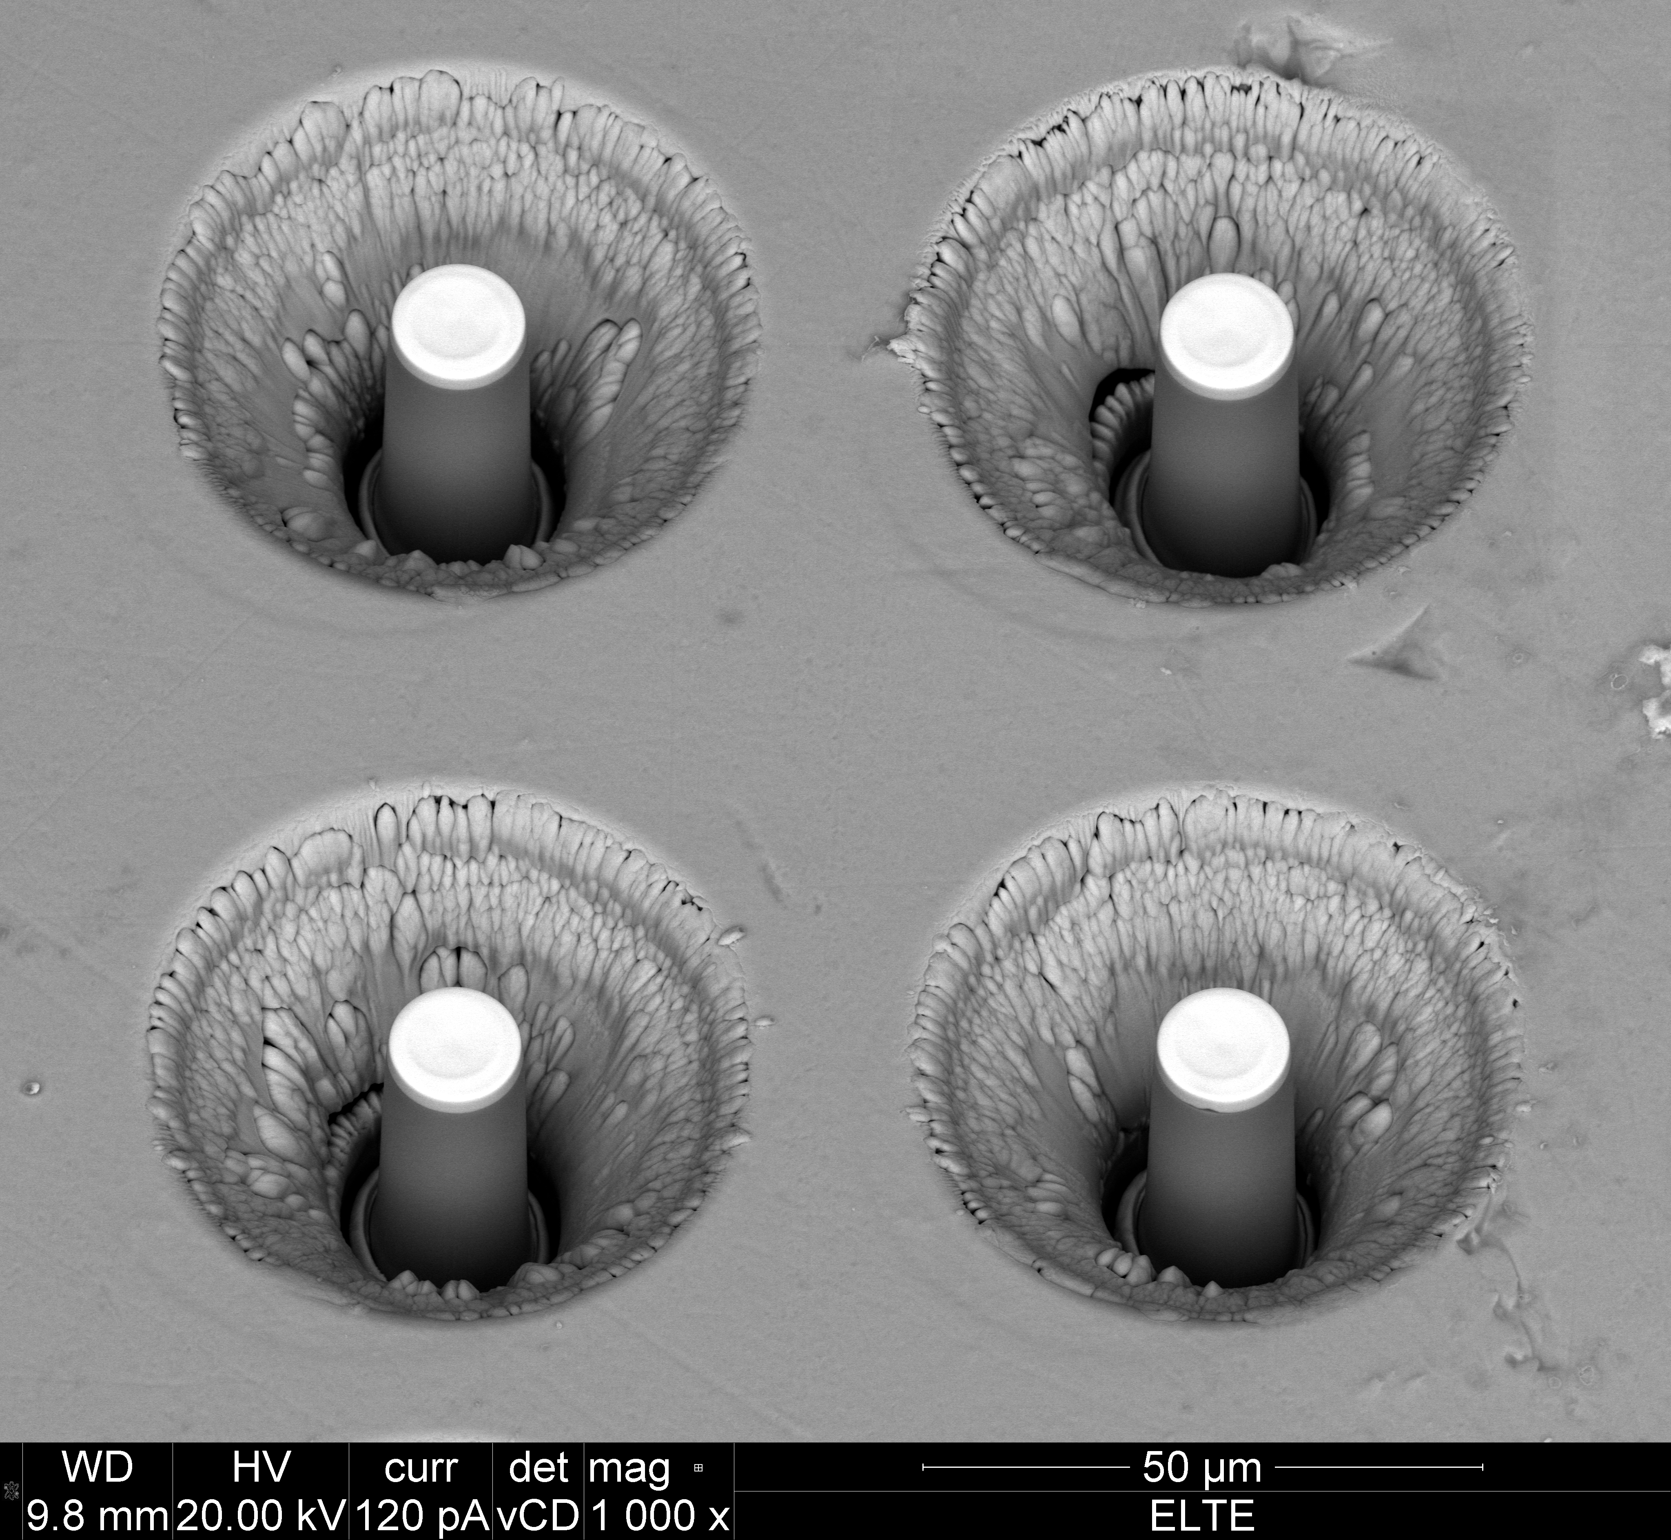
Thank you for your attention!
Thanks for my Supervisor:
Péter Dusán Ispánovity
Ádám István Hegyi
Budapest, 13. January 2014.
Ádám István Hegyi
Prague, 20-21. November 2014

