Slide 1
Linear stability analysis of discrete dislocation systems
Péter Dusán Ispánovity¹, Peter Derlet², Gábor Péterffy¹
¹ Eötvös University Budapest, Hungary
² Paul Scherrer Institut, Switzerland
Notes:
Konferencia logó

Slide 2
Motivation
Large stochastic fluctuations arise during the deformation of small (few um) crystalline samples
  Makes predictable deformation impossible
Power-law distributions characterize intermittency
The question of universality is still open
  What physical processes affect the critical behaviour and how?

Slide 3
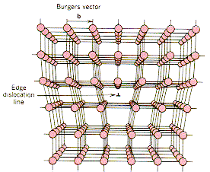
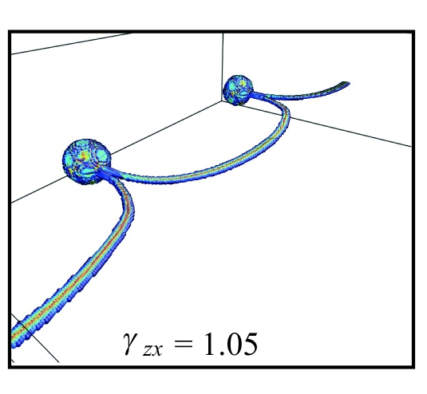
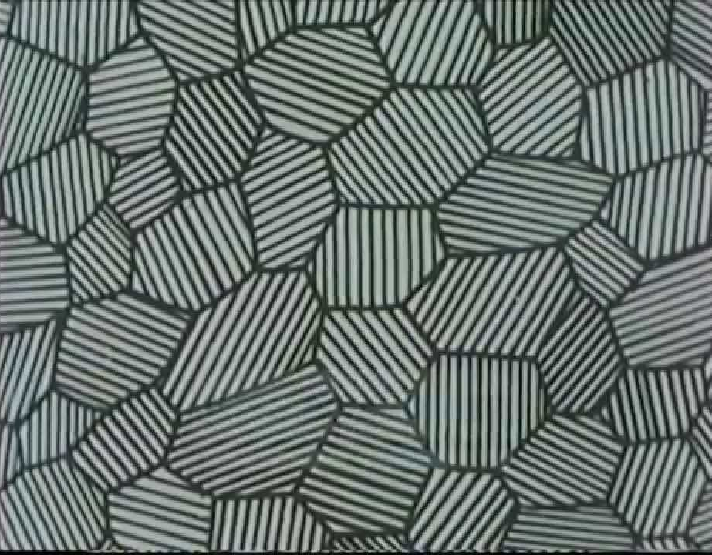
Relevant lenght scales
Atomic scale
Quenched disorder
Dislocation pattern
Specimen size
Grain size
Notes:
Additional length scales, point defects (irradiation, solutes), grain boundary, system size,
Lead to hardening for bulk specimens

Slide 4
Outline
2D discrete dislocation dynamics model
Extended criticality and effect of quenched pinning
Local yield thresholds
  Anomalous scaling
Linear stability analysis
  Dynamical correlations in the system
  Prediction of events
  Quenched pinning

Slide 5
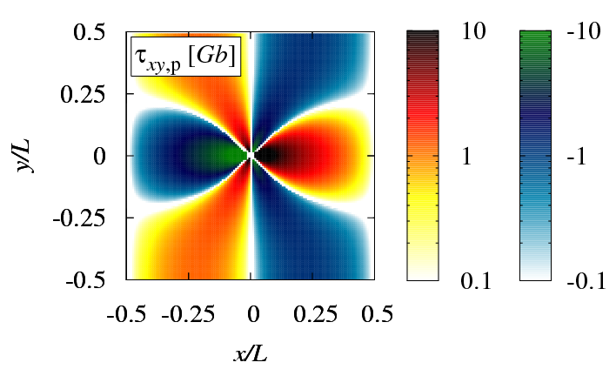
2D dislocation model
  The model contains:
  Long-range interactions
  Constrained (gliding) motion
  Dissipative dynamics
  The model does not contain:
  Forest dislocations
  Dislocation creation
  Dislocation reactions
  Peierls stress
  Curvature
2D DDD
Parallel edge dislocations in single slip
Periodic boundary conditions
Number of dislocations: N
Sign of dislocations: s_{i} = ±1
Stress-field of an individual dislocation: τ_{xy}
Overdamped motion:

Slide 6
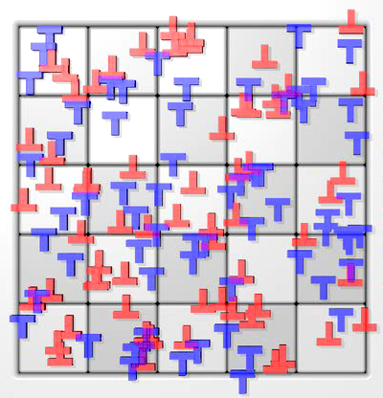
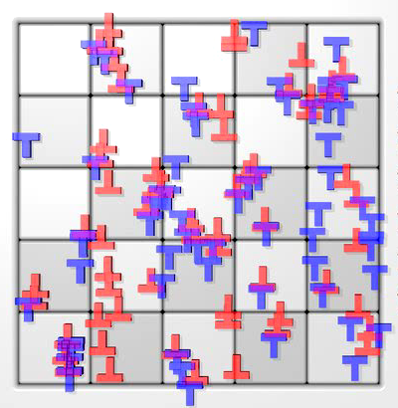
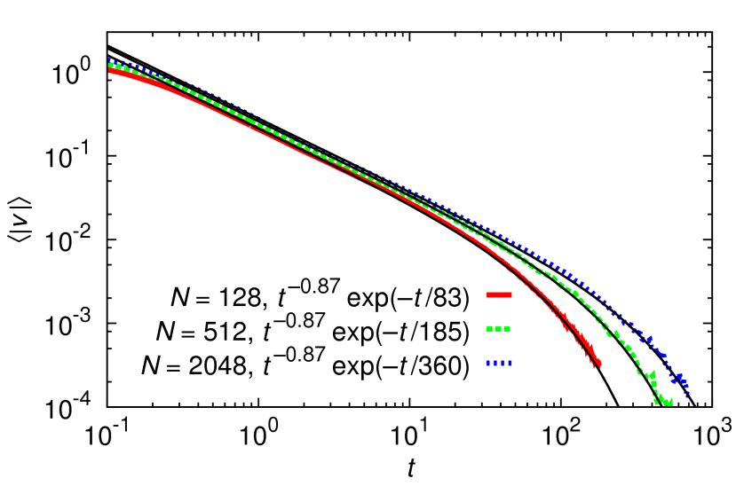
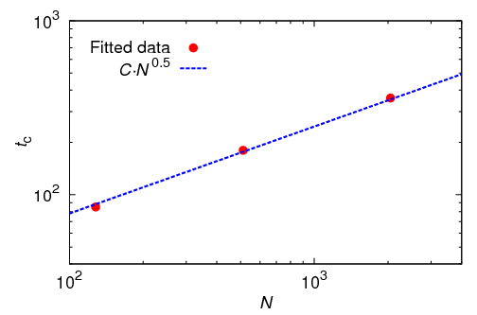
Relaxation from a random initial state
Average absolute velocity:
The cut-off t_{c} diverges with system size
F. F. Csikor et al., JSTAT, 2009
; P. D. Ispánovity et al., PRL, 2011
Notes:
Of course there is a time scale, because we are below the yield stress
The exponent is 0.86

Slide 7
Extended criticality
The system is always critical
  Avalanches always span the whole system
  Also true in 3D
PD Ispánovity, L Laurson, M Zaiser, I Groma, S Zapperi, M Alava, PRL, 2014
A Lehtinen, G Costantini, M Alava, S Zapperi, L Laurson, PRB, 2016
M Ovaska, A Lehtinen, M Alava, L Laurson, S Zapperi, PRL, 2017

Slide 8
Effect of quenched pinning
A new length-scale leads to:
  1.0 → 1.3 → Gaussian
  jamming → pinning → non-critical dynamics
[Ovaska, Laurson, Alava, Sci. Rep. (2015)]

Slide 9
Micropillar deformation
Alloying introduces a length-scale
  Critical → smooth dynamics
[Zhang et al, Acta Mater. (2017)]

Slide 10
Stochastic modelling
What should be the threshold distribution of the stochastic model?
What is the size of the Representative Volume Element?
?
[Ispánovity, Tüzes, Szabó, Zaiser, Groma, PRB, (2017)]

Slide 11
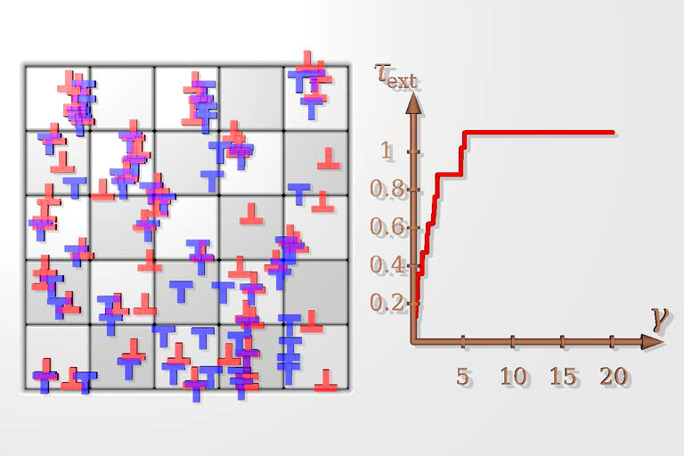
Single slip plastic quasi-static shear in 2D

Slide 12
Local yield threshold distribution
Cumulative distribution of τ⁽¹⁾
Number of links:
Average stress increment:
Average strain jump:
Local yield thresholds are correlated
Shape parameter:
[Ispánovity, Tüzes, Szabó, Zaiser, Groma, PRB, (2017)]

Slide 13
Linear stability analysis
EOM:
El. energy:
Initially
, where
dynamical matrix
[Derlet, Maass, PRE (2016)]

Slide 14
Linear stability analysis
Dyn. matrix:
Eigenmodes:
When one eigenvalue gets negative the satability analysis breaks down → event
The displacements are proportional to the given eigenvector
[Derlet, Maass, PRE (2016)]

Slide 15
Spectrum
Wide distribution of eigenvalues
Participation number:
Large number of soft modes with large number of participant dislocations

Slide 16
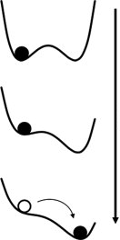
Individual events
N = 256
Linear loading:
Color code: PN
Small event
  Invloves a single dislocation dipole
Close to instability:
fold catastrophe
Increasing stress

Slide 17
Individual events
Large event
  Invloves ~40 dislocations
Close to instability:
fold catastrophe

Slide 18
Spatial structure
Color code:
Fourier weight corresponding to wavelenghts
k_{x} = 2πn/L

Slide 19
Addition of quenched disorder
Quenched pinning points with short-range potential:
Nr. of pinning points: N_{vac}
Relaxation from random initial state
  Power-law decay
  Cut-off time: t_{c}

Slide 20
Spectra
Without pinning
With pinning

Slide 21
Summary
Dynamical matrix describes local heterogeneities of the energy landscape
Transition from extended to depinning-like criticality
Opens new possibilities to understand system dynamics:
  Exploring relevant internal length scales through dynamical correlations
    Long- and short-range, RVE in stochastic modelling
  Predictions of avalanches
  Local yield threshold distribution
  Additional effects: Peiers-stress (friction) or multiple slip systems
  Can be generalized to 3D systems

